Slide 1
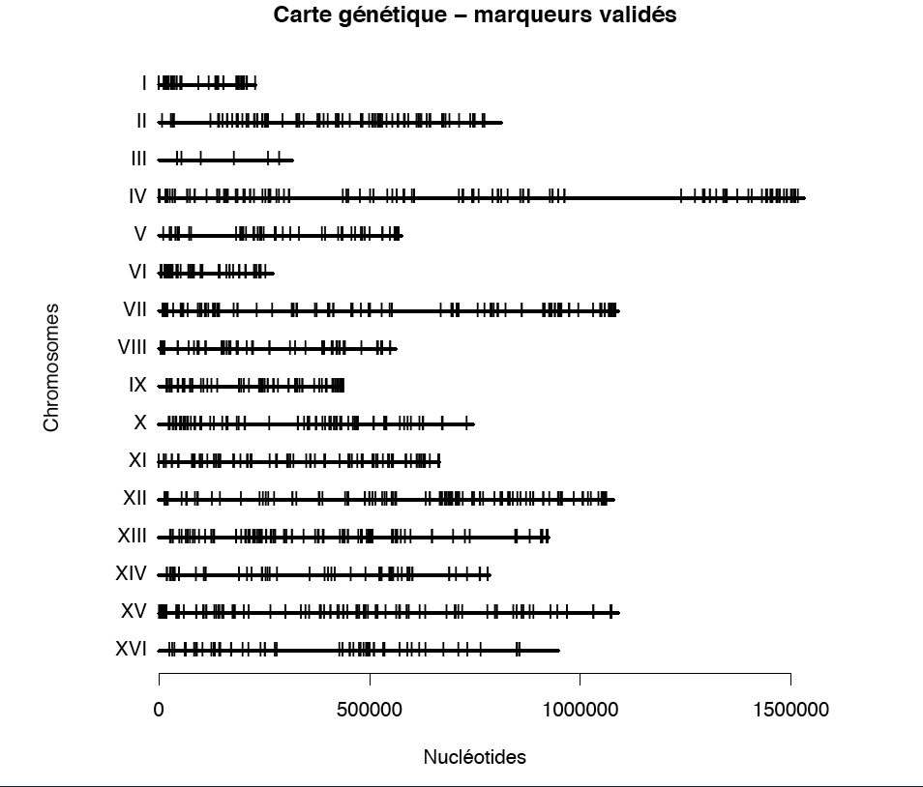
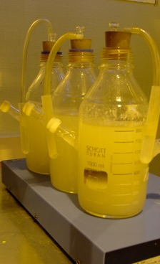
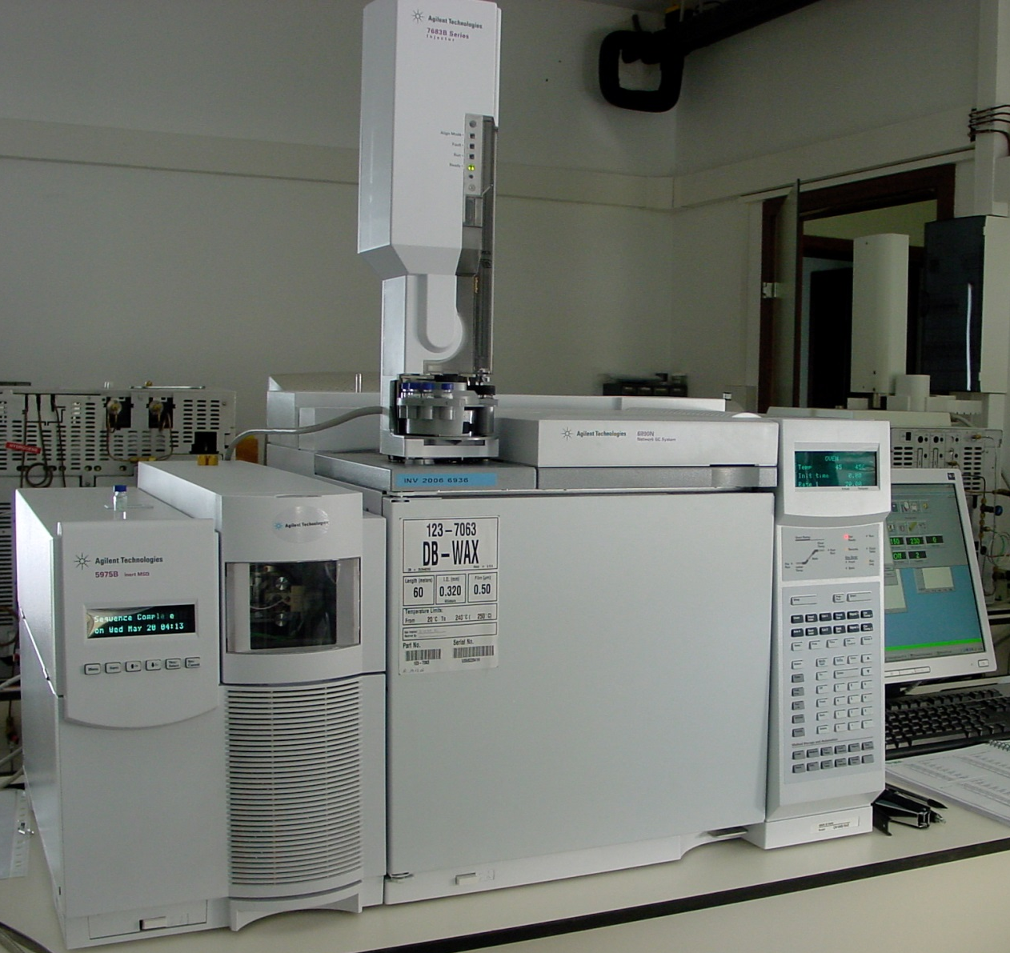
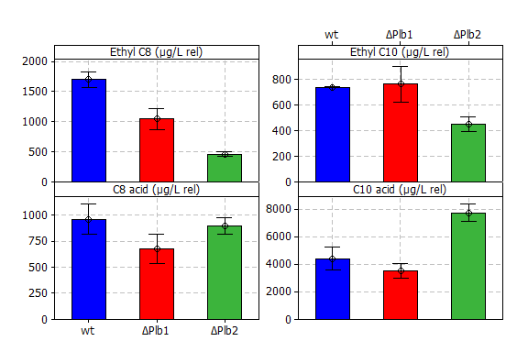
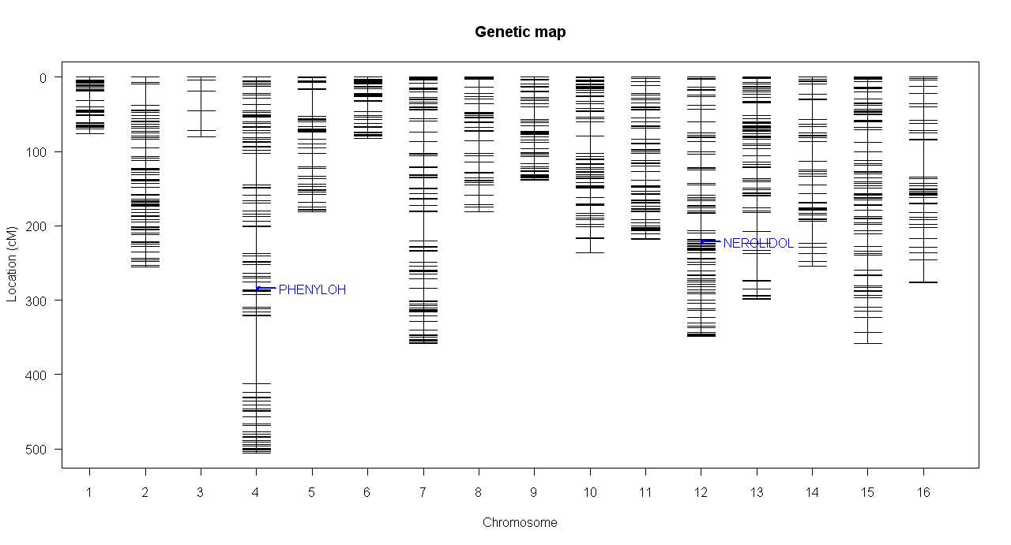
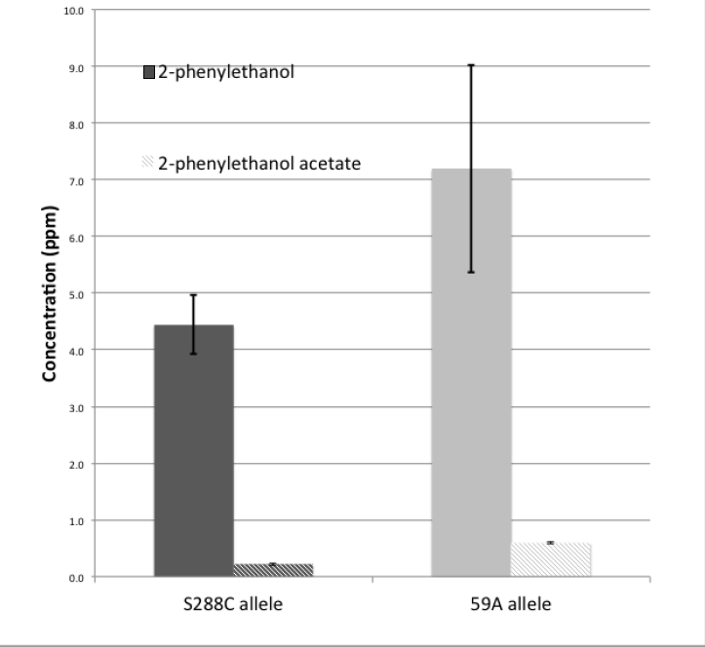
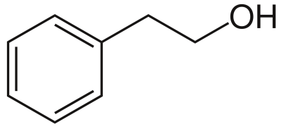
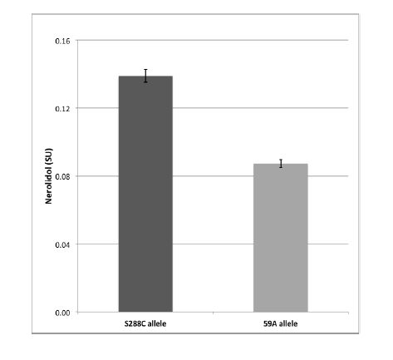
Quantitative genetic analysis of the metabolism of key aroma compounds by Saccharomyces cerevisiae during wine fermentation
Steyer D ^{1,2,3}, Ambroset C ^{4,5,6}, Brion C^{4,5,6}, Claudel P^{1,2}, Delobel P^{4,5,6}, Sanchez I^{4,5,6}, Erny
C⁷, Blondin B^{4,5,6}, Karst F^{1,2}, Legras JL ^{4,5,6}
Introduction
Wine aromatic profile is the combination of vine aromatic compounds that can be metabolized by yeast and of compounds produced by yeast during alcoholic fermentation. The variability of the influence of wine yeast strains on wine aroma is well known from wine makers who have selected numerous strains produced nowadays at an industrial scale. Even though several genes involved in the production of aroma have already been described, little is known about the genetic basis of the variability of the metabolism of these compounds. In order to answer this issue, we compared the aroma production and the geraniol metabolism during alcoholic fermentation using a progeny of 30 strains. This progeny was obtained from a cross between S. cerevisiae strains S288C and 59A, and was previously mapped using oligonucleotide microarrays.
Methods
Alcoholic fermentation of a synthetic medium that mimics grape juice, spiked with or without of geraniol
SBSE -LD extraction of aromatic compounds
Strains :
Lab strain
S288c
CGH characterization : high density genetic map with 1900 validated markers
Haploid derivative from EC1118 :
59a
QTL analysis with
R/QTL and J/QTL
Medium A : 1mg/L geraniol
1% Anaerobical factor 1L, 20°C
Test for fermentation abilities
30 strains
Medium B : 5mg/L geraniol
1% Anaerobical factor 250mL, 20°C
Candidate gene + validation
about 60 segregants
30 segregants
Medium C : 0mg/L geraniol
100% Anaerobical factor 1L, 28°C
Results/conclusion
fig
Ethyl octanoate (fruity)
Ethyl decanoate
(fruity)
DeletionPLB1/PLB2
C10 acid
C8 acid
Ethyl esters
IsoC8
A-terpi
Fig 1 : effect of the deletion of PLB1/PLB2 ont ethyl esters and medium chain fatty acids concentration in enological condition(BY background)
Farnesol
Cis-trans Roseox
2-PHENYLOH
NEROLIDOL
NEROLIDOL
2-PHENYLOH/Ac
IsoC8
Hemizigote comparison ABZ1
2-phenylethanol
(rose)
mQTL detected with J/QTL and R/QTL => LOD score > 3 ; p-value < 0,05 ; in blue QTL obtained with medium A ; in red QTL obtained with medium B ; in gree QTL obtained withe medium C
Hemizigote comparison PDR8
We detected 13 mQTL involved in the production of volatile compounds by yeast during fermentation. One was investigated by deletion and two by hemizigote comparison.
In a “By” background, deletion of Phospholipase B2 gene (PLB2) reduces drastically the concentration of ethyl octanoate and decanoate and increases the concentration of decanoic acid (fig 1). In the same condition, deletion of its homolog PLB1 contributes only to a decrease of ethyl octanoate (fig 1). Thanks to hemizigote we show that the allelic version of the Para-aminobenzoate synthase (ABZ1) is involved in the production of 2-phenyl –ethanol/-acetate (rose/honey) (fig 2).
We also demonstrate that the alleles of the transcription factor PDR8 found S288C and 59A differently regulate the release of nerolidol into the media (fig 3) (target : QDR2 data not shown).
This study illustrates the value of QTL analysis for the analysis of metabolic traits, and in particular the production of wine aromas. It also identifies the particular role of the PDR8 gene in the production of farnesyldiphosphate derivatives, of ABZ1 in the production of numerous compounds and of PLB2 in ethyl ester synthesis. This work also provides a basis for elucidating the metabolism of various grape compounds, such as citronellol and cis-rose oxide.
Fig 2 : effect of the allelic expression of ABZ1 in enological condition on 2-phenylethanol/acetate concentration
Nerolidol (floral)
Fig 3 : Effect of the allelic expression of PDR8 in enological condition on nerolidol concentration
1 INRA, UMR1131, F-68021 Colmar, France
2 Université de Strasbourg, UMR1131, F-68021
3 TWISTAROMA, F-68021 Colmar, France
4 INRA, UMR1083, F-34060 Montpellier, France
5 Montpellier SupAgro, UMR1083, F-34060 Montpellier, France
6 Université Montpellier 1, UMR1083, F-34060 Montpellier, France
7 Université de Haute Alsace, EA3991 Laboratoire Vigne Biotechnologies et Environnement;F-68021 Colmar, France
1) G3: Genes, Genomes, Genetics, 2011, vol. 1, no 4, p. 263-281.
2) Methods Mol Biol. 2009;573:175-88
3) R: A language and environment for statistical computing. R Foundation for Statistical Computing, Vienna, Austria. ISBN 3-900051-07-0.
* wikipedia

