Slide 1
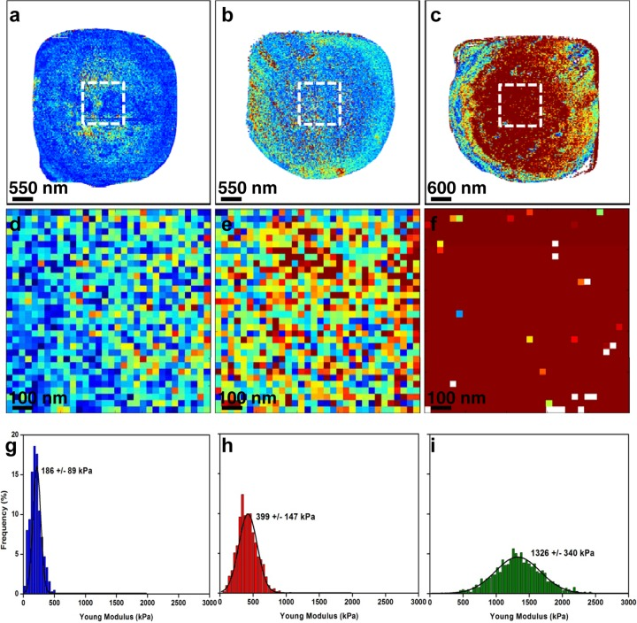
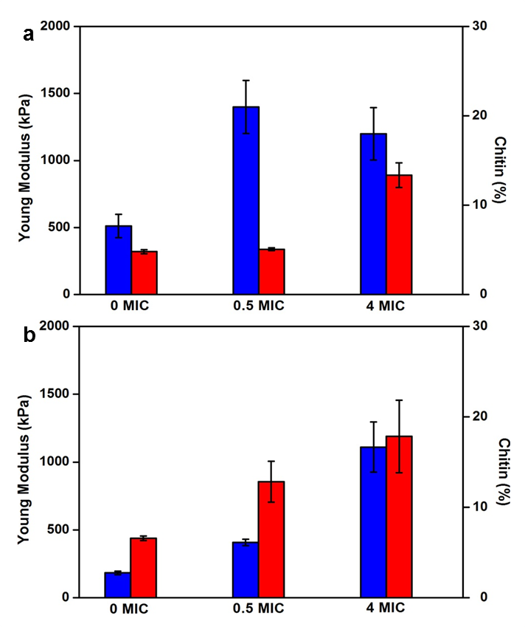
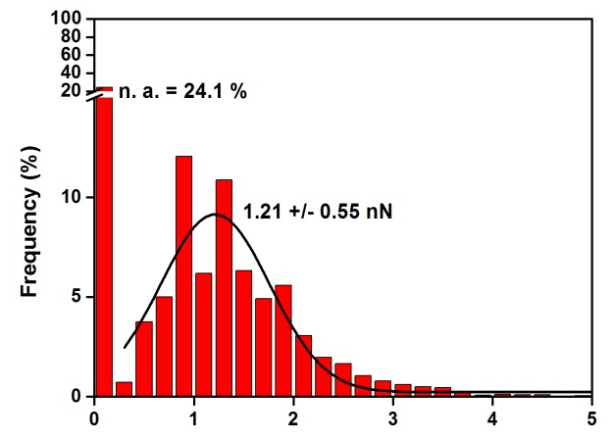
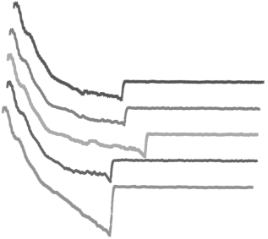
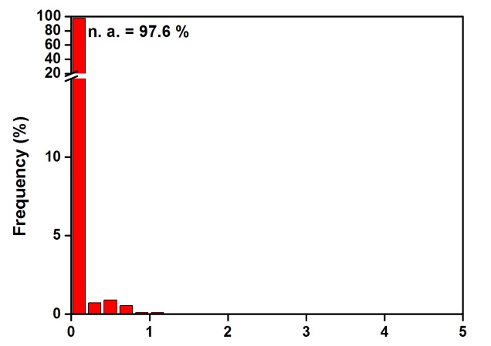
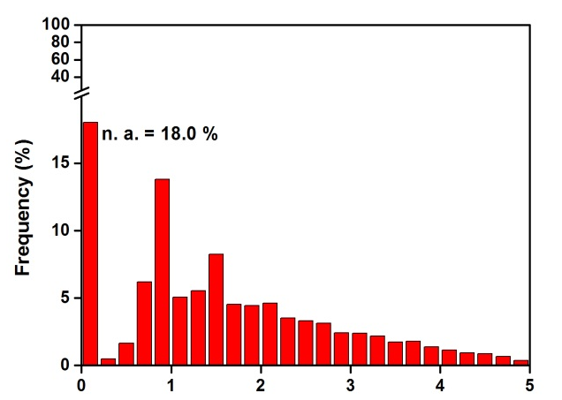
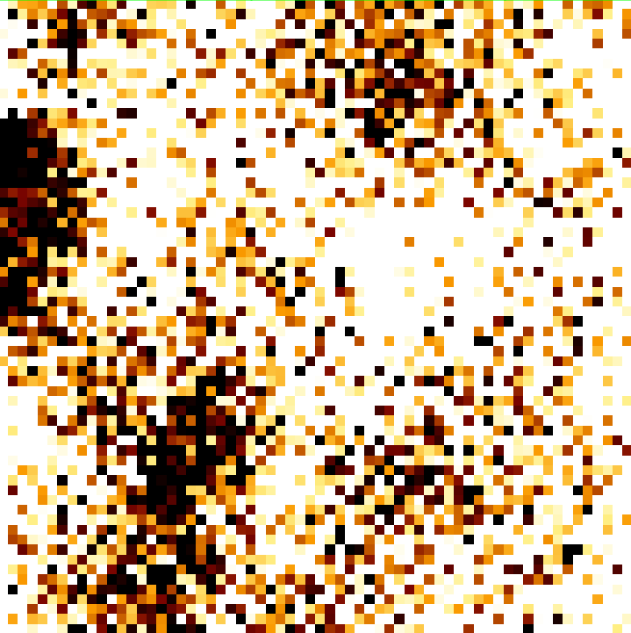
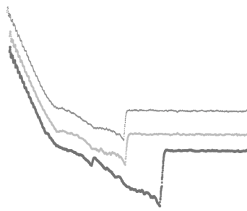
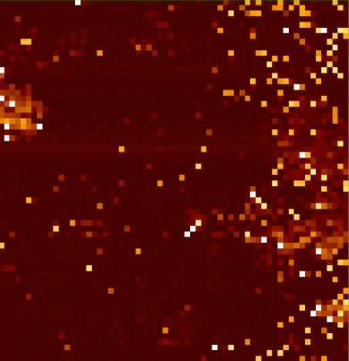
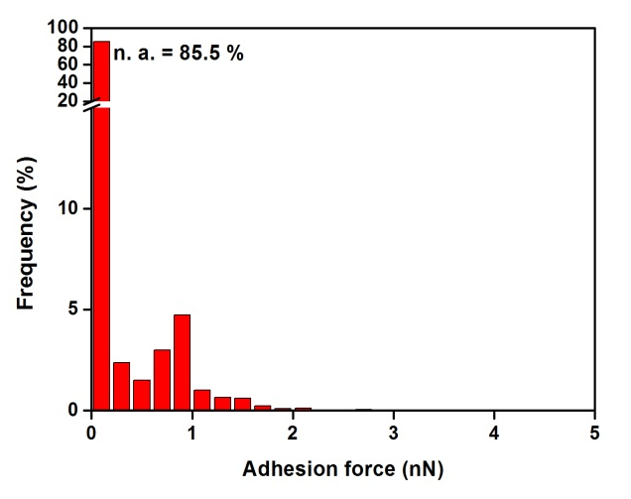
Drug resistance and adhesion:
a closer look at the dark side of the wall.
Hélène Martin-Yken, Cécile Formosa, Marion Schiavone, Jean Marie François and Etienne Dague.
1- Université de Toulouse; INSA, UPS, INP; LISBP, 135 Avenue de Rangueil, F-31077 Toulouse, France,
2- INRA, UMR792, Ingénierie des Systèmes Biologiques et des Procédés, F-31400 Toulouse, France,
3- CNRS, UMR5504, F-31400 Toulouse, France
Stress conditions and antifungal drugs induce significant changes in the cell wall composition of yeasts and fungi. They cause modifications of the cell wall molecular architecture, including nature, repartition and attachment of cell wall proteins to the cell surface. Atomic Force Microscopy (AFM) is a powerful tool for studying the morphology, nanomechanical and adhesive properties of live microorganisms under physiological conditions. We explored the effects of the antifungal drug caspofungin¹ and performed Single Molecule Force Spectroscopy (SMFS) experiments to visualize the adhesins organization and quantify adhesion forces. We were able to map the adhesins at the cell surface and to distinguish between non-specific hydrophobic and specific affinity interactions².
native cell
Caspofungin 0.5× MIC
Caspofungin 4× MIC
Nanoscale effects of Caspofungin on C. albicans cell wall
Elasticity maps
(z range = 0.5 MPa)
Local elasticity maps
on 1μm² areas
(white dashed squares
on the tops of the cells)
Distributions of Young
modulus values
(corresponding to the local
elasticity maps.)
Caspofungin induces
a deep cell wall remodeling, evidenced by its nano-mechanichal properties and dramatic chitin increase
A low dose of Caspofungin (0.5 x MIC) results in adhesins expression on the cell surface
Adhesion Maps
Measuring and mapping Cellular Adhesion
1.6 nN
1 nN
PGA22
Over-expressed
250 nm
Combined with molecular biology tools, AFM allowed to unravel the contribution of previously uncharacterized PGA proteins to
C. albicans adhesion mechanism³.
0 nN
Control -
1.6 nN
1 nN
250 nm
0 nN
1.6 nN
1 nN
We have also imaged
C. albicans hyphae, and we will attempt to perform adhesion
studies on them.
PGA59
Over-expressed
250 nm
Adhesion force
Maps of 1µm²,
corresponding histograms representing the adhesion force repartition, and a few representative force curves.
0 nN
1.6 nN
1 nN
Control -
250 nm
0 nN
Conclusions and outlook:
Our next projects involve combining Single Cell Force Spectroscopy by AFM and Optical Tweezers to Sheer-Stress Flow Chamber to study cellular adhesion from the molecule scale to the population scale.
Formosa C. et al., (2013), Nanoscale effects of caspofungin against two yeast species; S. cerevisiae and C. albicans, AAC, 57, 3498.
Formosa C. et al.,(2015), Multiparametric Imaging of Adhesive Nanodomains at the Surface of C. albicans by Atomic Force Microscopy. Nanomedicine NBM, 11, 57.
Cabral V. et al., (2015),Targeted changes of the cell wall proteome influence C. albicans ability to form single- and multi-strain biofilms. PloS Pathog. 2014 Dec 11;10(12).

