Slide 1






Genetic diversity and plant-plant interactions as drivers of disease resistance in cereals
jean-benoit.morel@inrae.fr

Slide 2
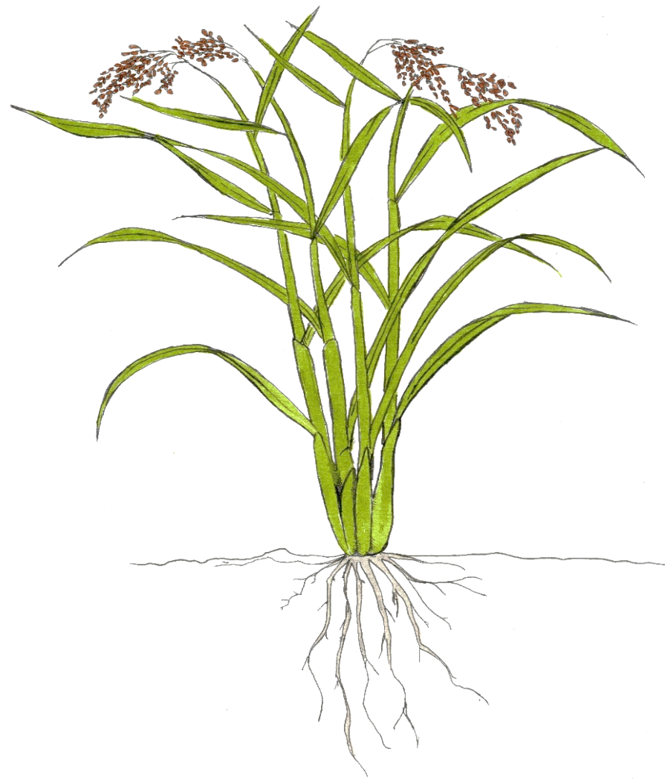
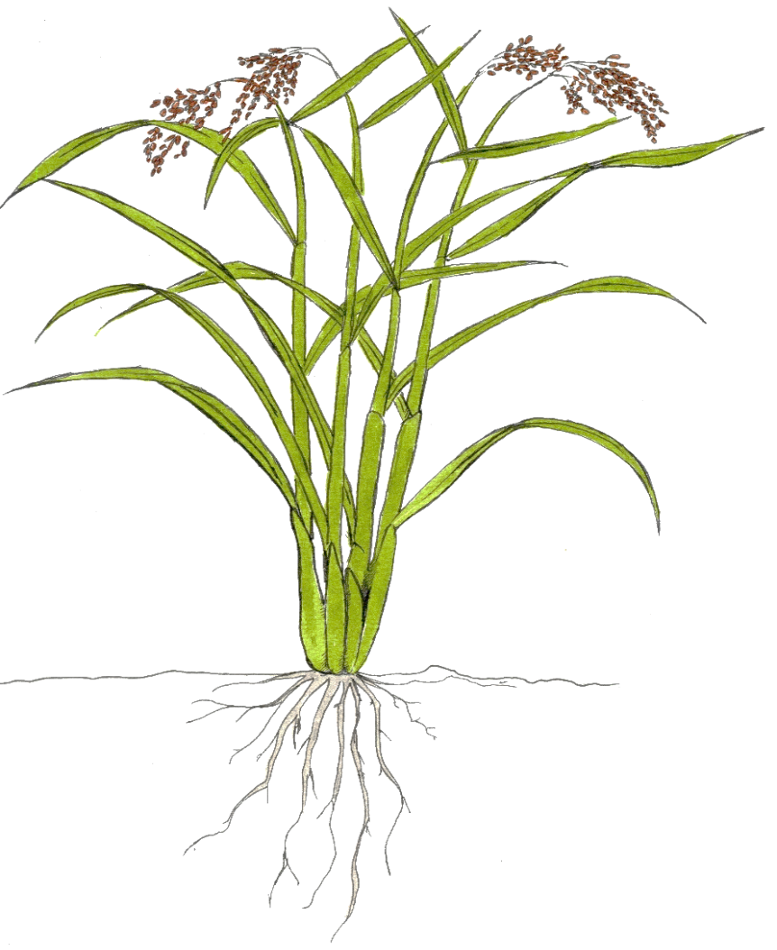
Plant immunity is modulated by the environment
Defense stimulators
Ballini et al,
Euphytica 2020
Plant health
microbiota
Signal integration
Alonso et al,
Env Microb 2020
Water
neighbors
Bidzinski et al, Frontiers in Plant Science 2016
microbiota
nutrients
Subrahmaniam et al, Plant 2018
Zhu and Morel, MPMI 2019
Henry et al, Plant Sign Behav 2020
Ballini et al, RICE 2013
Huang et al, Frontiers in Plant Science 2017

Slide 3
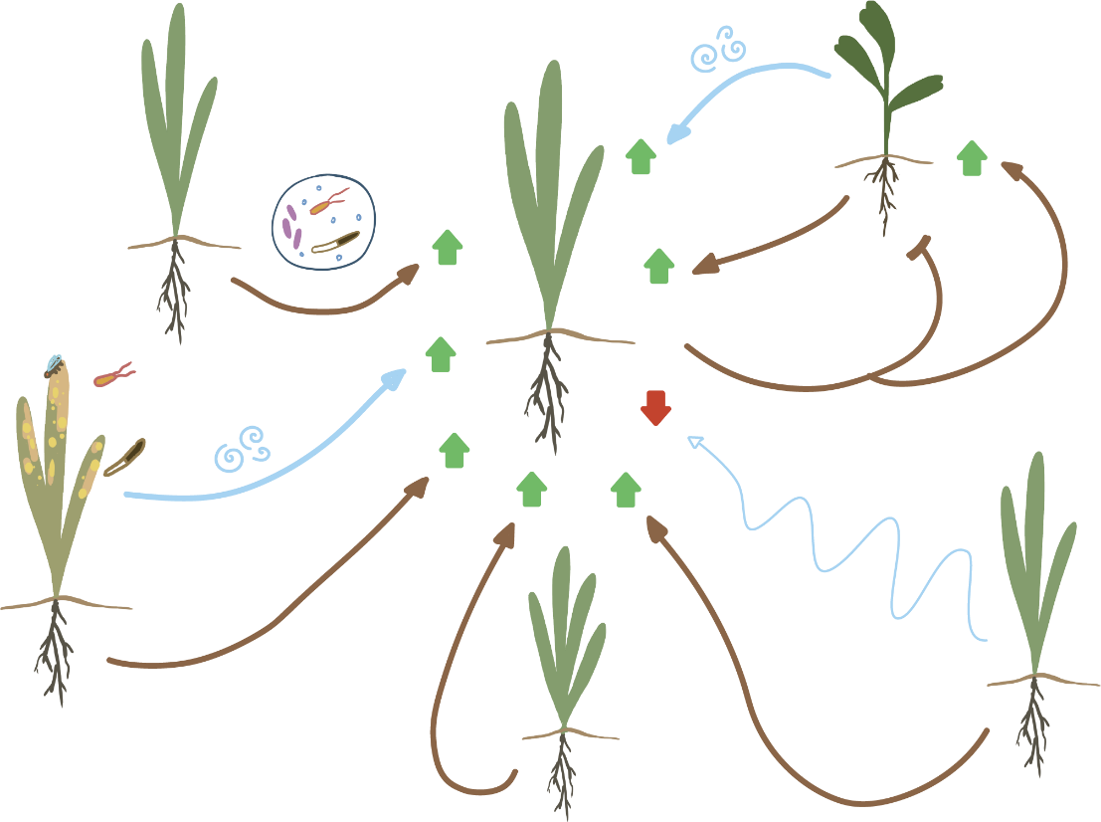
Plants modulate immunity and susceptiblity in their neighborhood
Ma et al, Frontier in plant science. 2017
Beredsen et al, ISME journal. 2018
Yuan et al, Microbiome. 2018
Hu et al, Nature com. 2018
Wang et al. New phytol, 2019
Sukegawa et al. Plant journal, 2018
Venturelli et al. Plant cell, 2015
Kong et al. 2018
Li et al. JEBX, 2020
Murata et al, Plant phisiology 2019
Takagi et al. JEBX, 2016
Cheng et al. Scientific report, 2016
Stranger
recognition
Constitutive
VOCs
Plant-soil feedbacks and legacies
Microbiota
modification
loliolide, allantoin
allelochemicals
SAS
Inducible
VOCs
Root Exudates,
small peptides
Root density,
nutrient foraging
Danger signalization
Root
exudates
Kin recognition
Competition
Markovic et al, JEBX. 2019
Wenig et al, Nature com. 2019
Orlovskis et al, New phytol. 2020
Coppola et al, Scientific reports. 2017
Wit et al, Plant Journal 2013
Cerrudo et al, Plant Physiology 2012
Ballaré, An. rev. of Plant biology 2014
Chen et al. Frontiers in P. Science, 2019
Biedrzycki et al, Plant Signaling & Behavior 2011

Slide 4
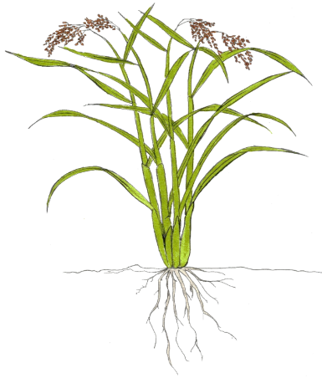
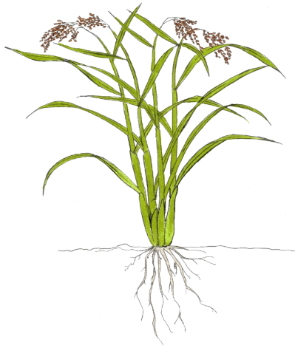
Intraspecific competition for nutrients between conspecifics
Intraspecific competition
Intraspecific plant density
Shade Avoidance Syndrom increases A.thaliana susceptibility to pathogens
SAS
Wit et al, Plant Journal 2013
Cerrudo et al, Plant Physiology 2012
Review in Ballaré, An. rev. of Plant biology 2014
Root interaction with conspecifics increases accumulation of chemical defense in tobacco
Competition for nutrient
Chen et al. Frontiers in Plants Science, 2019

Slide 5
Plants modulate immunity and susceptiblity in their neighborhood
Constitutive
VOCs
Stranger
recognition
Plant-soil feedbacks and legacies
Microbiota
modification
loliolide, allantoin
allelochemicals
SAS
Inducible
VOCs
Root Exudates,
small peptides
Root density,
nutrient foraging
Danger signalization
Root
exudates
Kin recognition
Competition

Slide 6
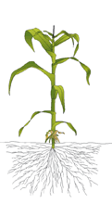
Stranger’s things from healthy neighbors
Sukegawa et al. Plant journal, 2018
Menthol (cVOCs)
Constitutive
VOCs
Modifiying histone acetylation of promoters of defense genes
- Defense gene upregulated
- Herbivory & pathogen resistance increased
- Production of allelopathic molecules against parasites
DIMBOA and derivatives
Venturelli et al. Plant cell, 2015
Kong et al. 2018
Allelochemicals
(-)-Loliolide
Li et al. JEBX, 2020
Murata et al, Plant phisiology 2019
Allantoine
Takagi et al. JEBX, 2016
Diallyl disulfide
Cheng et al. Scientific report, 2016

Slide 7
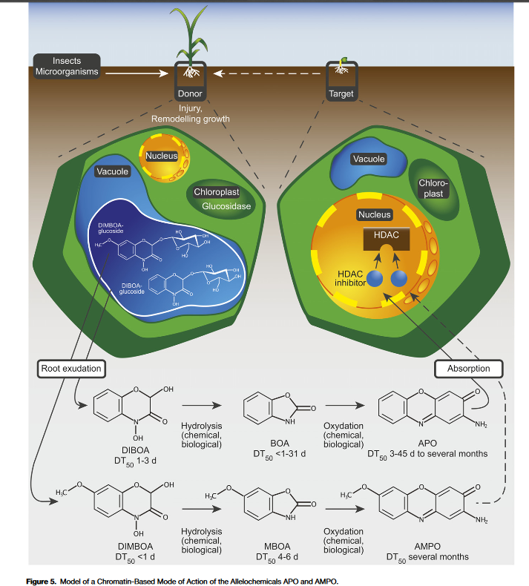



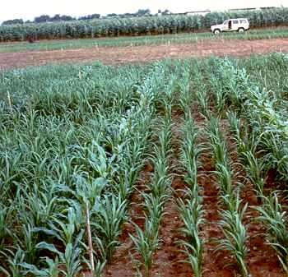
DIMBOA hypothesis
RESISTANCE
DIMBOA?
DIMBOA
(Venturelli et al, 2015)
DIMBOA
derivatives
HDAC
defense

Slide 8
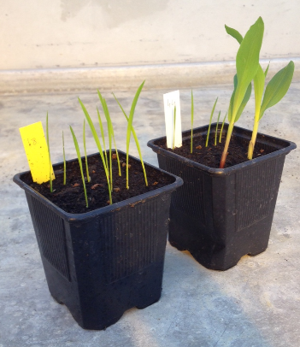
Intercropping rice and maize
Rice blast disease
(GY11)
Maize blast disease
(2 isolates)
*
**
(Nipponbare and B73)
(B73 and Maratelli)
~40% reduction of symptoms
Notes:
aduK42+adel 2018

Slide 9
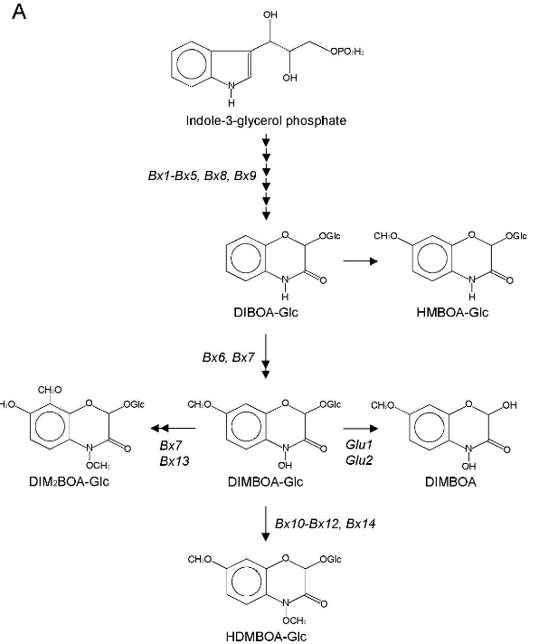
DIMBOA biosynthesis is required for protection in intercropping
Rice blast disease (on rice)
*
*
neighbor
rice
focal

Slide 10
Plants modulate immunity and susceptiblity in their neighborhood
Constitutive
VOCs
Stranger
recognition
Plant-soil feedbacks and legacies
Microbiota
modification
loliolide, allantoin
allelochemicals
SAS
Inducible
VOCs
Root Exudates,
small peptides
Root density,
nutrient foraging
Danger signalization
Root
exudates
Kin recognition
Competition

Slide 11
Plants leave a message : plant soil feedback and legacies
Plant–soil feedback is a process where plants alter the biotic and abiotic qualities of soil they grow in, which then alters the ability of plants to grow in that soil in the future
Wikipedia
Intraspecific & Interspecific
Ma et al, Frontier in plant science. 2017
Inductible or constitutive
Beredsen et al, ISME journal. 2018
Yuan et al, Microbiome. 2018
Induces defense genes, pathogen and herbivory resistance
Hu et al, Nature com. 2018
Microbiota modification
Depend on specific species of fungi, bacteria or combinaison
Wang et al. New phytol, 2019

Slide 12
Plants modulate immunity and susceptiblity in their neighborhood
Constitutive
VOCs
Stranger
recognition
Plant-soil feedbacks and legacies
Microbiota
modification
loliolide, allantoin
allelochemicals
SAS
Inducible
VOCs
Root Exudates,
small peptides
Root density,
nutrient foraging
Danger signalization
Root
exudates
Kin recognition
Competition

Slide 13
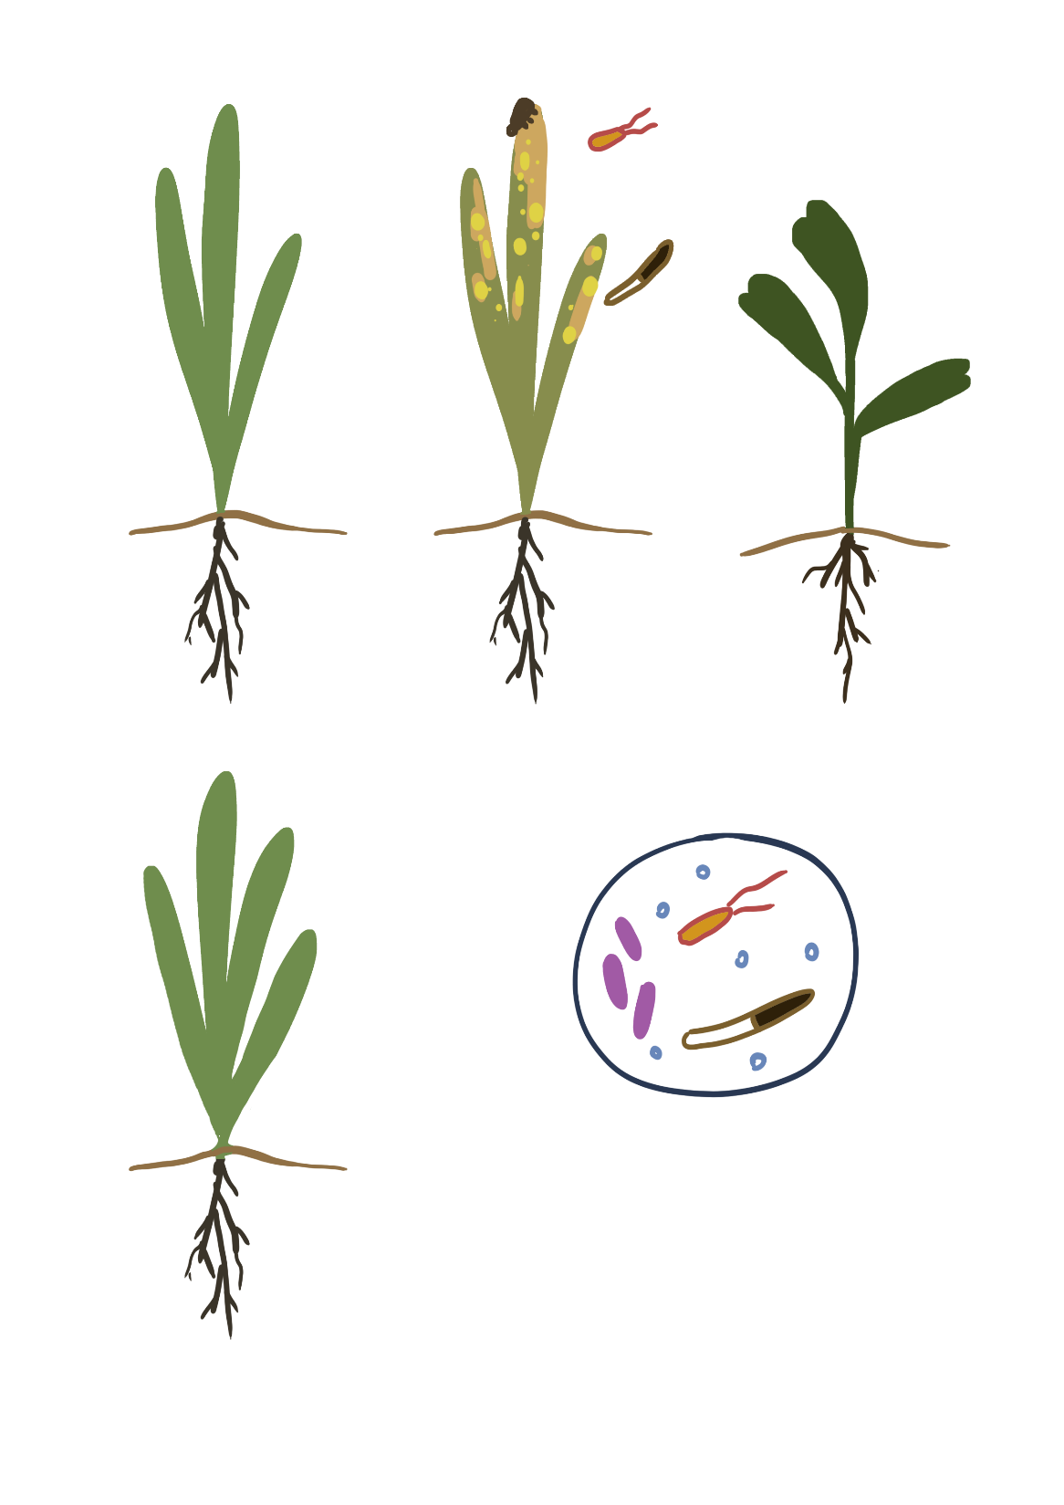
The neighbor watch, Signalisation of danger between plant
Disease / attack plant
Inducible VOCs
Can be triggered by touch in maize
Markovic et al, JEBX. 2019
iVOCs, HIPV etc ..
Monoterpene
Wenig et al, Nature com. 2019
Propagation of SAR
(Systemic acquired Resistance) between neighbor plants
Unknown root signal
Inductible Root exudates, small peptides ...
Orlovskis et al, New phytol. 2020
Excreted soil peptide (18 AA) by tomato roots
Systemin
Coppola et al, Scientific reports. 2017

Slide 14
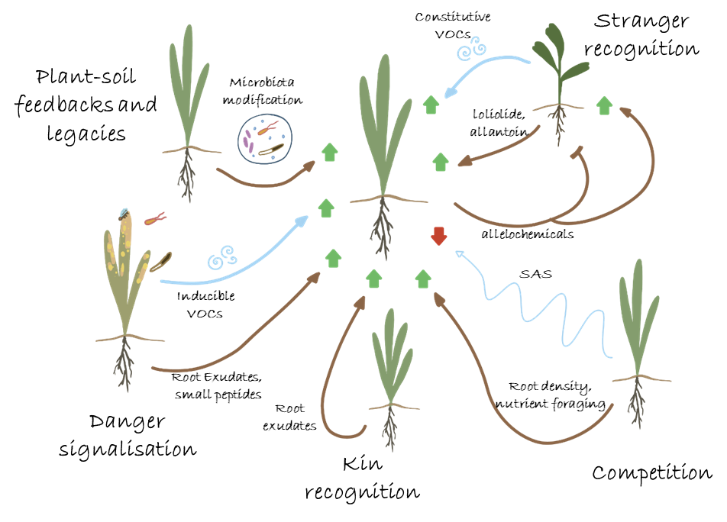
Plants modulate immunity and susceptiblity in their neighborhood
Pelissier, Violle and Morel, review submitted
Can kins/conspecifics modulate susceptiblity in their neighborhood?

Slide 15
Kin recognition: when plants recognize conspecifics
Kin recognition is an organism's ability to distinguish between close genetic kin and non-kin
Wikipedia
O= Own= plant alone
K= Kin= 2 plants together
S= Stranger= different ecotype
Biedrzycki et al, Plant Signaling & Behavior 2011
Only one example to our knowledge shows that Kin recognition can trigger the expression of immunity (kin relations known to affect response to insects)

Slide 16
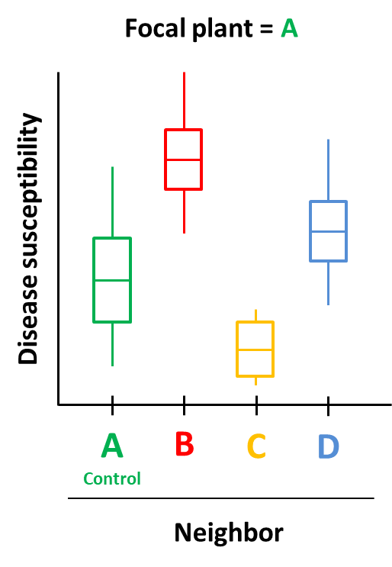
Screening for Neighbor-modulated susceptiblity
A
B
focal
neighbor
Specific ability
of a given neighbor
to modulate
susceptibility of focal A
(« good » or « bad » neighbor)
A
A
A
C
Pure
A
D
Mix

Slide 17
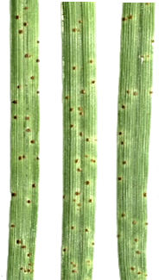
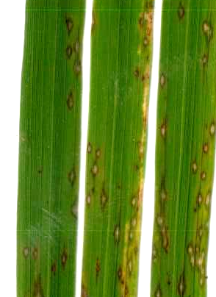
Neighbor-modulated susceptibility (NMS) in rice and wheat
Pelissier et al, submitted
Puccinia triticina
WHEAT
Leaf rust susceptiblity
Magnaporthe oryzae
RICE
Blast susceptibility
Pure
Mixes
Some kins can modulate susceptiblity in their neighborhood (NMS)

Slide 18
Localization of intra-specific plant-plant interactions leading to NMS
WHEAT
Leaf rust susceptiblity
RICE
Blast susceptibility
NMS takes place in the soil and does not require microbiome
(nor an infected neighbor)
Pelissier et al, submitted

Slide 19
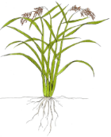


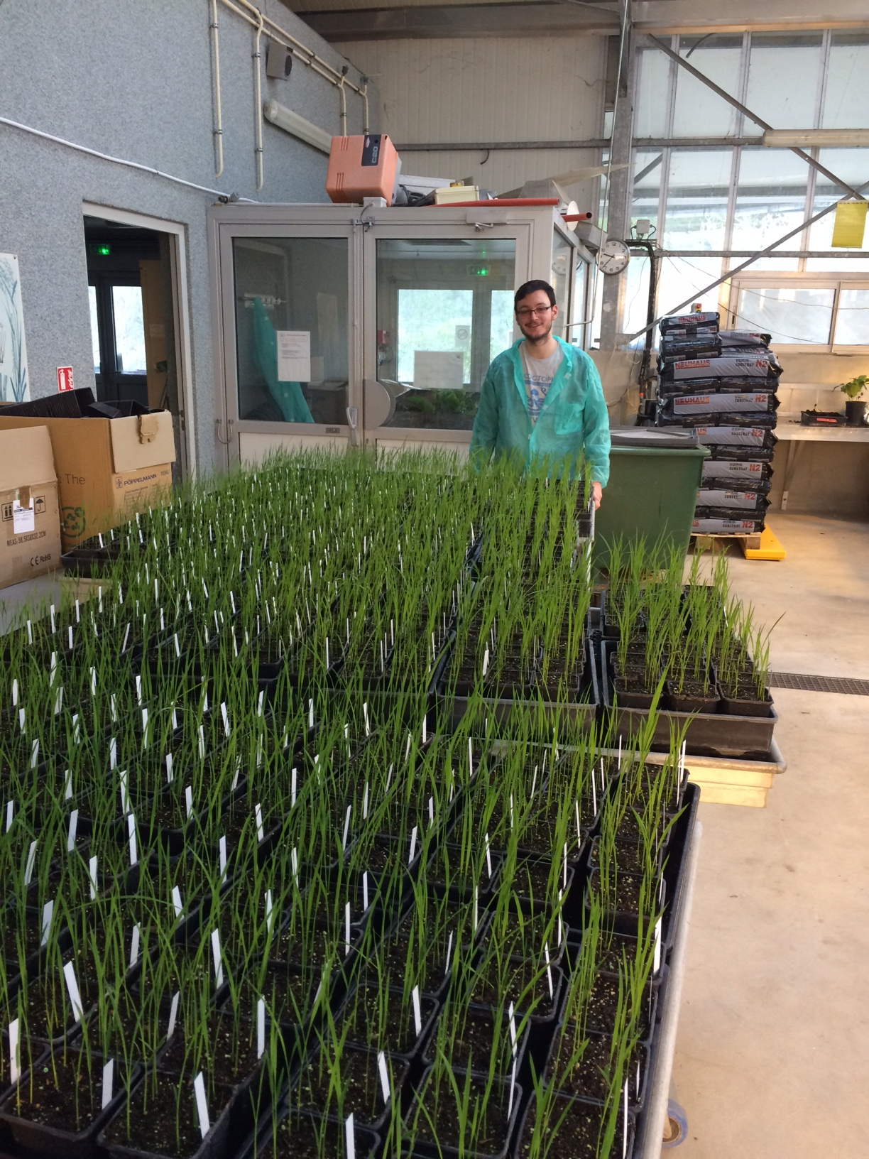

Mapping rice ability to modulate susceptibility in its neighborhood
Diversity of NMS?
Rice loci involved in NMS emission?
.
.
.
.
.
GWAS
(Genome Wide Association Study)
of NMS emission
Neighbor plant
=
280 genotypes of temperate japonica
Blast susceptibility
on Kitaake
CO-CULTURE
X 3 replicates
Focal plant
= Kitaake
Rémi
Pelissier et al, unpublished

Slide 20
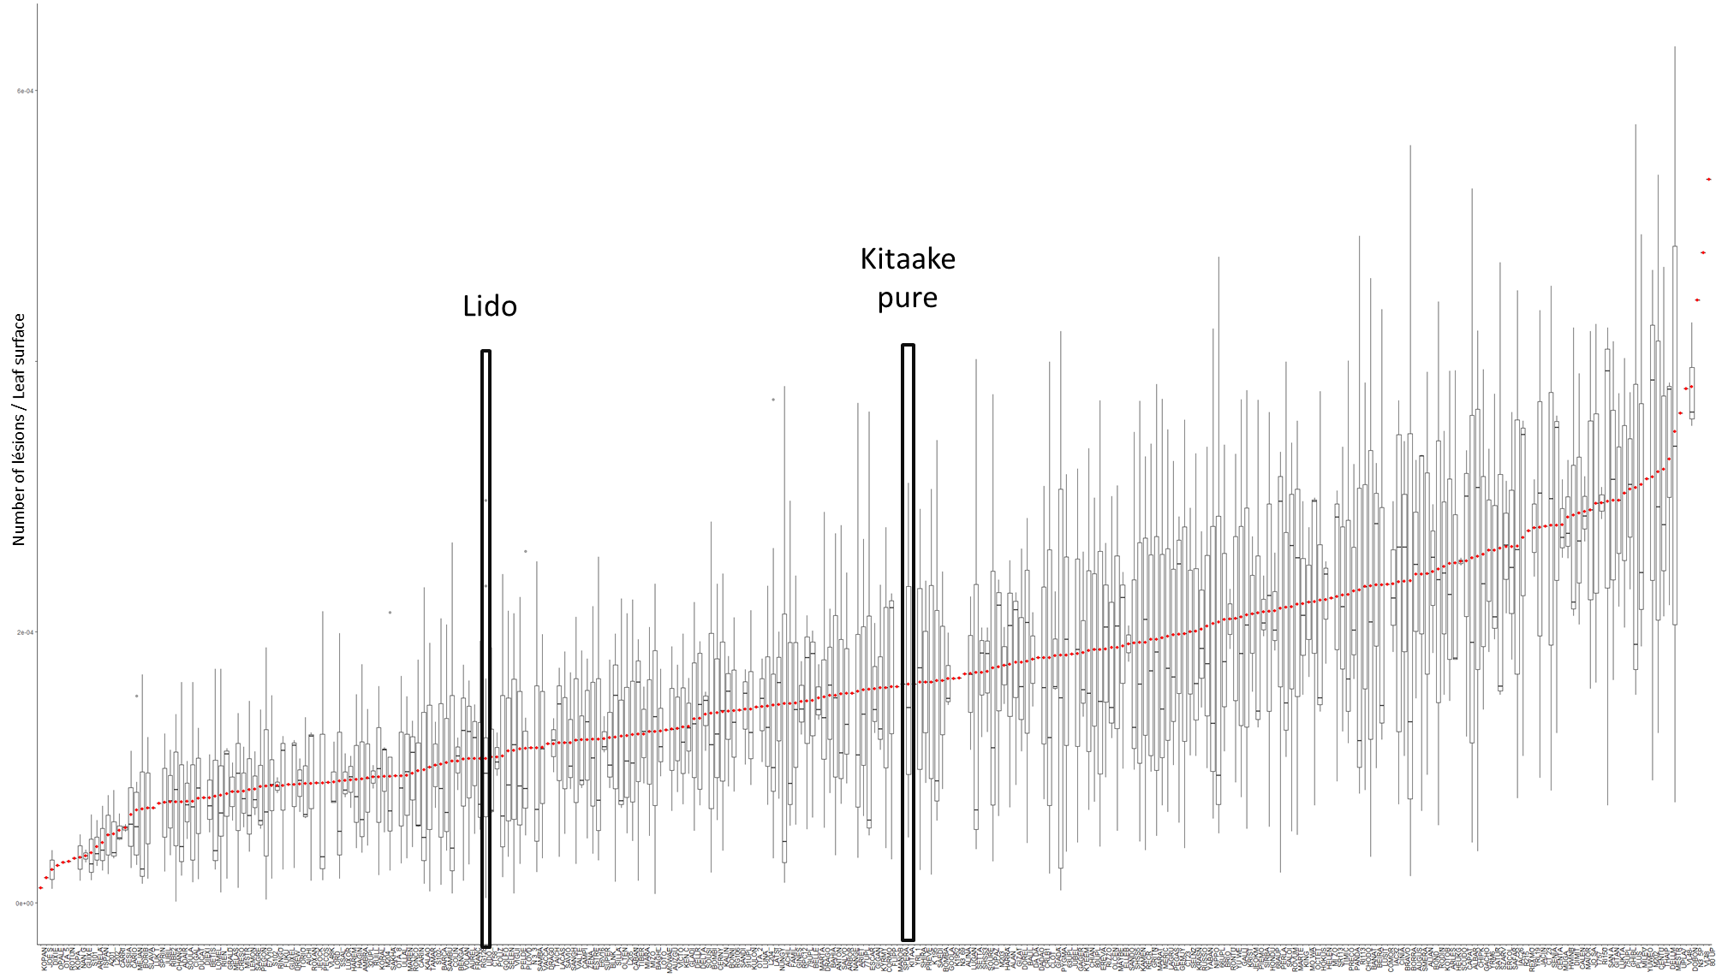
Blast susceptibility of Kitaake cultivated with 280 differents neighbors
Lesion number/leaf surface
X 2,3
X 1/7
280 rice neighbors
Neighbors can reduce but also increase disease susceptibilty of Kitaake
Pelissier et al, unpublished

Slide 21
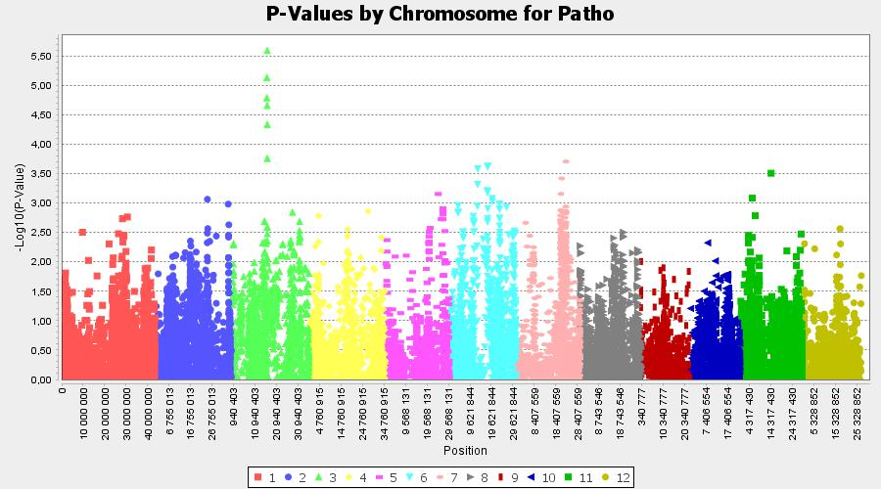
GWAS of the emission of NMS
LD block= 250kb
9 coding sequences, incl. 6 genes
One region on rice chromosome 3 controls NMS emission
Pelissier et al, unpublished

Slide 22
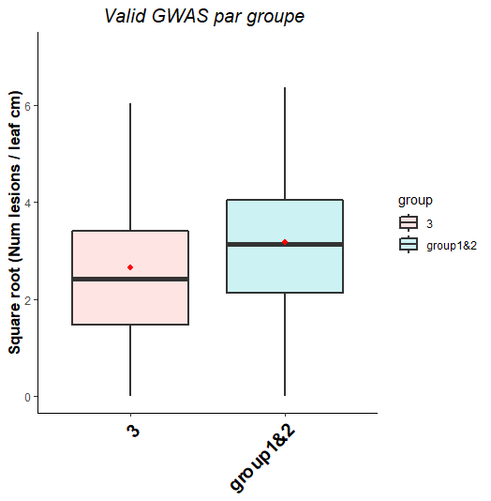
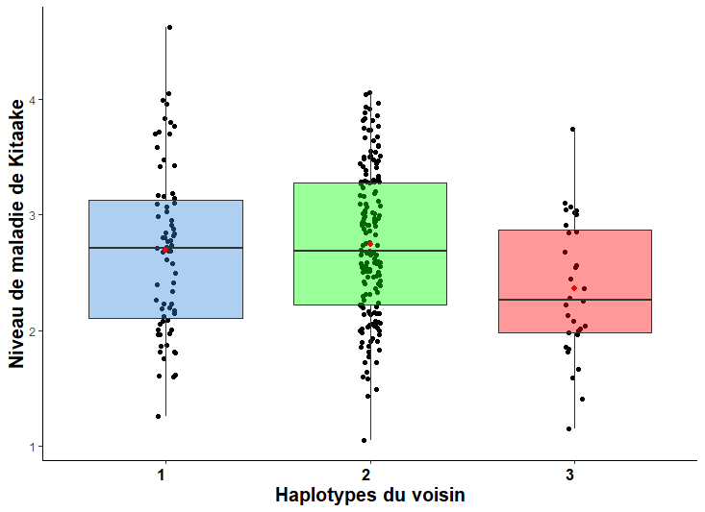
Test of GWAS prediction for emission of NMS
Independent validation
(6 haplotype 3 vs 6 haplotypes 1 or 2)
Susceptibility data
from GWAS
***
20% reduction of susceptibility
*
Kitaake susceptibility
Kitaake susceptibility
Neighbor haplotype
GWAS predicts that neighbors with haplotype 3
reduce susceptiblity in focal kitaake
Neighbor haplotype
Pelissier et al, unpublished

Slide 23
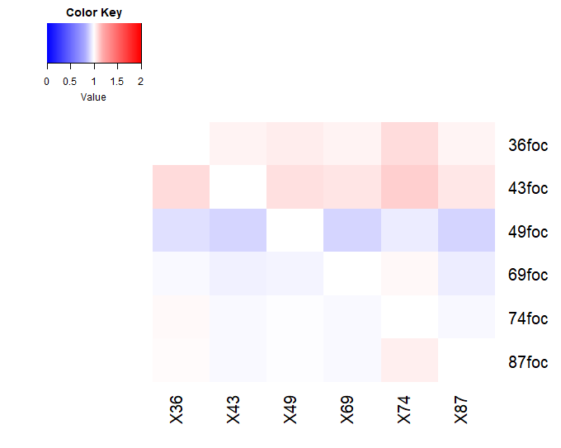
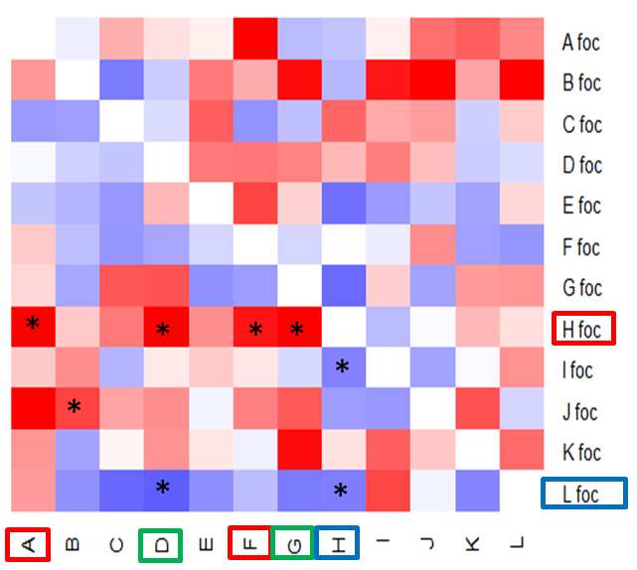
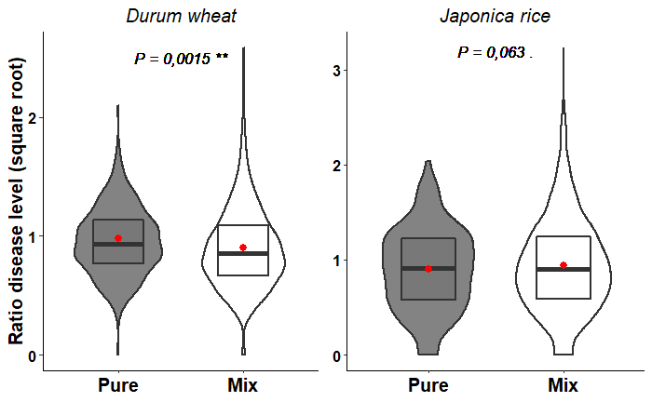
NMS at the species level: the case of temperate japonica rice
Rice
Blast fungus
More R
More S
Temperate japonica rice
Baldo
Calmochi
Gritna
Lido
Lomellino
Susceptibility (norm.)
Luxor
M204
Focal plant
Maratelli
OTA
+ 14 %
Sesia
Nipponbare
Kitaake
Baldo
Lido
Luxor
M204
OTA
Sesia
Kitaake
Gritna
Maratelli
Calmochi
Lomellino
Nipponbare
Neighbor plant
Intra-specific interactions are not favorable to rice blast resistance
Pelissier et al, unpublished

Slide 24
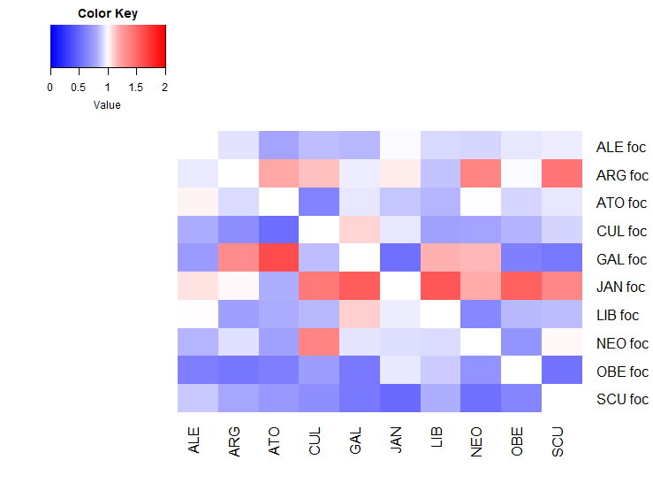
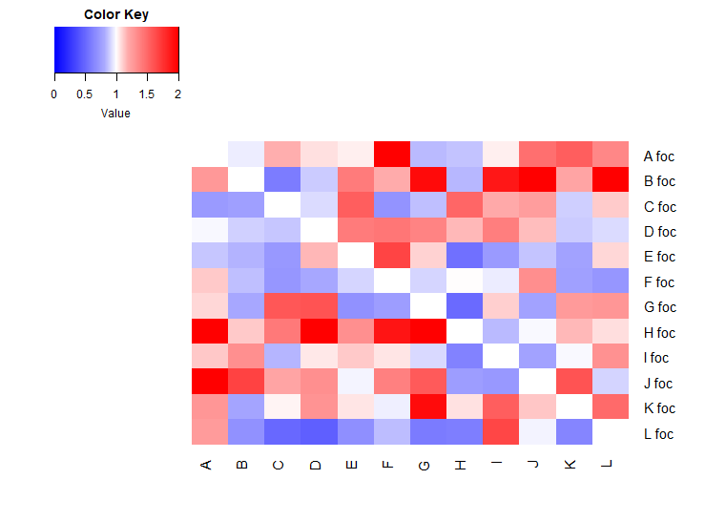
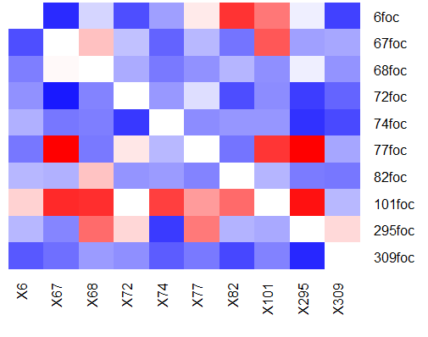
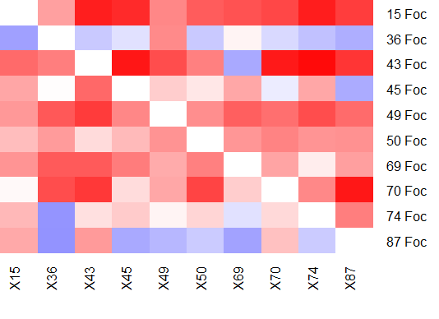
NMS: good neighbor and good focal plants
Wheat X leaf rust
Rice X Blast fungus
Cultivated durum wheat
Japonica Rice
*
*
*
*
*
*
*
*
*
*
*
*
*
*
*
*
*
*
*
*
*
*
*
*
EPO Wheat
Acuce rice
*
**
*
*
*
**
*
*
.
.
*
*
Focal plant
.
**
*
*
*
More R
More S
Pelissier et al, unpublished
Neighbor plant

Slide 25
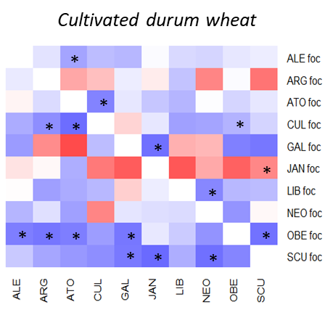
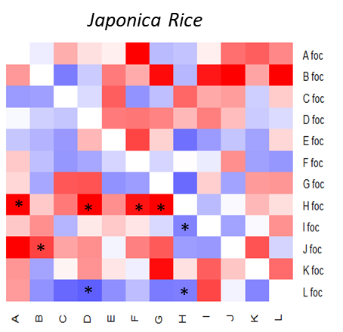
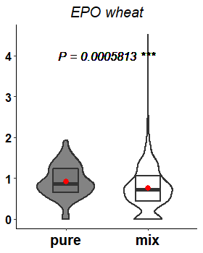
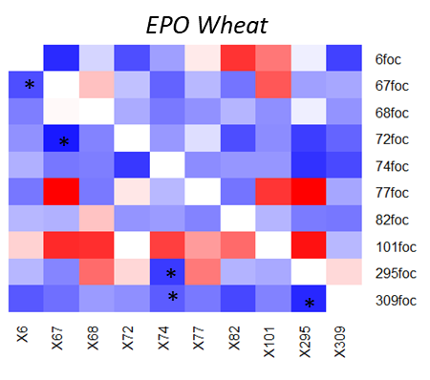
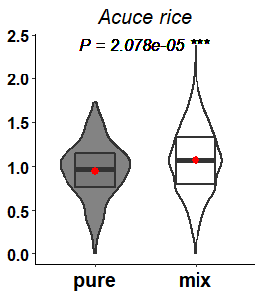
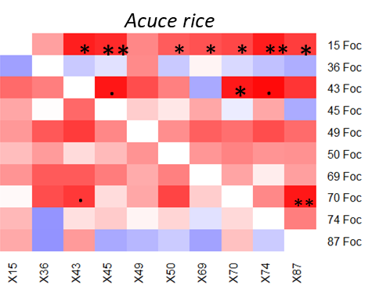
NMS and breeding
Wheat (leaf rust)
Rice
(Blast fungus)
Historical
within-field
co-existence
- 8 %
Pathogen susceptibility
+ 14 %
- 15 %
+ 27 %
Pelissier et al, unpublished

Slide 26



Cyrille Violle
Yunnan Agricultural University
Huichuan Huang
Jingjing Liao
Baihui Jin
Xiahong He
Chenyung Li
Youyong Zhu
Hélène Fréville
International joint Lab PLANTOMIX
jean-benoit.morel@inrae.fr
Rémi Pélissier
Elsa Ballini
Luis Buendia
Aurélie Ducasse
Andy Brousse
Funding
French ANR
INRAE Crop protection
CASDAR
QUESTIONS?
+ projet thèse (Inrae-ANR Mobidiv)
Génétique et physiologie des interactions blé-blé modulant la sensibilité aux agents pathogènes (Sept 2021-2024)

