Slide 1
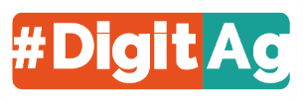
Digital: a source of convergence or divergence between organic and conventional farming?
IFSA – Smart technologies in farming and food systems
Eléonore SCHNEBELIN – 14/04/2022
PhD supervision : Jean-Marc Touzard & Pierre Labarthe

Slide 2
Context
A PhD thesis : How does digitalisation link to ecologisation trajectories of agriculture in France ?
A first analysis on the perceptions and actions of actors of the French Agricultural Innovation System
Schnebelin, É., Labarthe, P., Touzard, J.-M., 2021. How digitalisation interacts with ecologisation? Perspectives from actors of the French Agricultural Innovation System. Journal of Rural Studies 86, 599–610.
A second analysis on farmers digital uses and their link to agricultural models
Schnebelin, É., 2022. Linking the diversity of ecologisation models to farmers’ digital use profiles. Ecological Economics 196, 107422.
A third analysis on farmers’ cooperatives involvment in digitalisation and ecologisation and on how they articulate the two processes
Digital: a source of convergence or divergence between organic and conventional farming?

Slide 3
Introduction
Ecologisation & Digitalisation

Slide 4
Ecologisation
Environmental issues
Optimisation
Reconception
Organisations
.
.
Farms
In practices: continuum –differenciation mechanisms in the different paths
Organisations
.
.
Farms
Ecologisation = growing importance of environmental issues within agricultural policies, knowledge and practices (Lamine, 2011; Lucas, 2021)

Slide 5
Digitalisation
Farms
Crop production
Animal production
Providers
Buyers
Research & education
Public institutions
Information/
communication
Management
Selling and marketing
Improve efficiency ?
Gain or lost of knowledge ?
Increase farms economic performance ?
Gain or lost of autonomy ?
Reduce environmental impacts ?
Prause et al. 2020

Slide 6
Problem
Relations between digitalisation and ecologisation are the subject of academic debate :
Does digitalisation encourage ecologisation ?
Is it adapted to all farming models and paradigms ?
Knowledge gaps :
Organic actors perceptions and expectations on digital
Farmers’ digital uses, especially for organic farmers
Is digital a source of convergence or divergence between organic and conventional farming in France?

Slide 7
Material & Method

Slide 8
Material & Method
Agricultural Innovation System (AIS)
38 interviews on digital perceptions and project of actors
actors that represent conventional farming
actors that relate to organic farming
actors from organisations specialised in digital development (such as firms or research projects)
Qualitative analysis with coding of the interviews
Schnebelin, É., Labarthe, P., Touzard, J.-M., 2021. How digitalisation interacts with ecologisation? Perspectives from actors of the French Agricultural Innovation System. Journal of Rural Studies 86, 599–610.

Slide 9
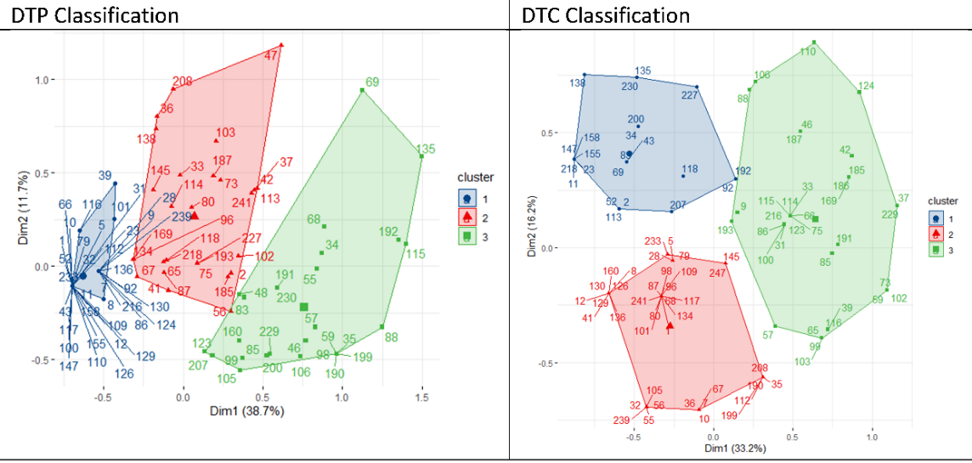
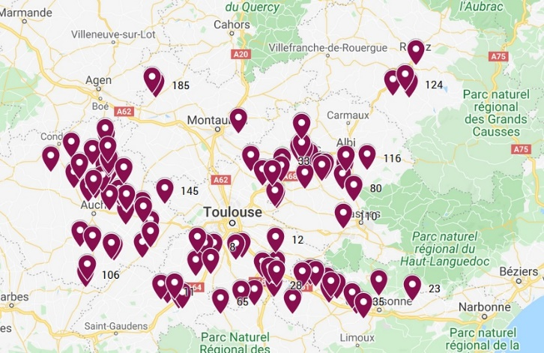
Material & Method
Farmers (field crop)
98 interviews on farming practices, digital uses, farming organisation
Quantitative analysis : classification to build clusters of digital use for Digital Technologies for Production (DTP) and Digital Technologies for Information and Communication (DTC) + Statistical specificities of clusters
Qualitative analysis to understand logics
Schnebelin, É., 2022. Linking the diversity of ecologisation models to farmers’ digital use profiles. Ecological Economics 196, 107422.

Slide 10
Results and discussion

Slide 11
AIS - Convergence
Perspectives from actors of the French Agricultural Innovation System
Agricultural organisations play an important role in digitalisation (diffusion, development, data management)
Perceived potential : to improve working conditions, to optimise practices, to manage risks, information for consumers, information and training for farmers, better economic management
Economic risks, lack of skills, dependance, capacity to repair, data-appropriation, exclusion
Regulations and standards as drivers of digitalisation

Slide 12
AIS - Divergence
Perspectives from actors of the French Agricultural Innovation System
Conventional | Organic
Increase traceability Improve image of agriculture and attractiveness Value creation Risk on the data and value appropriation Farmers : need to be digitalised Partnerships with digital firms | Risk of standardisation with digital technologies for traceability Endogenous knowledge to conceive/analyse production systems Risk of loss of power and know-how Farmers : need to manage digitalisation Internal development
Actors do not envision the same digitalisation. Organic actors hope digital technologies to be low-cost, reflexive rather than prescriptive, with a systemic conception of production systems

Slide 13
Farms – Digital Technologies for Production (DTP)
Profile | Part | Digital technologies | Over-represented
No-DTP | 39% | Few DTP, 1/3 have a farm management software | Organic farms Direct selling Farms with livestock
Average DTP | 32% | Guidance, farm management software ; Sometimes section control, DST, connected weather station, connected irrigation system | Conventional farms
Intensive DTP | 29% | Guidance, Variable rate technology, yield map, connected weather station | Farms that have outsourcing business Seed growers Mixed farms (organic + conventional) Larger farms

Slide 14
Farms – Digital Techno for Communication (DTC)
Profil | Part | Digital technologies | Over-represented
DTC-no | 23% | Few use of internet | Farms that are advised by cooperatives or seed company
DTC-website | 41% | Frequent use of Internet to get information : specialised websites | Farmers that are members of knowledge exchanges groups Farmers that grow pulse crops
DTP-network | 37% | Frequent use of Internet to get information : youtube, facebook, forums… | Farmers that have high digital skills Farmers that are member of professional union

Slide 15
Divergence
DTP :
Diversity of logic and need
- To optimise conventional inputs → less advantageous for strategies that reduce input ; Less adapted to diverse cropping system
Diversity of inputs
- Organic versus conventional inputs
Diversity of regulation
DTP to justify inputs : less necessary for organic farmers
Diversity of Micro-AKIS and value-chain between farmers
Actors that favour or impose technologies (cooperatives, food industries, seed companies)
DTC
Organic farming reasoning implies more individualised advice, more contextualised knowledge
“Other farmers who have GPS [ ...] they save money on diesel, seeds, fertiliser and weed killer. Because they only use what they need. So perhaps they can pay for things with what they save. But me, I am only going to save on diesel, and on time.” Thomas (No-DTP)

Slide 16
Convergence
For DTP
Needs for better work conditions, more information
Mixed farms are over represented in the Intensive-DTP profile : allows to move towards organic farming, with a similar way of working = substitution strategy
Industrial structures : common need in terms of work, of traceability and monitoring
“If I had not had guidance for organic crops, perhaps I would not have done it, plain and simple. Where we are organic, we can use big tools with guidance, it’s great.” Baptiste (Intensive DTP)
For DTC
Lack of knowledge in the micro-AKIS for innovative practices
Complementarity of knowledge on internet and knowledge with advisers or farmers groups

Slide 17
Conclusion
Some incompatibilities between actual digital technologies and organic agriculture
Reinforcement of conventional model of farming (Carolan, 2020; Lioutas and Charatsari, 2020 ; Wolf and Buttel, 1996)
Forms of hybridation
Common uses of DTC : common spaces to exchange knowledge
Some industrial ecologisation (Gkisakis and Damianakis, 2020)
Digitalisation is not neutral for farming models
The adoption and use of a technology : result of a production model interacting with a socio-economic system that encourages, or even imposes, these technologies
Digitalisation public policies can impact farming models
=> Digitalisation also associated with sub-contracting

Slide 18
Bibliographie
Badillo, P.-Y., Pélissier, N., 2015. Usages et usagers de l’information numérique. Renouvellement des problématiques et nouveaux enjeux pour les SIC. Revue française des sciences de l’information et de la communication. https://doi.org/10.4000/rfsic.1448
Bronson, K., Knezevic, I., 2016. Big Data in food and agriculture. Big Data & Society 3, 2053951716648174. https://doi.org/10.1177/2053951716648174
Burton, R.J.F., Riley, M., 2018. Traditional Ecological Knowledge from the internet? The case of hay meadows in Europe. Land Use Policy 70, 334–346. https://doi.org/10.1016/j.landusepol.2017.10.014
Carbonell, I.M., 2016. The ethics of big data in big agriculture. Internet Policy Review 5. https://doi.org/10.14763/2016.1.405
Clapp, J., Ruder, S.-L., 2020. Precision Technologies for Agriculture: Digital Farming, Gene-Edited Crops, and the Politics of Sustainability. Global Environmental Politics 20, 49–69. https://doi.org/10.1162/glep_a_00566
Darnhofer, I., Lindenthal, T., Bartel-Kratochvil, R., Zollitsch, W., 2010. Conventionalisation of organic farming practices: from structural criteria towards an assessment based on organic principles. A review. Agron. Sustain. Dev. 30, 67–81. https://doi.org/10.1051/agro/2009011
DiMaggio, P., Hargittai, E., 2001. From the “Digital Divide” to “Digital Inequality”: Studying Internet Use as Penetration Increases. Center for Arts and Cultural Policy Studies 15, 25.
Dosi, G., 1982. Technological paradigms and technological trajectories: A suggested interpretation of the determinants and directions of technical change. Research Policy 11, 147–162. https://doi.org/10.1016/0048-7333(82)90016-6
Fleming, A., Jakku, E., Lim-Camacho, L., Taylor, B., Thorburn, P., 2018. Is big data for big farming or for everyone? Perceptions in the Australian grains industry. Agron. Sustain. Dev. 38, 24. https://doi.org/10.1007/s13593-018-0501-y
Frank, A.G., Dalenogare, L.S., Ayala, N.F., 2019. Industry 4.0 technologies: Implementation patterns in manufacturing companies. International Journal of Production Economics 210, 15–26. https://doi.org/10.1016/j.ijpe.2019.01.004
Gkisakis, V.D., Damianakis, K., 2020. Digital innovations for the agroecological transition: A user innovation and commons-based approach. Landbauforschung : journal of sustainable and organic agricultural systems 1–4. https://doi.org/10.3220/LBF1595407375000

Slide 19
Bibliographie
Gurstein, M., 2007. Effective use: A community informatics strategy beyond the Digital Divide (originally published in December 2003). First Monday. https://doi.org/10.5210/fm.v0i0.1798
Higgins, V., Bryant, M., Howell, A., Battersby, J., 2017. Ordering adoption: Materiality, knowledge and farmer engagement with precision agriculture technologies. Journal of Rural Studies 55, 193–202. https://doi.org/10.1016/j.jrurstud.2017.08.011
Klerkx, L., Rose, D., 2020. Dealing with the game-changing technologies of Agriculture 4.0: How do we manage diversity and responsibility in food system transition pathways? Global Food Security 24, 100347. https://doi.org/10.1016/j.gfs.2019.100347
Knierim, A., Kernecker, M., Erdle, K., Kraus, T., Borges, F., Wurbs, A., 2019. Smart farming technology innovations – Insights and reflections from the German Smart-AKIS hub. NJAS - Wageningen Journal of Life Sciences 90–91, 100314. https://doi.org/10.1016/j.njas.2019.100314
Lajoie-O’Malley, A., Bronson, K., van der Burg, S., Klerkx, L., 2020. The future(s) of digital agriculture and sustainable food systems: An analysis of high-level policy documents. Ecosystem Services 45, 101183. https://doi.org/10.1016/j.ecoser.2020.101183
Lê, S., Josse, J., Husson, F., 2008. FactoMineR: An R Package for Multivariate Analysis. J. Stat. Soft. 25. https://doi.org/10.18637/jss.v025.i01
Lioutas, E.D., Charatsari, C., 2020. Big data in agriculture: Does the new oil lead to sustainability? Geoforum 109, 1–3. https://doi.org/10.1016/j.geoforum.2019.12.019
Lucas, V., 2021. A “silent” agroecology: the significance of unrecognized sociotechnical changes made by French farmers. Rev Agric Food Environ Stud. https://doi.org/10.1007/s41130-021-00140-4
Nguyen, G., Brailly, J., Purseigle, F., 2020. Strategic outsourcing and precision agriculture: towards a silent reorganization of agricultural production in France?, in: AgEcon Search. Presented at the Annual Meeting of the Allied Social Sciences Association, San Diego. https://doi.org/10.22004/ag.econ.296670
Prause, L., Hackfort, S., Lindgren, M., 2020. Digitalization and the third food regime. Agric Hum Values. https://doi.org/10.1007/s10460-020-10161-2
Rotz, S., Duncan, E., Small, M., Botschner, J., Dara, R., Mosby, I., Reed, M., Fraser, E.D.G., 2019. The Politics of Digital Agricultural Technologies: A Preliminary Review. Sociologia Ruralis 59, 203–229. https://doi.org/10.1111/soru.12233
Wolf, S.A., Wood, S.D., 1997. Precision Farming: Environmental Legitimation, Commodification of Information, and Industrial Coordination1. Rural Sociology 62, 180–206. https://doi.org/10.1111/j.1549-0831.1997.tb00650.x

Slide 20
Thank you
Eleonore.schnebelin@inrae.fr

Slide 21
AIS interviews coding

Slide 22
Conceptual framework
Heterogeneity
A diversity of paradigms
Agricultural Innovation System
Farms
Public policies - Institutions
Knowledge
Actors
Technologies
Image : Pillaud, 2015
(Malerba, 2004)

Slide 23
A mixed method
98 interviews with field crop farmers in South-West France
Hierarchical cluster analysis
Digital use profile
Agronomic practices
Socio-economic caracteristics
Statistical tests
Qualitative analysis of ideal-type
23

Slide 24
Farms
Linking digital use and farming models
Digital Technologies for Production (DTP) : guidance, automatic guidance, section control, connected weather station, field mapping, variable-rate technology (VRT) for fertilizers or for seeding, connected tensiometer, yield map, decision support tool for crop protection, connected irrigation technology and farm management software
Digital Technologies for information and Communication (DTC) : frequency with which the internet is used, the use or otherwise of social networks, Facebook, YouTube, specialised agronomic websites, technical institute websites, and farming press websites

Slide 25
Cross-referencing digital use profiles
 | DTC-Non | DTC-sites | DTC-reseaux | DTC N/A | Total
DTP-non | 8 | 19 | 10 | 0 | 37
DTP- moyen | 6 | 11 | 13 | 1 | 31
DTP- Intensif | 8 | 8 | 11 | 1 | 28
DTP N/A | 0 | 1 | 1 | 0 | 2
Total | 22 | 39 | 35 | 2 | 98

