Slide 1





International Ecohydrology Workshop in Tunisia
ECOTUN 2022
Carthage, October 04th to 07th 2022
Experimentation of a sand bio-filter in an arid region to reuse wastewater in agricultural irrigation
Dr. Pascal BREIL
pascal.breil@inrae.fr

Slide 2



















@AfriAlliance1
Tailor-Made Socio Economic Approaches for Integrated Water Management in Rural to Urban Driven Mutations
“SoWat”
Hydraulic design of Nagaa Diab pilot field for wastewater reuse (dark & grey)
This project has received funding from the European Union’s Horizon 2020 Research and Innovation Programme under grant agreement No. 689162.

Slide 3
Identified problems to solve
Local physical limitations:
Soil, irrigation water and groundwater with high salt content.
Limitation of fruits and vegetables, even in small quantities for self-consumption.
Potential solution:
1- Improve soil quality
2- Irrigate with better quality water
Constraint: develop an affordable solution for low-income people.

Slide 4
Potential solution to be tested
Water supplied for domestic services has a low level of salinity. It can be reused after adequate treatment, depending on its pollution load.
Low cost treatment to reduce the pollution carried:
1- For grey water: filtration, decantation of suspended particles
2- For black water: septic tank followed by a sand bio-filter
These solutions are normally sufficient, but this must be confirmed by analyses to verify the compatibility of the final uses with the regulations.

Slide 5
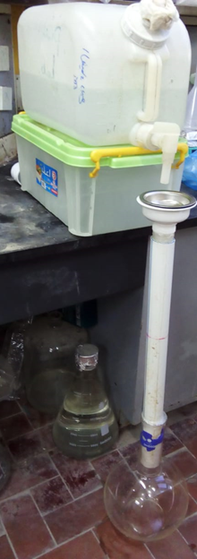
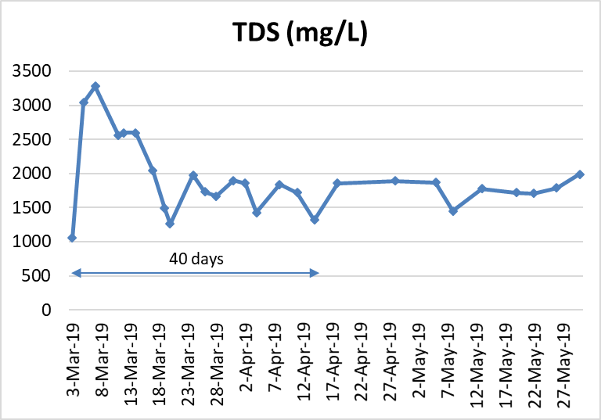
Feasability test for soil recovery
Given this result, we considered a water use scenario for a family of 4 with a European standard, in the absence of sufficiently accurate data from the field in Nagaa Diab.
This represents 0.37 m3 of wastewater per day that we can use after treatment to reduce soil salinity and irrigate small agricultural plots.

Slide 6




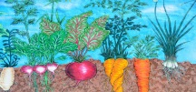
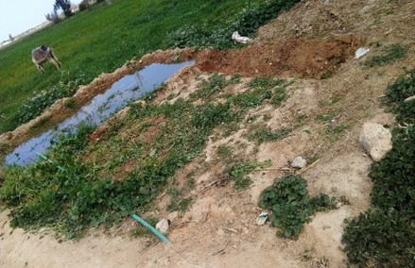
Part 1: Anaerobic biodegradation
Part 3: Rincing & irrigation part
Gas vent
Part 2: “Aerobic” biodegradation -polishing
0.37m³/day
Pebble / cobble protection layer
Draining pipe buried at 0.3m deep , equipped with a tap
Storing tank closed with a tap
Injection tank
(+)
Collecting tank
(-)
Sceptic tank principle
Medium to coarse sand
(0.25<∅<1mm)
Phase 1 : washing soil by flooding irrigation (as it is practice by local people). Duration is 40 days for a plot of 5m2 flooded each night under 0.07 m of treated WW.
Phase 2 : drip irrigation with 0.007 m / day (0.7 cm) required for vegetable growing in arid zone (FAO data).
Oxic mineralization phase
Anoxic biodegradation
phase
Design assuming
Hydraulic conductivity of 10⁻⁴ m/s
Sand Volume of 0.5 m X 2.0 m X 12.0 m
Hydraulic gradient of 0.5 m
Which gives:
A flux of 0.36 m³/day
Residence time of 10 days
Storage capacity of 3.7 m³
Design
3-4 m³ for 5 people
Must be cleaned every 3 years

Slide 7
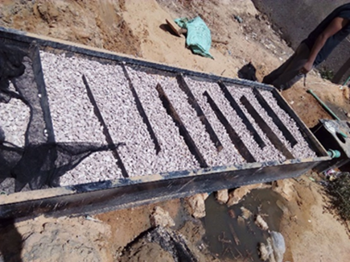
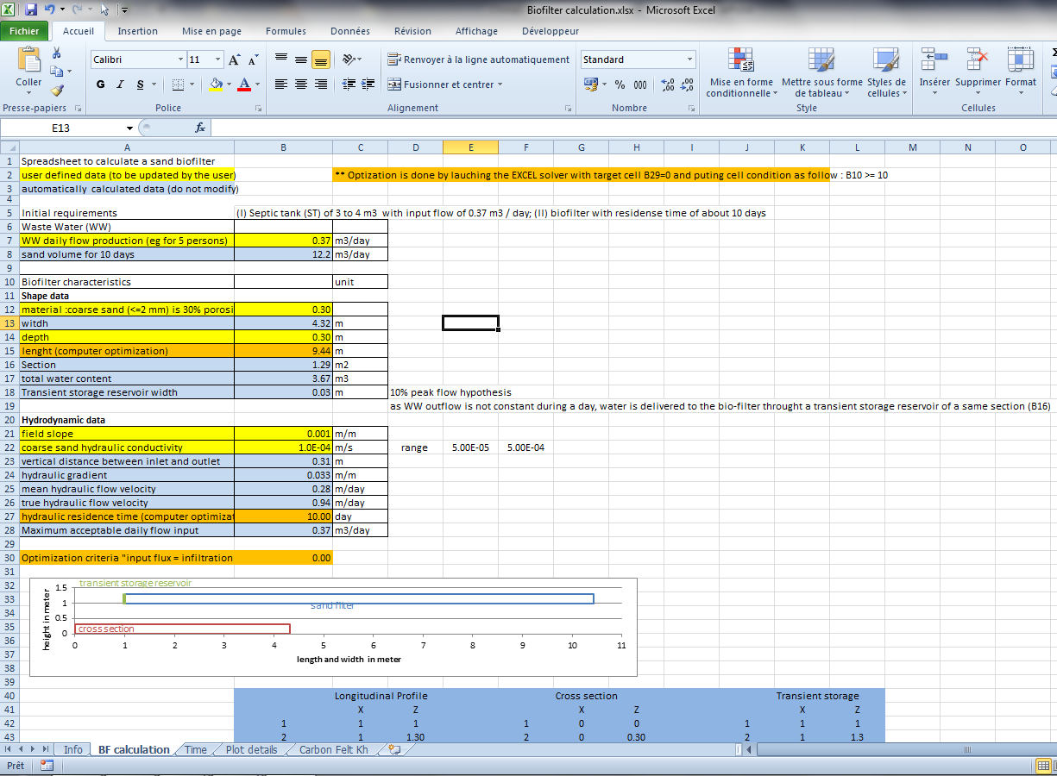
Part 2: Biofilter profile design
The shape of the BF depends on the available free area and the topography to allow gravity flow from ST to BF to the irrigated plot.
The flow capacity is calculated using Darcy’s equation….Q = - Kh * dH/dL * FS
Collecting storage reservoir
Total gradient
Transient storage reservoir
A spreadsheet has been developed. The input data are :
The depth of the biofilter (not more than 0.6m to avoid anoxic zones.
The hydraulic conductivity at saturation of the selected sand material (Khs)
Gradient of the bottom of the BF, which should not deviate too much from the natural gradient of the land to limit the amount of earthwork.

Slide 8
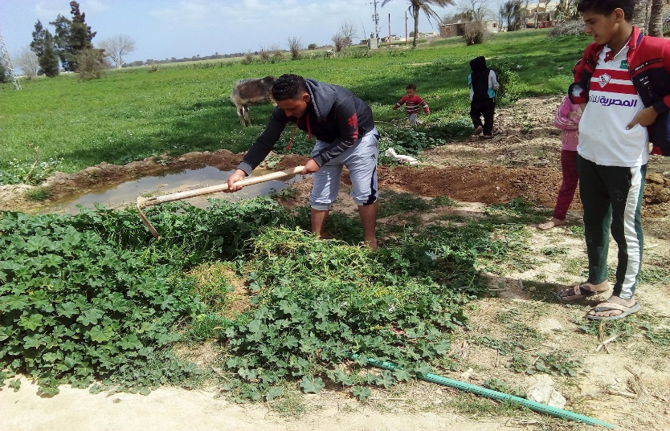
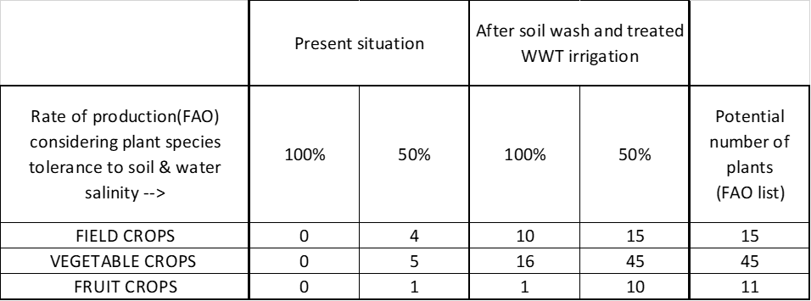
Soil rincing and irrigation strategy
 | m2 | cumulated area m2 | required water volume /m2 | Total required volume m3 | outflow m3/j | days | Plot irrigation m/day | cumulated days | years
Plot1 | 5 | 5 | 3 | 15 | 0.37 | 40.5 | 0.035 | 40.5 | 0.1
plot2 | 5 | 10 | 3 | 15 | 0.335 | 44.8 | 0.035 | 85.3 | 0.2
Plot3 | 5 | 15 | 3 | 15 | 0.3 | 50.0 | 0.035 | 135.3 | 0.4
Plot4 | 5 | 20 | 3 | 15 | 0.265 | 56.6 | 0.035 | 191.9 | 0.5
Plot5 | 5 | 25 | 3 | 15 | 0.23 | 65.2 | 0.035 | 257.1 | 0.7
Plot6 | 5 | 30 | 3 | 15 | 0.195 | 76.9 | 0.035 | 334.1 | 0.9
Plot7 | 5 | 35 | 3 | 15 | 0.16 | 93.8 | 0.035 | 427.8 | 1.2
Plot8 | 5 | 40 | 3 | 15 | 0.125 | 120.0 | 0.035 | 547.8 | 1.5
Plot9 | 5 | 45 | 3 | 15 | 0.09 | 166.7 | 0.035 | 714.5 | 2.0
Plot10 | 5 | 50 | 3 | 15 | 0.055 | 272.7 | 0.035 | 987.2 | 2.7
This means that after 40 days of soil flushing, the first plot can be irrigated with less water. The excess water can be used to flush another plot, and so on...
Daily discharge of cleaned water is | 0.37 | m3
Water requirement for vegetables in desert conditions is 5 cm / week (FAO data) | 0.7 | cm/day

Slide 9

How these results relate to EH ?.....
WSBR+C – water, biodiversity, ecosystem services, resilience, cultural heritage
ECOTUN 2022 – Carthage, octobre 04-07th

Slide 10
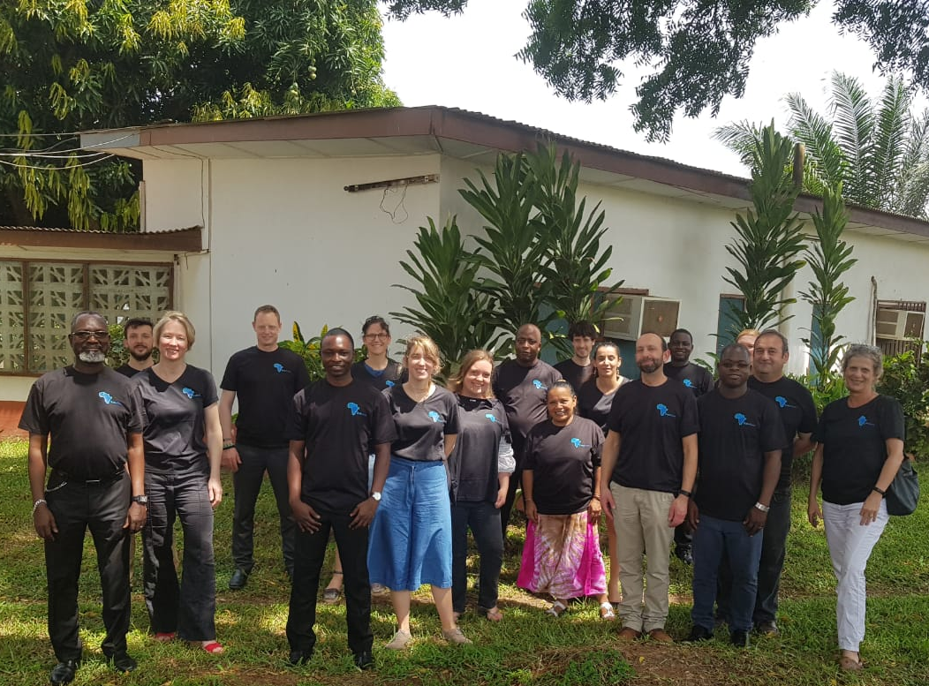





Thank you!
Keep in touch with AfriAlliance:
www.afrialliance.org
afrialliance@un-ihe.org
@AfriAlliance1
Project Coordinator: Dr. Uta Wehn, IHE Delft, u.wehn@un-ihe.org
This project has received funding from the European Union’s Horizon 2020 research and innovation programme under grant agreement No. 689162.

