Slide 1




Rheological properties of mixed dispersions
of milk serum proteins and casein micelles
Presented by Hossein GHOLAMIAN
Supervisors and co-authors:
Maksym LOGINOV
Fabienne LAMBROUIN, Nadine LECONTE
Marie-Helene FAMELART, Florence ROUSSEAU
Géneviève GESAN-GUIZIOU
Funding:

Slide 2
Introduction | Materials and methods | Results and discussion | Conclusion
Serum proteins
Transmembrane Pressure
For developing a model:
compressibility
permeability
viscosity
Casein micelle ≈ 150nm
Serum protein ≈ 2-4nm
Casein micelles
Bulk
Retentate
Concentration polarization layer
Gel (deposit) layer
Membrane
Permeate

Slide 3
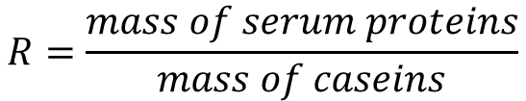
Objective:
Introduction | Materials and methods | Results and discussion | Conclusion
$$R=\frac{mass of serum proteins}{mass of caseins}$$
R _{skimmed milk} ~ 0.2
R = 0.07 (casein micelle isolate)
R = 0.175
R = 0.25
R = 0.5
R = 1
R = 10.03 (serum protein isolate)
The influence of serum proteins on rheological properties and sol-gel transition zone of casein micelle dispersions
Native casein micelle isolate: 83.1 wt. % caseins, 5.8 wt. % serum proteins
Serum protein isolate: 84.7 wt.% serum proteins, 8.4 wt.% caseins

Slide 4




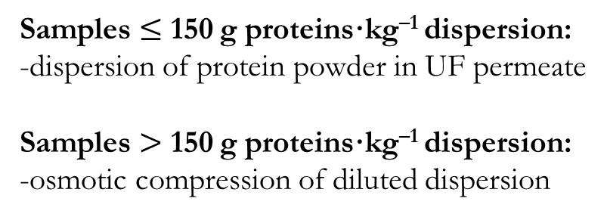
Sample preparation:
Introduction | Materials and methods | Results and discussion | Conclusion
Protein dispersion
Samples $≤$ 150 g proteins·kg^{–1} dispersion:
-dispersion of protein powder in UF permeate
Samples $>$ 150 g proteins·kg^{–1} dispersion:
-osmotic compression of diluted dispersion
Solvent
Protein dispersion
Stressing solution
Stressing Solution: Polyethylene Glycol powder solubilized in milk ultrafiltration (UF) permeate
Solvent (aqueous phase): UF permeate
Protein dispersions: casein micelles isolate + serum proteins isolate
Protein powders dispersed in UF permeate in different ratios R

Slide 5
Introduction | Materials and methods | Results and discussion | Conclusion
Flow measurements at T = 20 °C:
Low shear 400
Diluted dispersions (apparent viscosity < 10 mPa·s):
low shear 400 viscometer using a Couette geometry,
shear rate = 0.12 – 120 s^{–1}
Concentrated dispersions: DHR2 rheometer,
cone–plate geometry for liquid samples,
plate–plate geometry whenever the gel was detected,
shear rate = 0.1 – 1000 s^{–1}
Cone–plate geometry
Plate–plate geometry

Slide 6
Introduction | Materials and methods | Results and discussion | Conclusion
Shear stress vs. shear rate for R (serum prot./casein)= 0.175
Total protein concentration:
g·kg⁻¹
Power law model:
n = 0.075
R² = 0.92
g·kg⁻¹
τ = K γ͘^{n}
τ – shear stress (Pa)
K – consistency index (Pa·s^{n})
n – shear thinning index
γ͘ – shear rate (s^{–1})
g·kg⁻¹
n = 0.99
R² = 0.99
g·kg⁻¹
n = 1.00
R² = 0.99
g·kg⁻¹
g·kg⁻¹

Slide 7
Introduction | Materials and methods | Results and discussion | Conclusion
Changes in consistency and shear-thinning index for R (serum prot./casein)= 0.175
Concentration ↑
K ↑ and n↓
Newtonian fluid
Shear thinning fluid
n
K
7

Slide 8

Introduction | Materials and methods | Results and discussion | Conclusion
Consistency and shear thinning index vs. total protein concentration at different R
R (serum prot. )↑
K ↓
R (serum prot.) ↑ n ↑
8

Slide 9
Introduction | Materials and methods | Results and discussion | Conclusion
Determination of sol-gel transition zone (C_{sg} ) for R (serum prot./casein) = 0.175
Oscillation measurements at T = 20 °C:
Sol–gel transition zone:
G ’ is no longer dependent to frequency
Critical concentration zone, C_{sg}
9

Slide 10
Introduction | Materials and methods | Results and discussion | Conclusion
Sol-gel transition zone (C_{sg}) and effective volum fraction (φ_{sg}) vs. R (serum prot./casein)
R ↑ (serum prot. ↑):
C_{sg} ↑ φ_{sg, CM} ↓
Maximum volume fraction= 0.71*
φ_{sg, CM} =[CM]_{g/l} .ν
Apparent voluminisity of casein micelle, ν = 4.1 (ml/g)
*Doudiès et al. 2019
10

Slide 11
Introduction | Materials and methods | Results and discussion | Conclusion
Casein micelles*
Serum protein*
Casein micelles
(R = 0.07)
R = 0.5
R > 0.5
Concentration ↑ : viscosity ↑
R ↑ (serum prot. ↑) :
  viscosity ↓
  Sol-gel transition point (Csg) ↑
  Effective volume fraction (φ_{sg, CM} ) ↓
*Illustrations of the proteins are schematic and are not intended to meet the scale.
11

