Slide 1
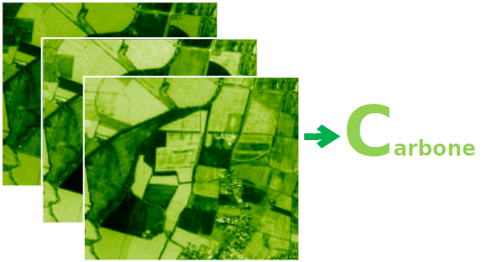
Assessing the impact of cover crops as a GHG mitigation solution at intra-field scale using the AgriCarbon-EO tool
Taeken Wijmer, Ahmad Al Bitar, Remy Fieuzal, Ludovic Arnaud, Gaetan Pique, and Eric Ceschia
EGU21- BG3.21 - 15272 wijmert@cesbio.cnes.fr

Slide 2
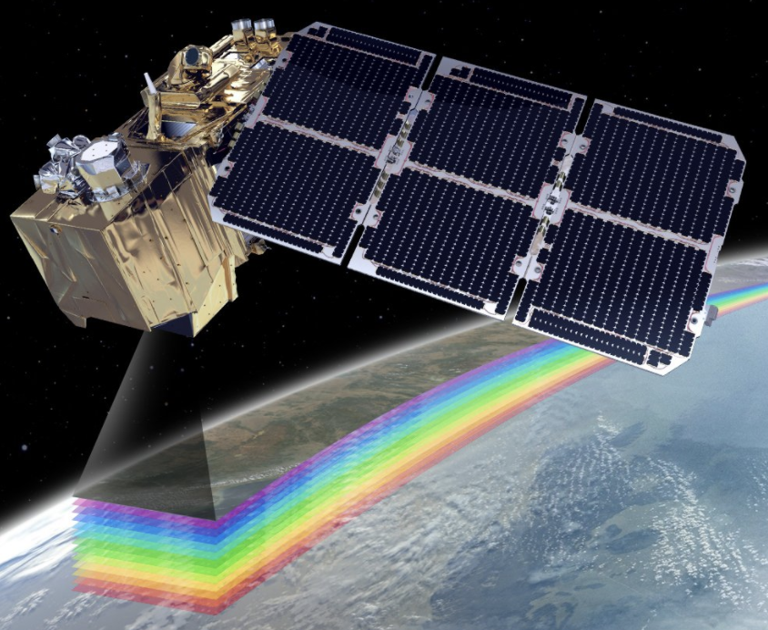
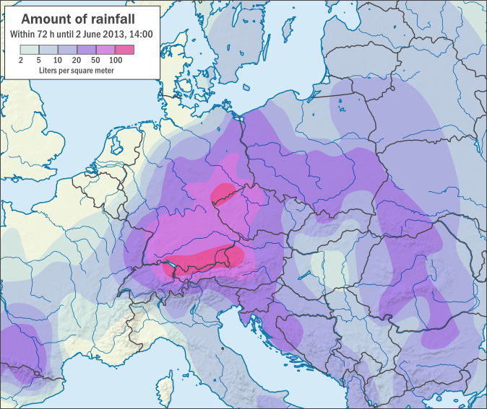
AgriCarbon-EO:
high resolution (10m)
large scale (100km)
multicycle
carbon & water budgets
assimilation (sentinel2)
uncertainty (Bayes)
ProSAIL Bayesian spatial inversion
Sentinel-2
Reflectance (10m)
Spatial LUT generator
RTM - ProSAIL
A-priori parameters
SAFYE-CO2 Bayesian temporal inv.
Weather data
(Rain, Rg, Temp.)
Agro. -SAFYE-CO2
application for one pixel:
A
GPP= green primary production
Rh = heterotroph respiration
Rauto =autotroph respiration
NEE= net ecosysthem exchange
B
A) Fitting of the SAFY-CO2 model to the remote sensed leaf area index (LAI) for a pixel and corresponding biomass (DAM) dynamic
B) Cumulated biological carbon fluxes over two years for one of the pixels
[Session BG3.21] EGU21-15272 wijmert@cesbio.cnes.fr

Slide 3
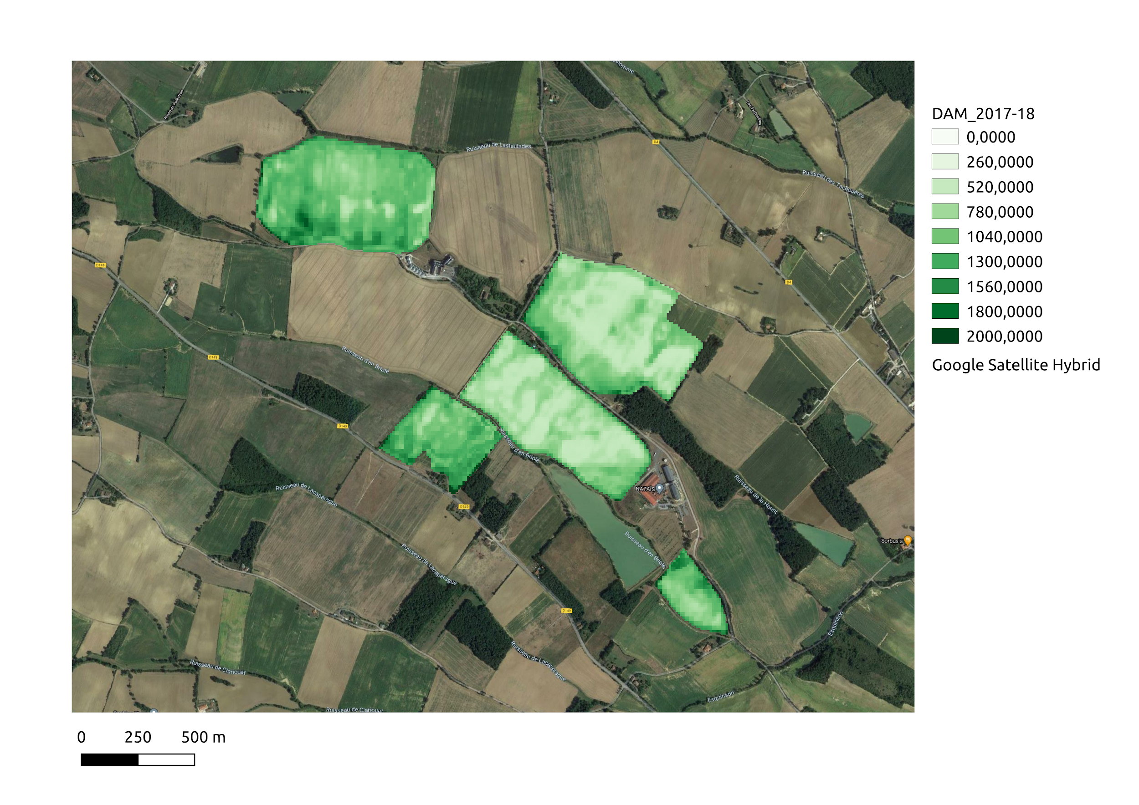
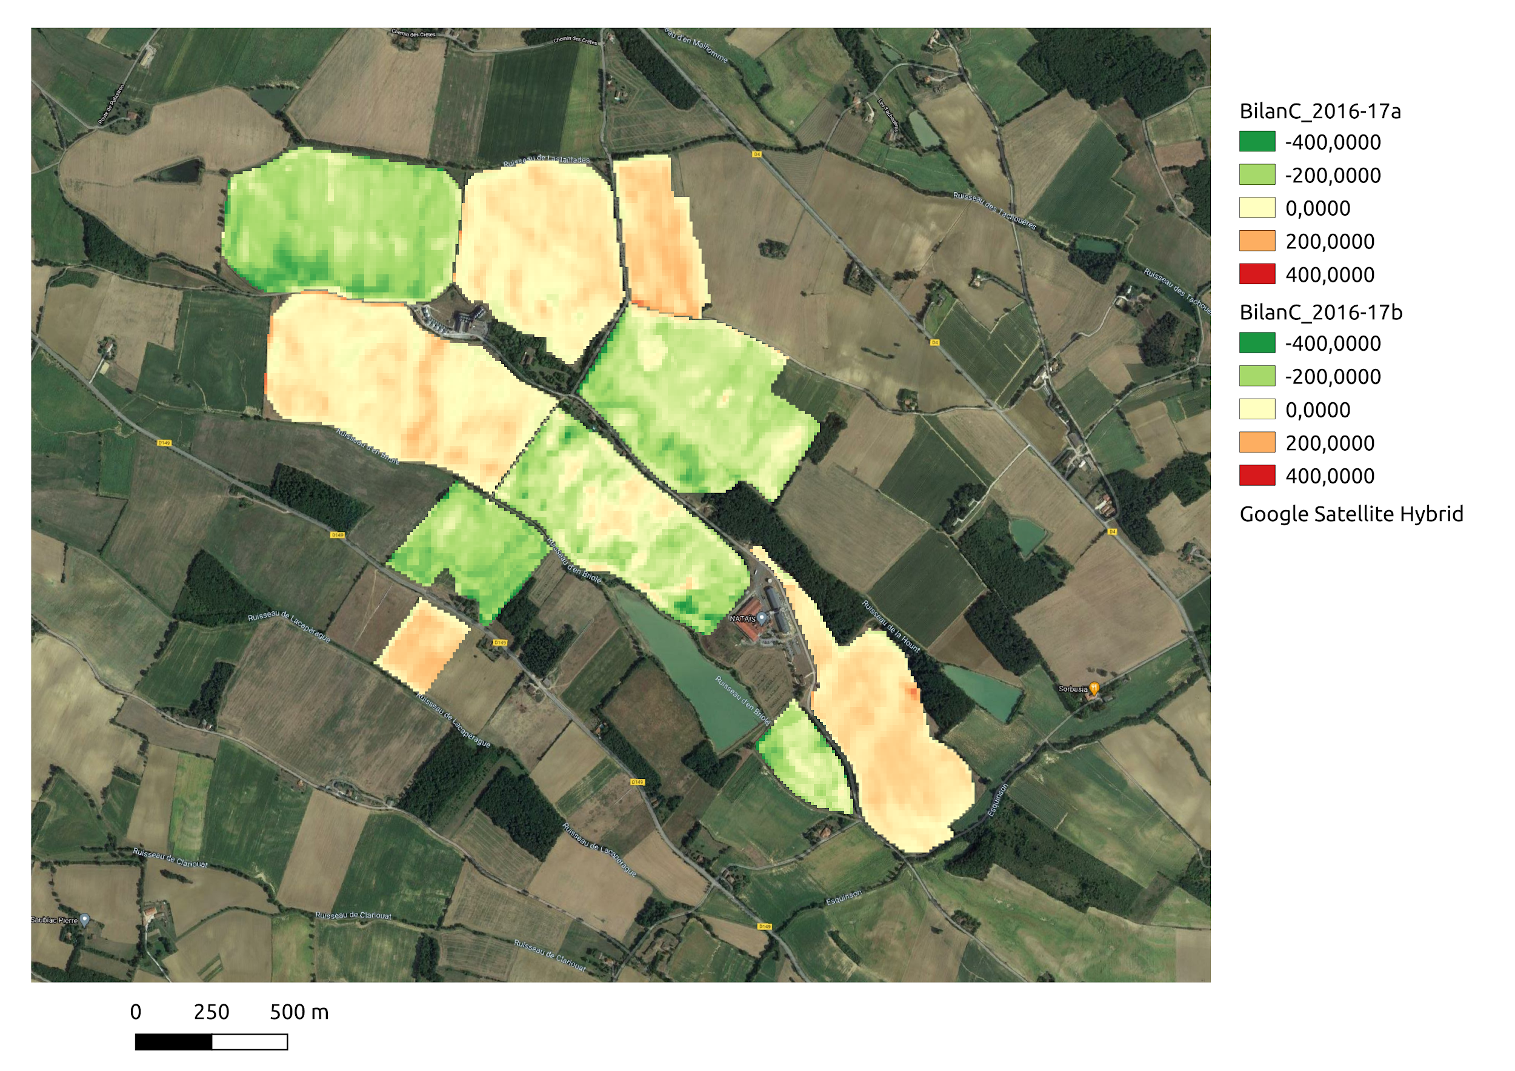
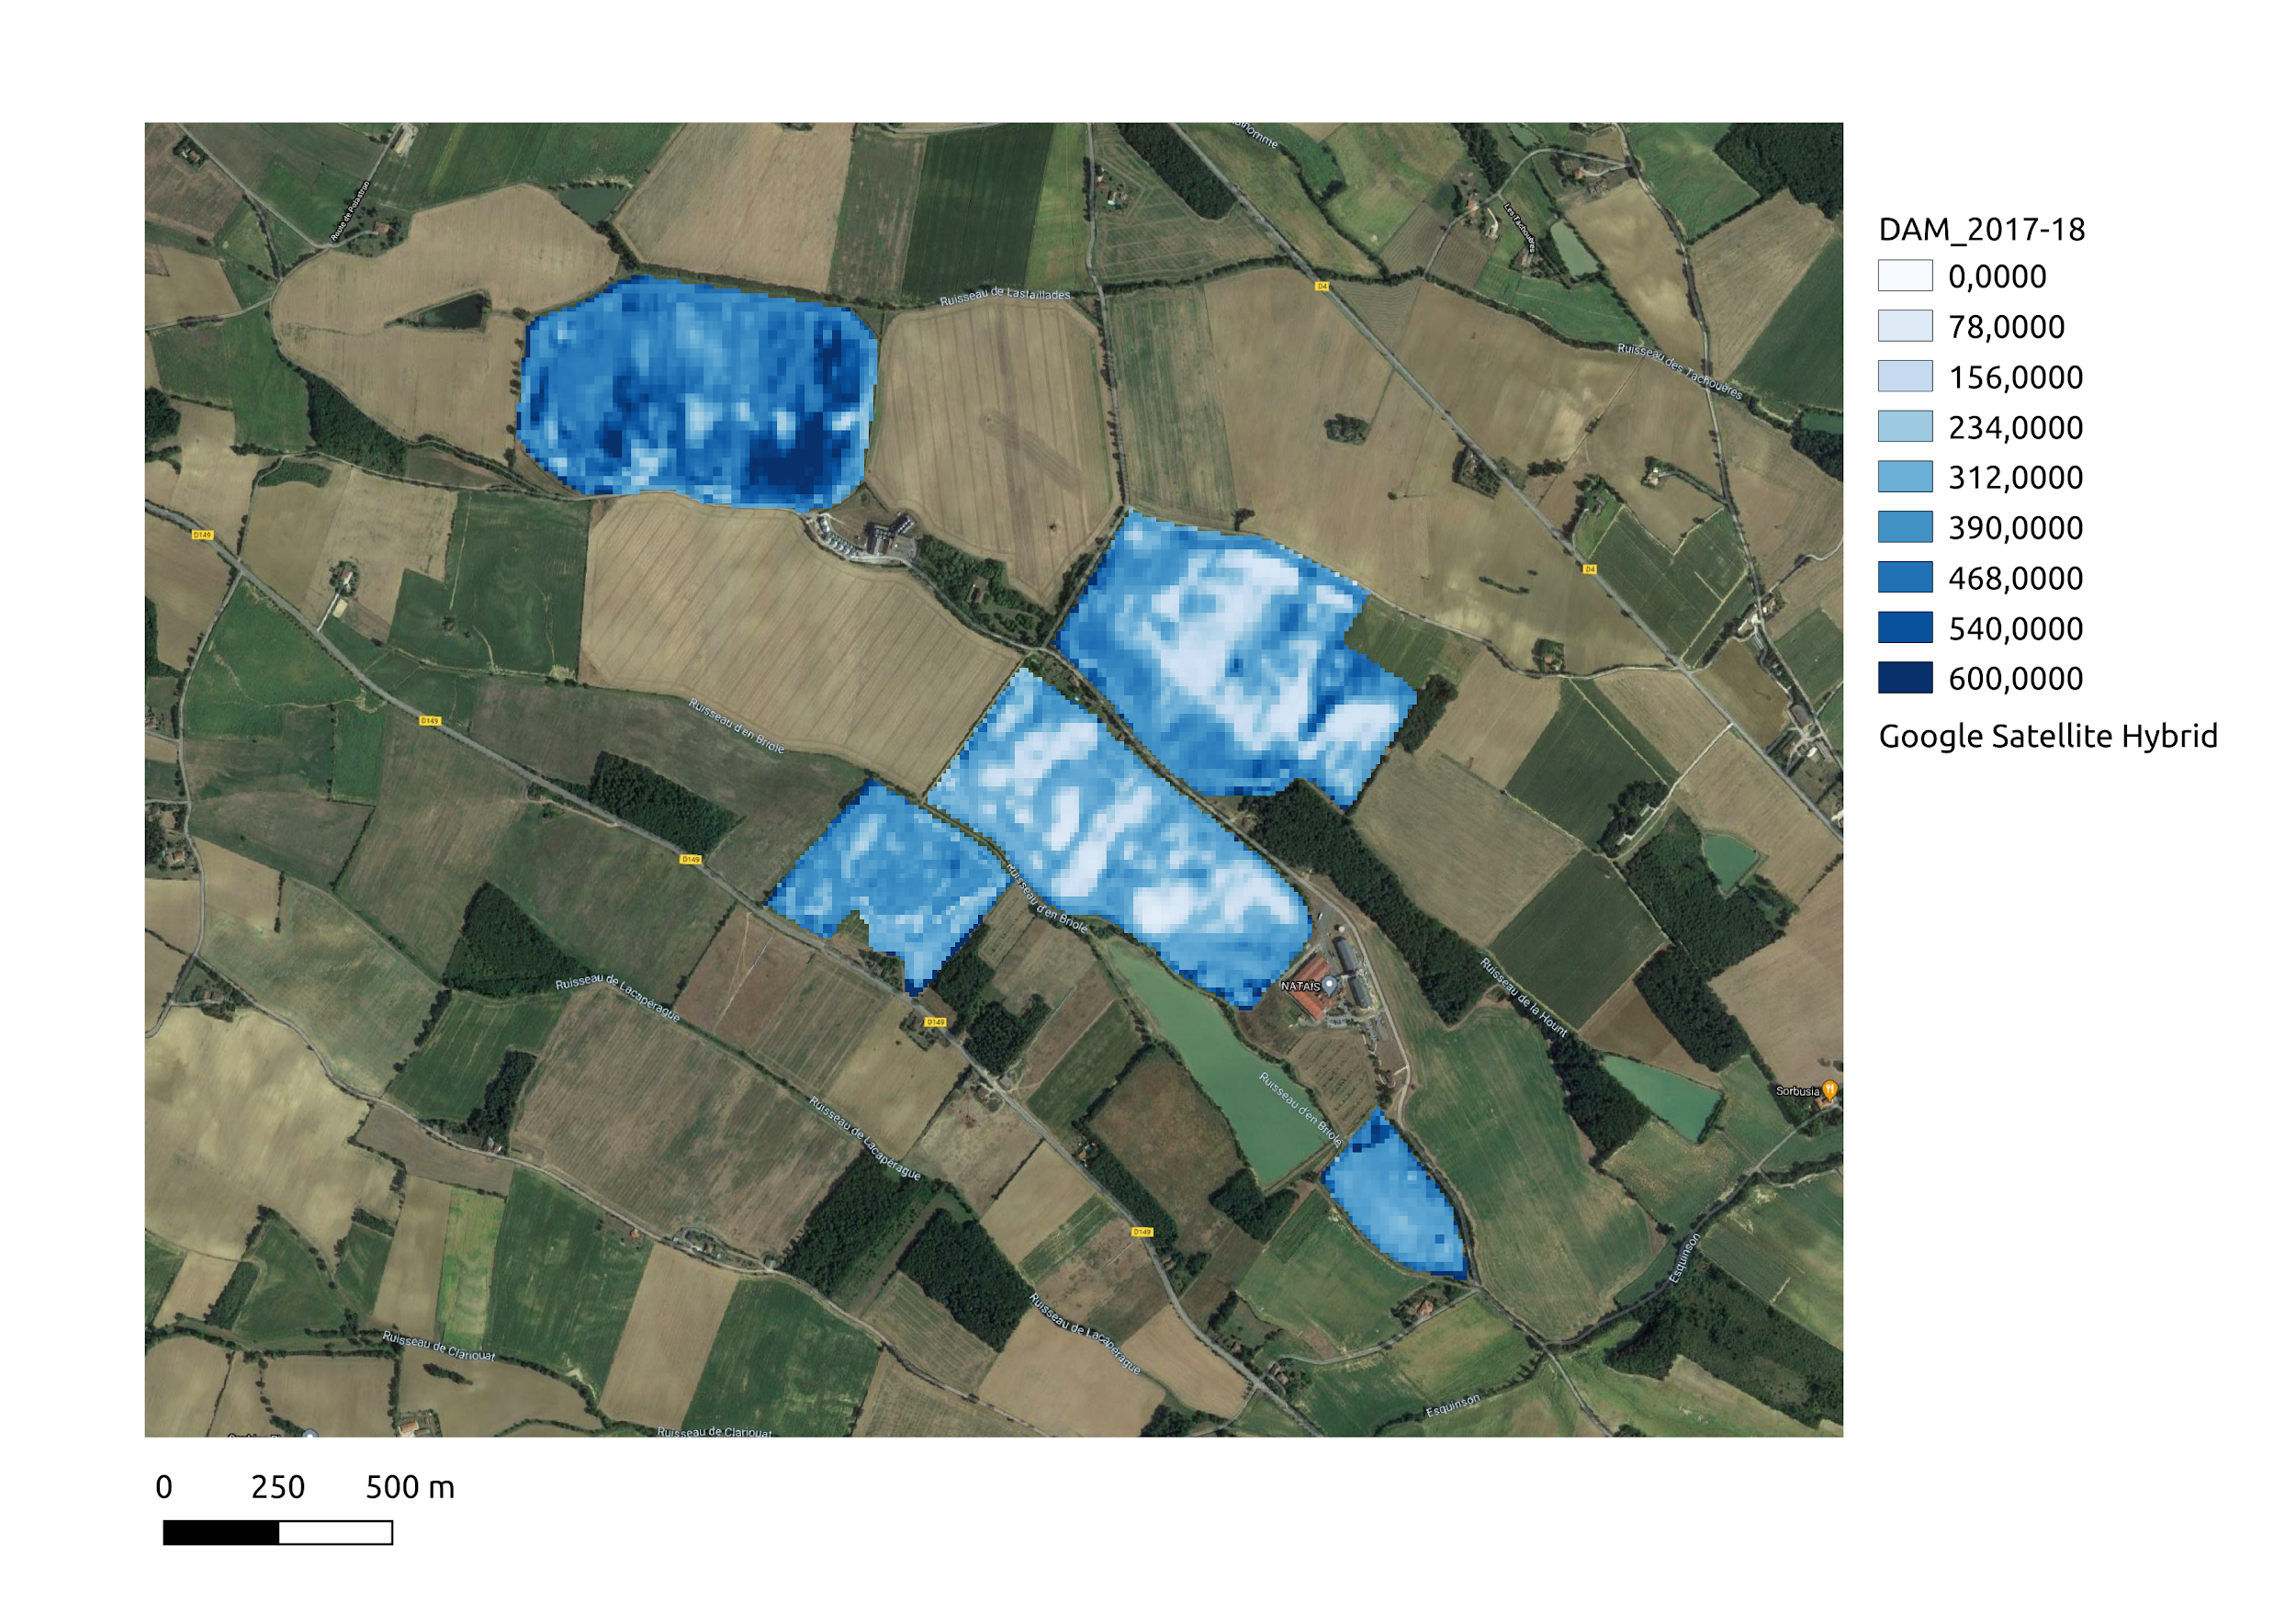
intra-plot spatial patterns:
A
B
gC/m2
Small scale application to retrieve cover crop biomass with its uncertainty.
Carbon budget with the agricarbon eo tool over several plots with a wheat /covercrop /corn rotation
[Session BG3.21] EGU21-15272 wijmert@cesbio.cnes.fr

Slide 4
Conclusions:
The model allows fit the LAI dynamics (wheat ,cover-crop and maise )
The produced variables are in credible ranges.
We can observe high spatial heterogeneity.
Perspectives :
validation with in situ measurements
large scale applications
Principal referances:
SAFYE-CO2:
Pique, Gaetan, et al. "Estimation of daily CO2 fluxes and of the components of the carbon budget for winter wheat by the assimilation of Sentinel 2-like remote sensing data into a crop model." Geoderma 376 (2020): 114428.
Prosail
Jacquemoud, Stéphane, et al. "PROSPECT+ SAIL models: A review of use for vegetation characterization." Remote sensing of environment 113 (2009): S56-S66.
Agicarbon EO chain:
Al Bitar, Ahmad, et al. Quantification of Yield, Water, and Carbon budget at intra-field scale using the AgriCarbon-EO tool. No. EGU21-15413. Copernicus Meetings, 2021.
article in preparation ….
[Session BG3.21] EGU21-15272 wijmert@cesbio.cnes.fr

