Slide 1



INRAE : Eric Ceschia, Christian Bockstaller, David Sheeren, Clélia Sirami,
IGN : Arthur Favreau, Dominique Laurent, Guillaume Marchand,
ASP : Ludovic Arnaud, Emmanuel De Laroche
Agri-environmental indicators for the CAP
Copernicus and the Common Agricultural Policy Workshop
10/03/2021
This project has received funding from the European Union’s Horizon 2020 research and innovation program under grant agreement No. 842009

Slide 2
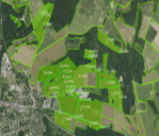
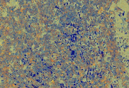
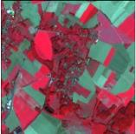
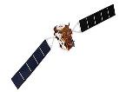
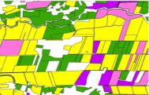
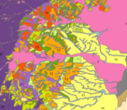
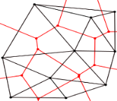


Objectives and principles
To propose annual indicators in order to measure the impact of agricultural practices on environment
  Based on published scientific methods & former EU projects (DiverImpact, Sensagri, Farmland)
  Based on Sentinel 1&2 satellite data and other data widely available in Europe (LPIS, climate, soil maps…)
IACS Data at
parcel level
Sentinel data
IACS data
LPIS + GSAA
Indicator modelling and calculation
Meteorological
and soil data
FMIS data
Farming practices

Slide 3
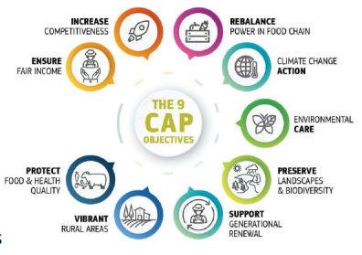
Selection of indicators to be processed
Discussion with key stakeholder (European Commission) based on a preliminary selection of 13 candidate indicators
Selection of 3 indicators
  Carbon storage => climatic change
  Nitrate Lixiviation => water quality
  Biodiversity
Indicators may be computed at various TIERs,
  TIER 1 : easily feasible, less accurate, operationnal
  TIER 2 : better result but requires farmer’s data
  TIER 3 : best results, less operational
Empirical approaches
Modelling approach

Slide 4
Carbon budgets indicators
Are calculated for each cropping year (at 10m/plot level), but can be summed over several years (crop rotation),
3 TIERS:
  TIER 1 (CO₂ fluxes) and TIER 2 (C budget) are based on empirical approaches and can be applied to most crops species except rice,
  TIER 3 is based on the SAFYE-CO2 crop model assimilating LAI derived from Sentinel 2 data ➔ allows other indicators to be calculated (biomass, yield, CO₂ fluxes, evap/transp…) but only for 4 crops species (wheat, sunflower, maize and rapeseed) + cover crops at this stage.
  A similar conceptual approach:
TIERs
2 & 3
  C budget = Net CO₂ flux – C harvested + Org. manure
TIER 1
Farmer’s data (FMIS)

Slide 5
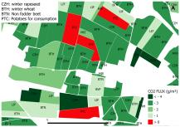
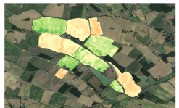

Carbon budgets indicators
Level of readyness
Tested in 4 MS
LPIS
Sentinel 2
Meteo. data
Soil map
Tested in France
API
To be developped
SEN4CAP (NDVI)
Image processor
AgriCarbon-EO
FMIS
(straw, orga. amendments)
NDVI
Prosail (Jacquemoud et al. 2009)
TIER1 calculator
LAI
SAFYE-CO2
(Pique et al.
2020 a&b)
Ceschia et al.
(2010)
API
FMIS Interface
Pixel scale C budget (gC.m⁻²)
TIER2
Calculator
Soil module
(e.g. RothC)
CO₂ fixation/emission
TIER 1 plot map (net CO₂ flux)
TIER 2 plot map (C budget)
TIER 3 pixel map (C budget)

Slide 6
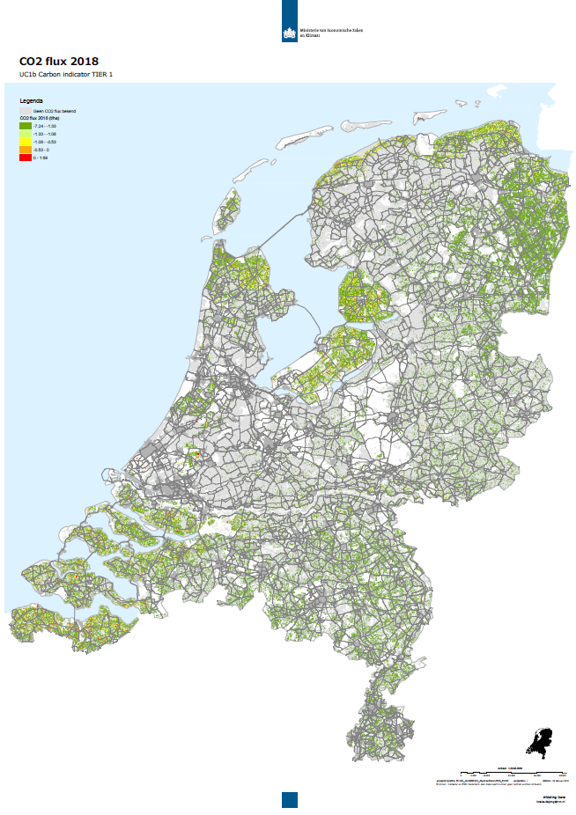
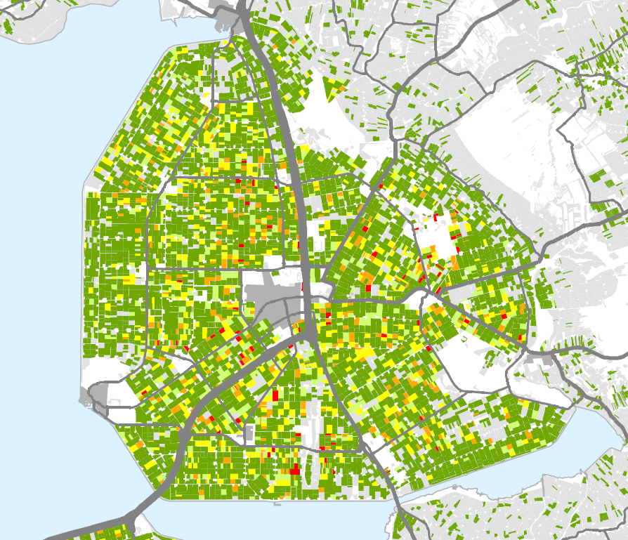


Carbon Tier 1 : Testing results
Net annual CO₂ fluxes of croplands in Netherlands (2018)
Annual CO₂ fixation
Annual CO₂ losses
Notes:
Testing day : enregistrement de 1h 29 min 40s à 1h 31min 17s (donc environ 1 min 40 s)
Garder cette diapo ou la précédente.

Slide 7
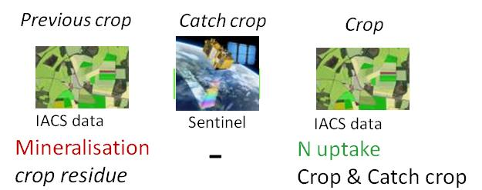
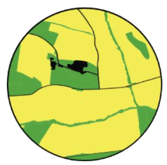
Progress concerning the other indicators
Risk of Nitrate leaching (to be coded soon in AgriCarbon-EO) ➔ plot scale
TIER1 :
- TIER2 : same as TIER1 + climatic data + catch crop type (FMIS)
Biodiversity indicator (to be tested soon in France) ➔ Landscape
TIER 1: proportion of SNH
TIER 2: proportion + type of SNH
    TIER3:
    Same as TIER 2 + data on pesticides intensity (FMIS)
AEI
Crops
Artificial surfaces
Woods, hedges, grassland, ponds
Crops
Artificial surfaces
7

Slide 8
Conclusions
3 indicators (Carbon, Nitrate and Biodiversity) adressing 3 categories of environmental issues/ecosystem services calculated at pixel plot/landscape levels (related to ➔ impact indicator I11, I15, I 16, I19),
They are based on Sen4Cap standards & developped in open source,
TIER 1 could easily be implemented everywhere thanks to the IACS data + the Sentinel data. Operationnal tool ➔ core service at short term,
TIER 2 still under development & requires access to the FMIS ➔ calculated at the state level ? ➔ will depend on the objectives/efforts of the MS,
TIER 3 (model) offers higher levels of accuracy, more indicators (yield, ETR) but needs additional data (FMIS, pedoclimatic data) ➔ still requires some research (parametrise new crops, analyse transposability…),
In the future, AgriCarbon-EO could be used as a generic toolbox to calculate C & N indicators from TIER 1 to 3 in a nested approach.

Slide 9











THANKS for Your attention !
This project has received funding from the european union’s horizon 2020 research and innovation programme under grant agreement no. 842009

Slide 10

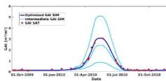










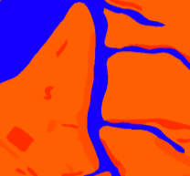


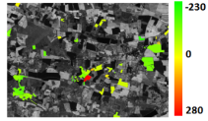
Carbon budgets indicators
TIER 3, modelling approach: SAFYE-CO2
Input
m² leaves/m² soil
Sentinel 2
Calibration of phenological & photosynthetic efficiency parameters
Crop map
(LPIS)
SAFYE-CO₂
Pique et al.
(2020 a and b)
Leaf Area Index
Crop param
P, Rg, T°
Validation
Climatic data (e.g., ERA-5)
Texture
Biomass,
Yield,
Yield
Soil maps
(e.g. SoilGrids)
CO₂ & H₂O fluxes
Flux stations networks
Straw export?
Organic Fertil ?
Irrigation ?
FMIS
C & water budgets
T C/ha
+ uncertainty maps

Slide 11
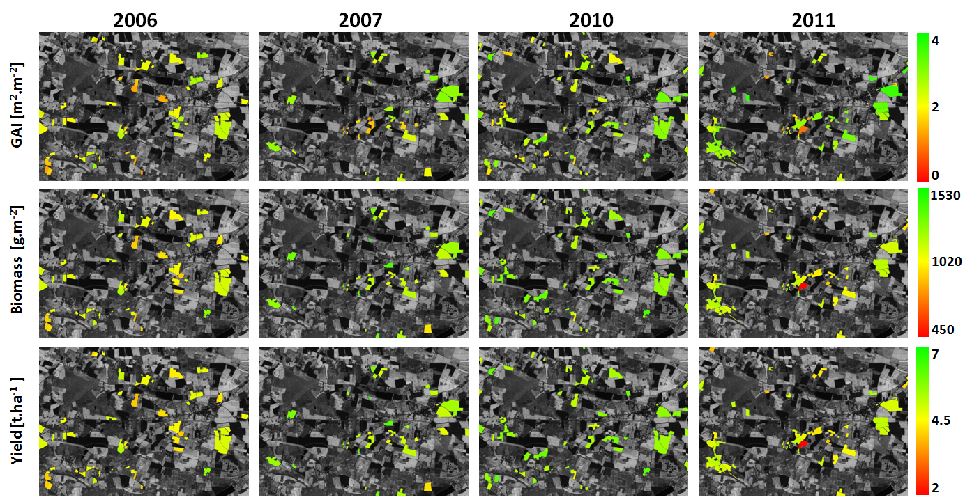
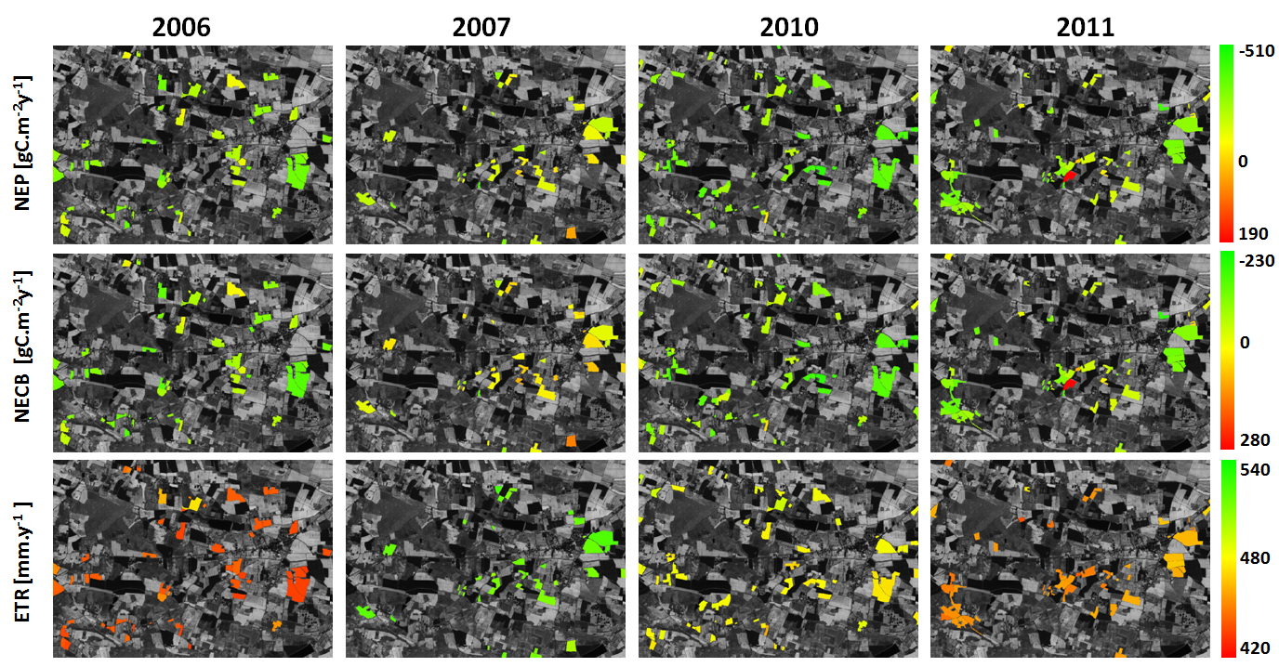
SAFYE-CO2 simulations
Winter wheat (Veloso, 2014)
CO₂

Slide 12
Impact indicators
I.11 Enhancing carbon sequestration: Increase the soil organic carbon
I.15 Improving water quality: Gross nutrient balance on agricultural land
I.16 Reducing nutrient leakage: Nitrate in ground water - Percentage of ground water stations with N concentration over 50 mg/l as per the Nitrate directive
I.19 Enhanced biodiversity protection: Percentage of species and habitats of Community interest related to agriculture with stable or increasing trends

