Slide 1
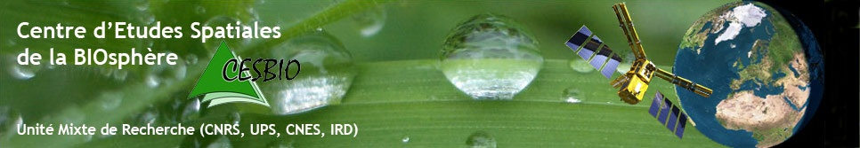

The NIVA project and how to link NIVA with the models and tools recommended in the Label Bas Carbone
Univ. Toulouse III, CNRS, CNES, IRD, INRAE
Eric Ceschia, INRAE Senior scientist
G. Pique, T. Wijmer, L. Arnaud, A. Al Bitar, R. Fieuzal from CESBIO,
E. De La Roche from ASP,
G. Marchand, D. Laurent from IGN
June 2nd , 2021
SCARF Webinar | Carbon labelling : lessons learned from the French label (Label Bas Carbone)

Slide 2

Context: indicators for the NIVA project
Discussion with key stakeholder (European Commission) based on a preliminary selection of 13 candidate indicators
Priority : 3 indicators for the CAP
  Carbon storage => climatic change
  Nitrate Lixiviation => water quality
  Biodiversity
Indicators may be computed at various TIERs,
  TIER 1 : easily feasible but less accurate
  TIER 2 : better result but more difficulties to get
  TIER 3 : best results, less operational
Empirical approaches
Modelling approach

Slide 3
C budget : what are we talking about ?
It represent a change in soil organic carbon stocks between two dates (yearly, crop rotation, decades),
How to assess it:
  Soil sampling ? ➔ very time consuming, very expensive or inaccurate (10000 samples/plot to detect a few % change in Corg in 3 years),
  Soil modelling oriented approaches (AMG, RothC, DayCent…) require many input data : management, accurate measurement of the biomass returned to the soil and accurate/recent soil analysis ➔ time consuming, expensive,
  In/out carbon fluxes approaches with a focus on biomass
  Production/restitution to the soil (crop modelling driven by
  remote sensing observations ➔ SAFYE-CO2 model)
  Cropland Carbon budget is mainly driven by the biomass
  returned to the soil (Moureaux et al. 2008…) !!!

Slide 4
Carbon budgets indicators : principle
Are calculated for each cropping year (at 10m/plot level), but can be summed over several years (crop rotation),
3 TIERS (Bockstaller et al, 2021):
  TIER 1 (CO₂ fluxes) and TIER 2 (C budget) are based on empirical approaches and can be applied to most crops species except rice,
  TIER 3 is based on the SAFYE-CO2 crop model assimilating LAI derived from Sentinel 2 data ➔ allows other indicators to be calculated (biomass, yield, CO₂ fluxes, evap/transp…) but only for 4 crops species (wheat, sunflower, maize and rapeseed) + cover crops at this stage.
  A similar conceptual approach:
TIERs
2 & 3
  C budget = Net CO₂ flux – C harvested + Org. manure
TIER 1
Farmer’s data (FMIS)

Slide 5
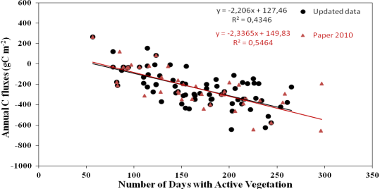
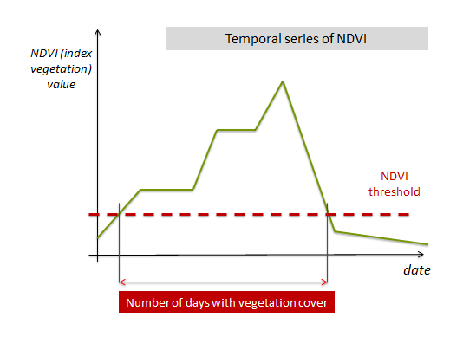
Carbon indicator Tier 1 : principle
Objective: estimate empirically the net annual CO₂ flux at parcel level
  The net annual CO₂ flux is related to number of days of vegetation
  Method valid only on arable land for 13 family crops
CO₂
release
Based on Ceschia et al. (2010)
Araya et al. (2017)
Net annual CO₂ flux
gC-CO₂/m²/yr
CO₂
fixation
  Simple relation between number of days with active vegetation and CO₂ flux : validated on additionnal/recent data
Apply threshold on NDVI profile to get number of days with active vegetation
5
Notes:
A CO2 flux corresponding to carbon storage has a negative sign according to GIEC conventions as it is withdrawing carbon from atmosphere.

Slide 6

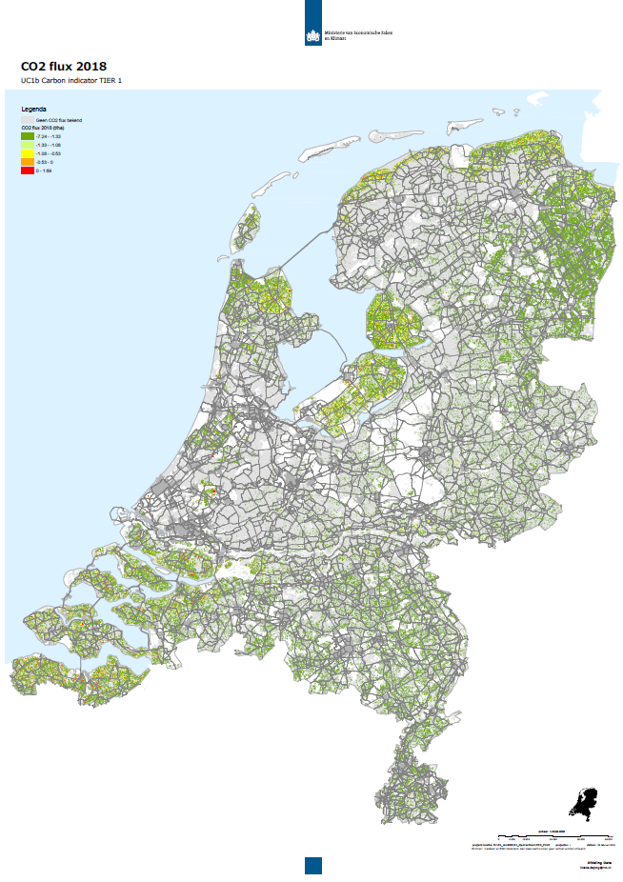
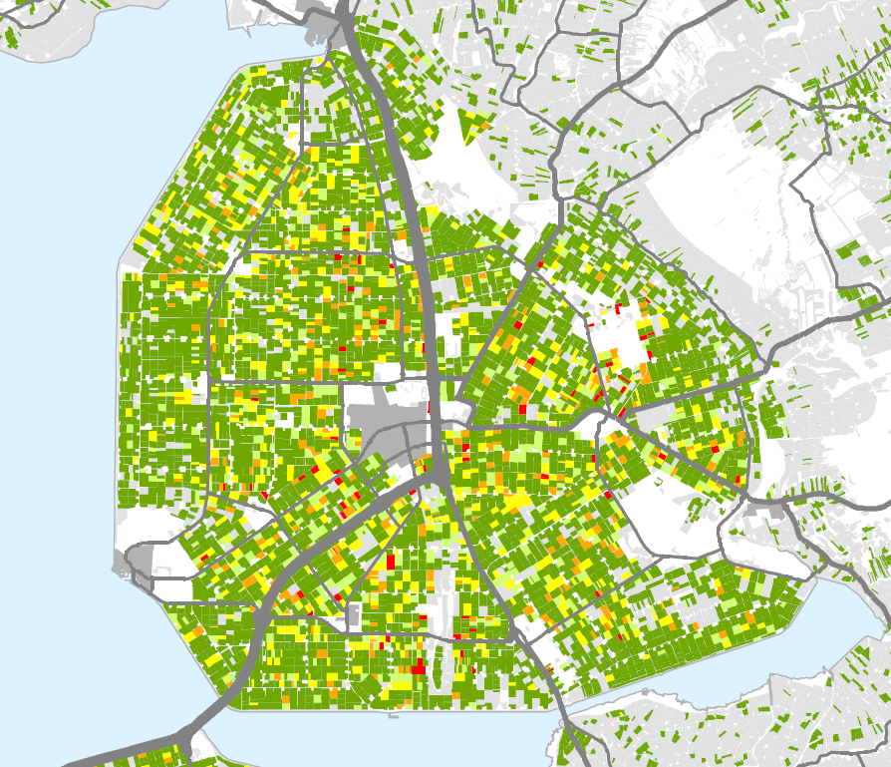


Carbon Tier 1 : Testing results
Net annual CO₂ fluxes of croplands in Netherlands (2018)
Annual CO₂ fixation
Annual CO₂ losses
Similar map will produced for France in summer 2021
Notes:
Testing day : enregistrement de 1h 29 min 40s à 1h 31min 17s (donc environ 1 min 40 s)
Garder cette diapo ou la précédente.

Slide 7
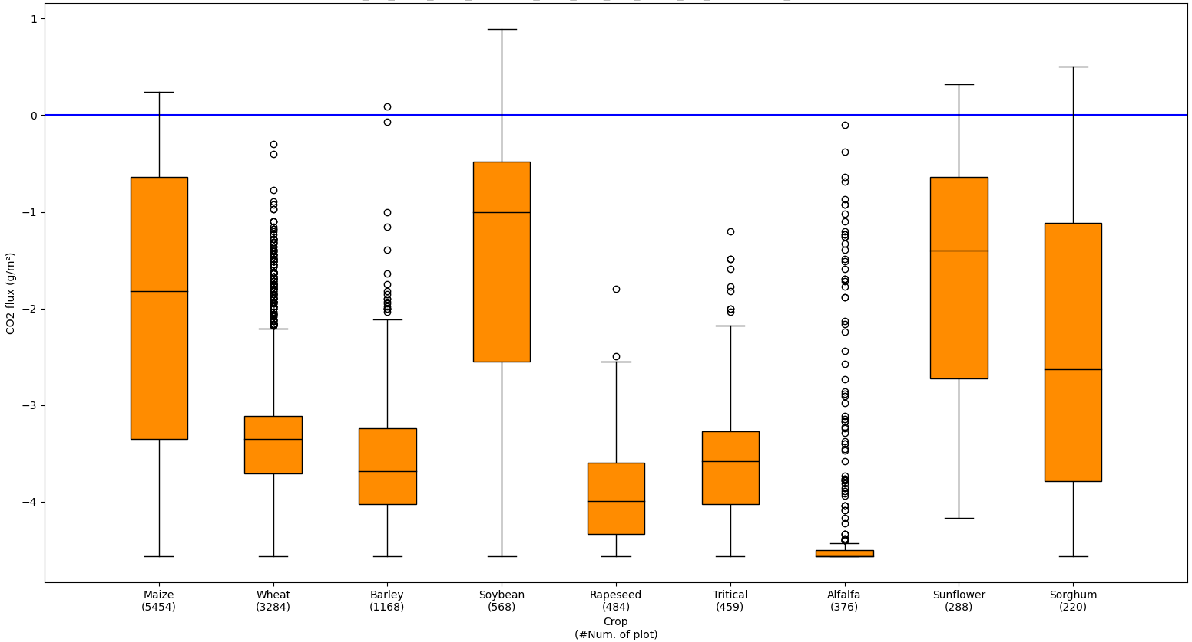
Tier 1 : Ain Department test results
Cooler climate compared to Spain ➔ longer vegetation cycles ➔ more CO₂ absorbed
More CO₂ absorption in Ain Compared to Spain (fluxes are more negative)
Winter crops (long veget. cycles) are fixing more CO₂ than summer crops (as expected)
Notes:
Testing day : enregistrement de 1h 27min 50 s à 1h 29 min 40s (donc environ 1 min 50)
Il faut garder soit cette diapo, soit la suivante.
A mon avis, la suivante est un peu plus courte et un peu plus facile à comprendre (et a donc ma préférence) mais c’est à discuter.

Slide 8
Carbon indicator Tier 2 : principle
Empirical approaches: plot level/annual
  C budget = Net CO₂ flux + C harvested – Org. fertil.
TIER 1
TIER 2
Farmer’s data (FMIS)
CO₂
release
What do we need to know from the farmers ?
C harvested:
  - yield (grain t/ha)
  - eventually the amount of straw/cover crop exported (t/ha),
  Are organic amendments applied ? If yes:
  - type of amendment,
  - amount (t/ha).
Net annual CO₂ flux
gC-CO₂/m²/yr
CO₂
fixation
Based on Ceschia et al. (2010)

Slide 9

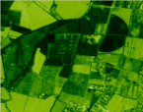
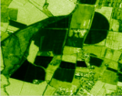

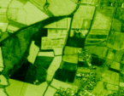
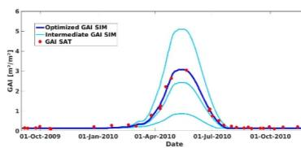

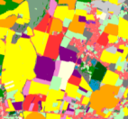
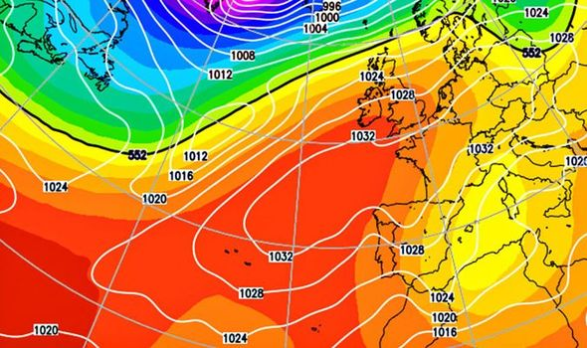




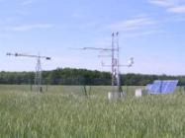

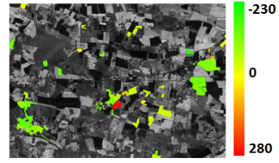

Carbon indicator Tier 3 : principle
TIER 3, modelling approach: SAFY-CO2
m² leaves/m² soil
Sentinel 2
Calibration of phenological & photosynthetic efficiency parameters
SAFYE-CO₂
Pique et al.
(2020 a, b, c)
Crop maps
Crop param
Leaf Area Index
Rg,T°C, P
Validation with farmers & regional stat. for yield
Soil & climatic data (e.g., ERA-5)
Biomass,
Yield,
Yield
International flux stations networks
CO₂ fluxes, ETR
C budgets
T C/ha
FMIS
Straw export?
Organic Fertil ?

Slide 10
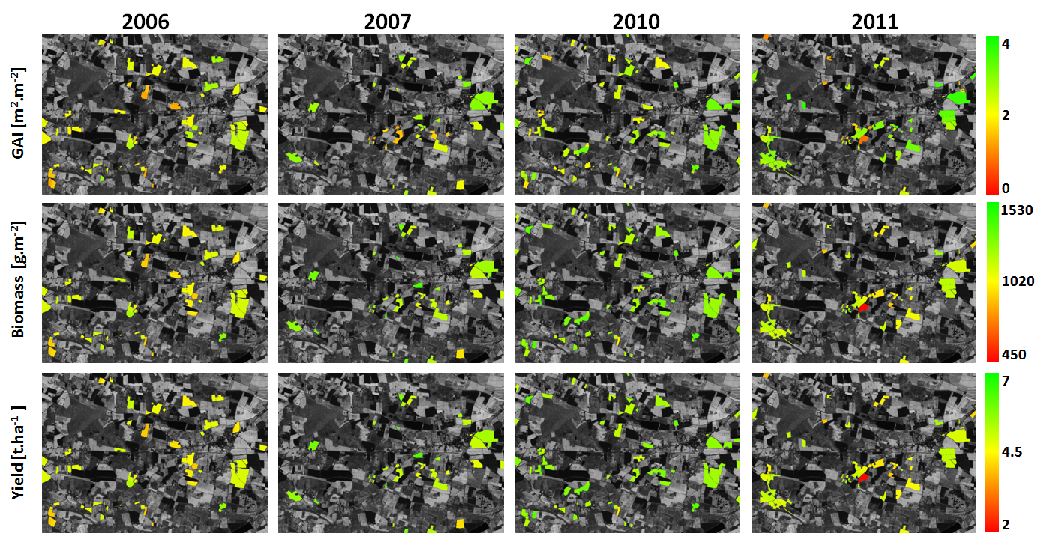
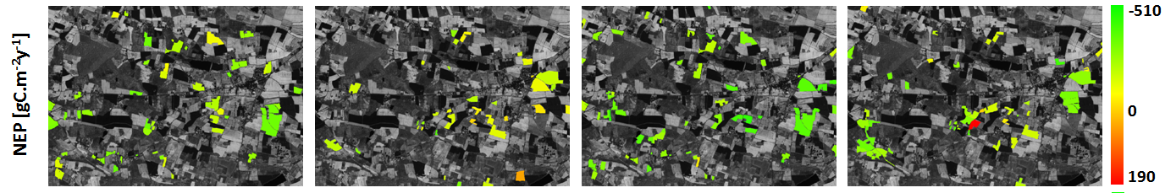
SAFYE-CO2 simulations
Winter wheat (Veloso, 2014)
CO₂
Monitoring of cover crop heterogeneous development based on Sentinel 2 satellite data
(vegetation appears in red)

Slide 11
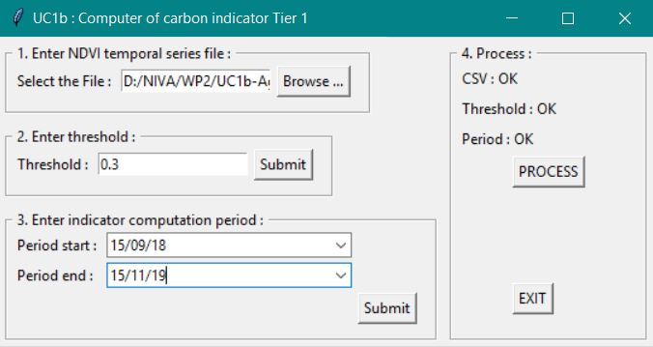
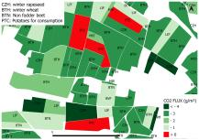
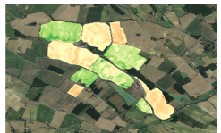

Carbon budgets tools
Level of readyness
Tested in 4 MS
LPIS
Sentinel 2
Meteo. data
Soil map
Tested in France
To be developped
SEN4CAP (NDVI)
Image processor
AgriCarbon-EO
FMIS
(straw, orga. amendments)
NDVI
Prosail (Jacquemoud et al. 2009)
Net annual CO₂ flux
gC-CO₂/m²/yr
SAFYE-CO2
(Pique et al.
2020 a&b)
TIER1 calculator
LAI
Ceschia et al.
(2010) updated
API
FMIS Interface
Pixel scale C budget (gC.m⁻²)
TIER2
Calculator
Soil module
(e.g. AMG)
CO₂ fixation/emission
+ uncertainties
TIER 1 plot map (net CO₂ flux)
TIER 2 plot map (C budget)
TIER 3 pixel map (C budget)

Slide 12
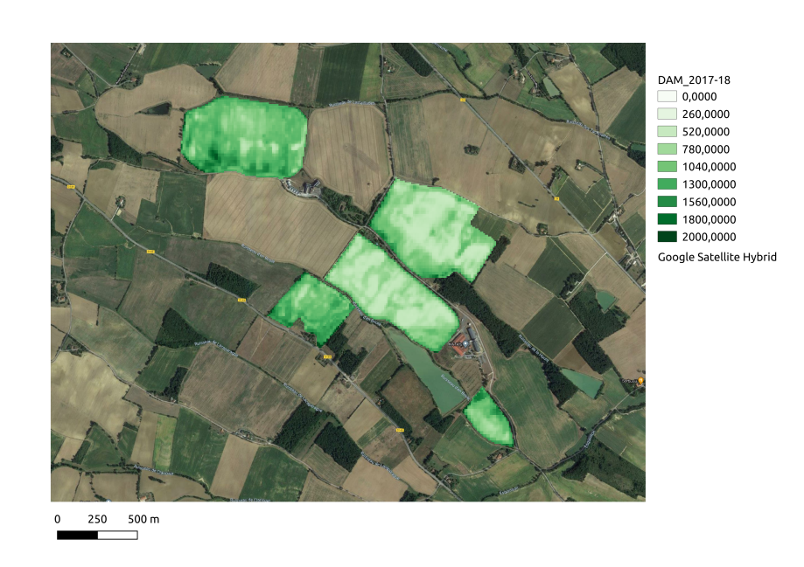
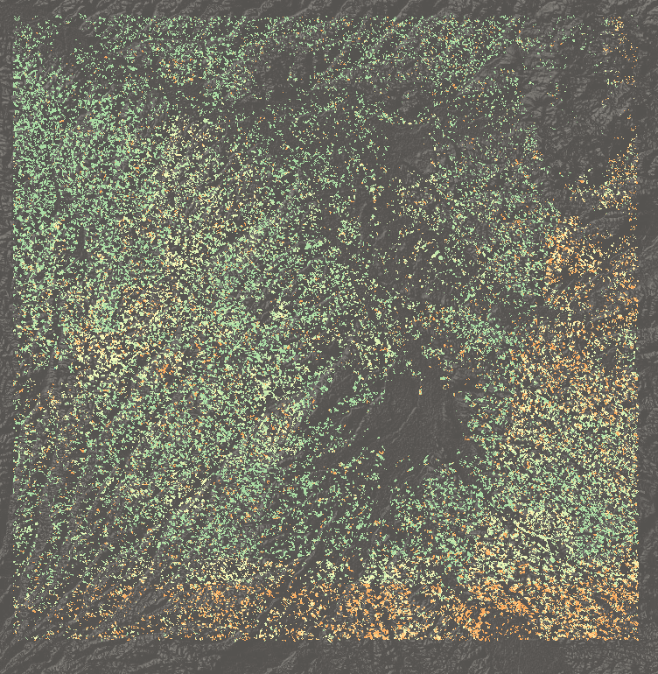
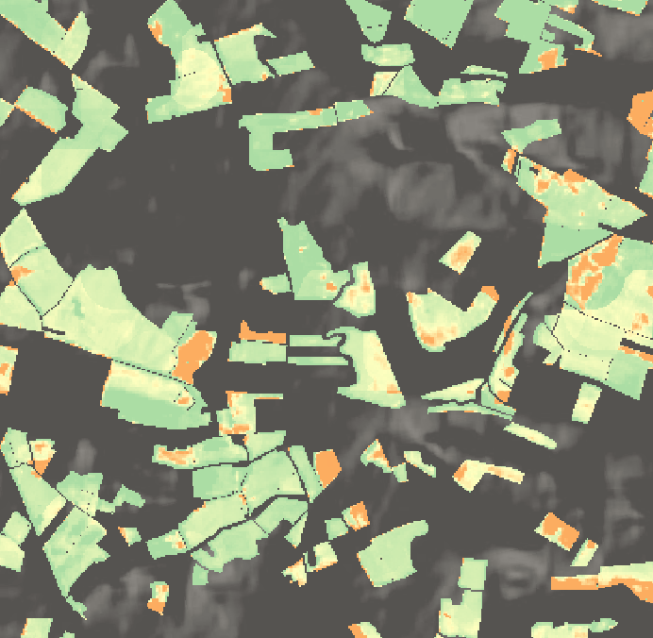
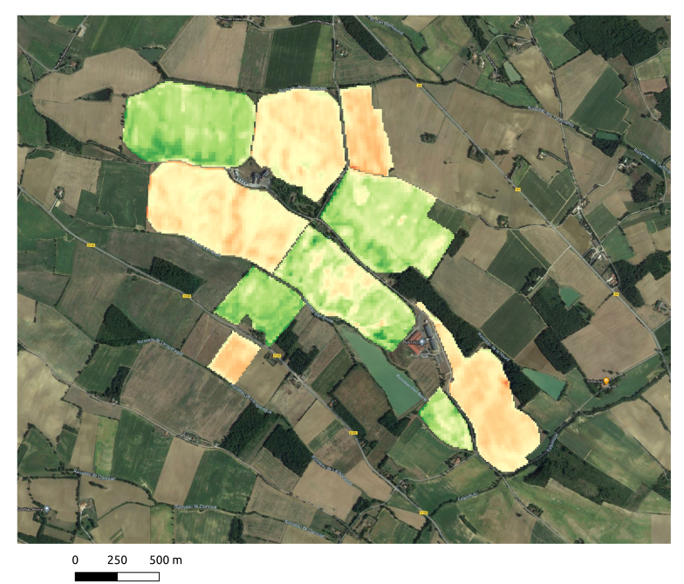

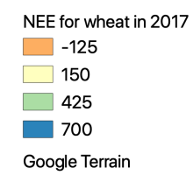
Tier 3 : application over a Sentinel 2 tile
AgriCarbon-EO currently tested in France,
Net annual CO₂ fluxes for straw cereals in South West France
Cover crop biomass ➔ C storage
High Resolution C budget maps for cover crop/maize/wheat crop rotations
R.O.I
Whole Tile (31TCJ)
Method compliant with Verra’s Certified Carbon Standard VCM0042.

Slide 13
Conclusions
3 Carbon indicators at pixel/plot scale based on HR EO data for agri-environmental monitoring and for the C market/Low Carbon Label in agriculture (huge demand) ; TIER2 & 3 require farmer’s data (accessibility, consent…),
They are compliant with the CAP monitoring approach base on EO data and are developed in open source,
TIER 1 could easily be implemented everywhere thanks to the IACS data + the Sentinel data. Operational tool ➔ core service at short term ?
TIER 2 still under development & requires access to the FMIS ➔ calculated at the state level ? ➔ will depend on the objectives/efforts of the European MS,
TIER 3 (model) offers higher levels of accuracy, more indicators (yield, ETR) but also needs additional data (FMIS, pedoclimatic data) ➔ still requires some research (parametrise new crops, analyse transposability…),
In the future, AgriCarbon-EO could be used in combination with farm level GHGbudget tools (e.g. SIMEOS-AMG) for more accurate C budgets estimates.

Slide 14


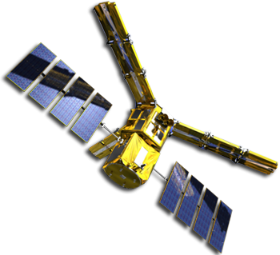









Thanks for your attention

