Slide 1
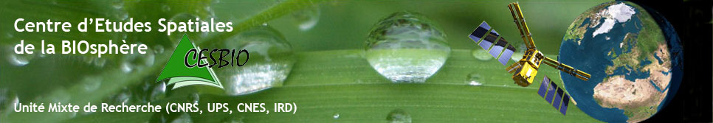
CNRS, CNES, INRAE, IRD, Univ. Toulouse III
C budget indicators based on remote sensing & crop modelling
ECO innovations from biomass congress
17th and 18th March 2022, Papenburg
Session A: Climate saving agriculture | 15:30 to 17:20
Eric Ceschia (INRAE)
Gaétan Pique, Taeken Wijmer, Rémy Fieuzal, Ahmad Albitar, Ludovic Arnaud

Slide 2
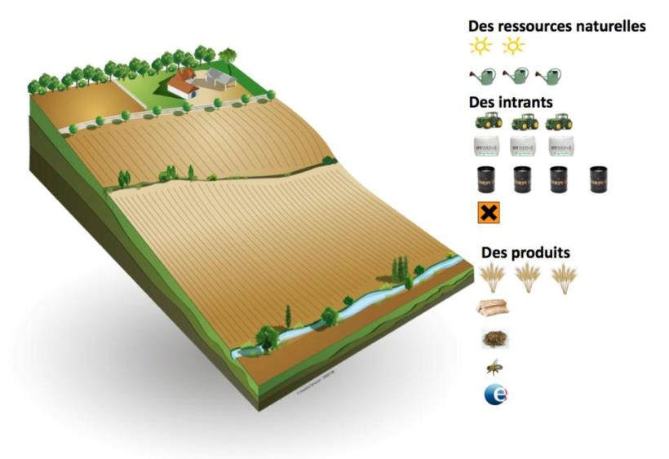
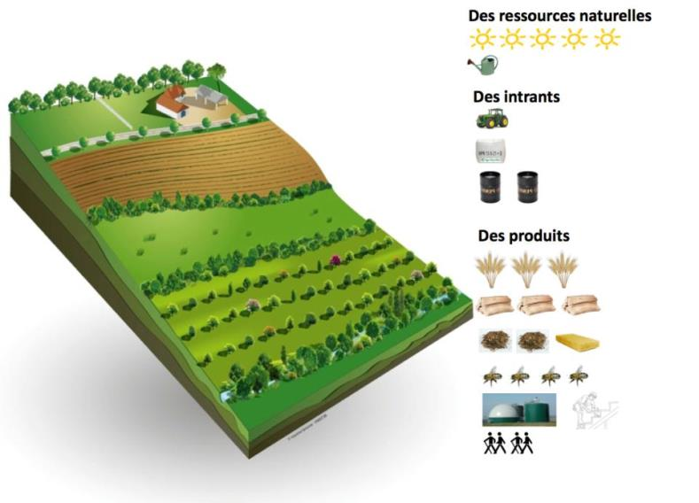
Context/Societal challenges
  Questioning of the durability of conventional agriculture ➔ food security, resilience, climatic & other environmental impacts)
Agro-ecological practices
No till
Cover crops
Agroforestery
Illustrations: Arbre et Paysage 32
C storage
➔ 4p1000 initiative
  Lack of large scale tools to quantify cropland C budgets and its components (e.g. biomass, CO₂ fluxes) at plot level and to analyse the effect of management practices on C budgets
Development of a range of tools and approaches adapted to different context (CAP, C market) combining crop modelling and high resolution remote sensing ➔ e.g. H2020 NIVA & Soil Carbon Farming projects
ECO innovations from biomass congress 17th and 18th March 2022

Slide 3
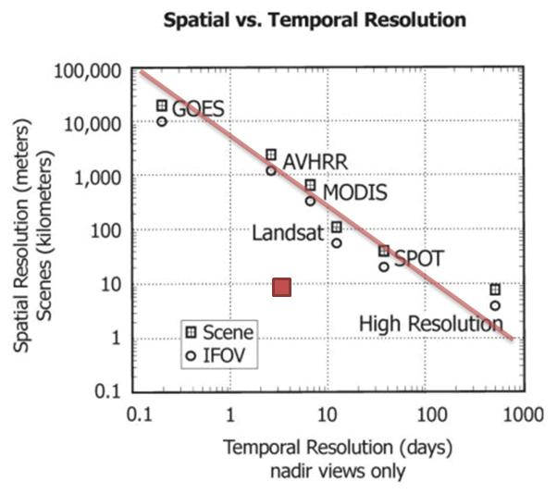
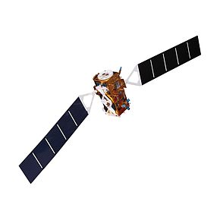
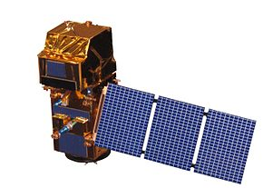

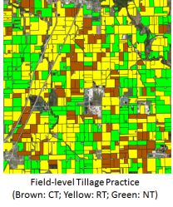
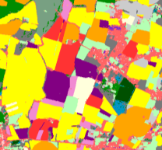
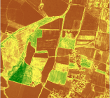
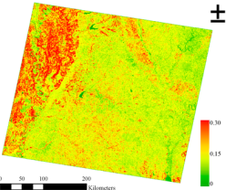
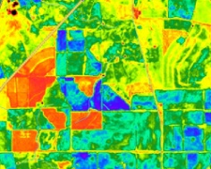
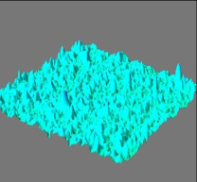
Why is it possible now ?
A
Revolution !!!
(free all over
the globe)
Sentinel 1
(10 m, 6j, Radar)
Sentinel 2
(10 m, 5j, Optical)
Sentinel
Clear or cloudy sky conditions
Rugosity & surface water content
Monitored
parameters
Clear sky conditions
Reflectances (13 bands)
40%
Dynamic mapping
Soil water content
2%
Biomass
Soil work
Land cover
LAI/
phenology
Albedo
!! Monitoring of superficial Soil Organic C content do not provide information on SOC stock changes !!
Analysis of ecosystem services
How to use those data to answer scientific and societal challenges related to agriculture ?
Notes:
A la différence des anciennes missions spatiales…les nouveaux satellites S1&2 lancés en 2015 n’obligent pas à faire un compromis entre résol spatiale et temporelle

Slide 4

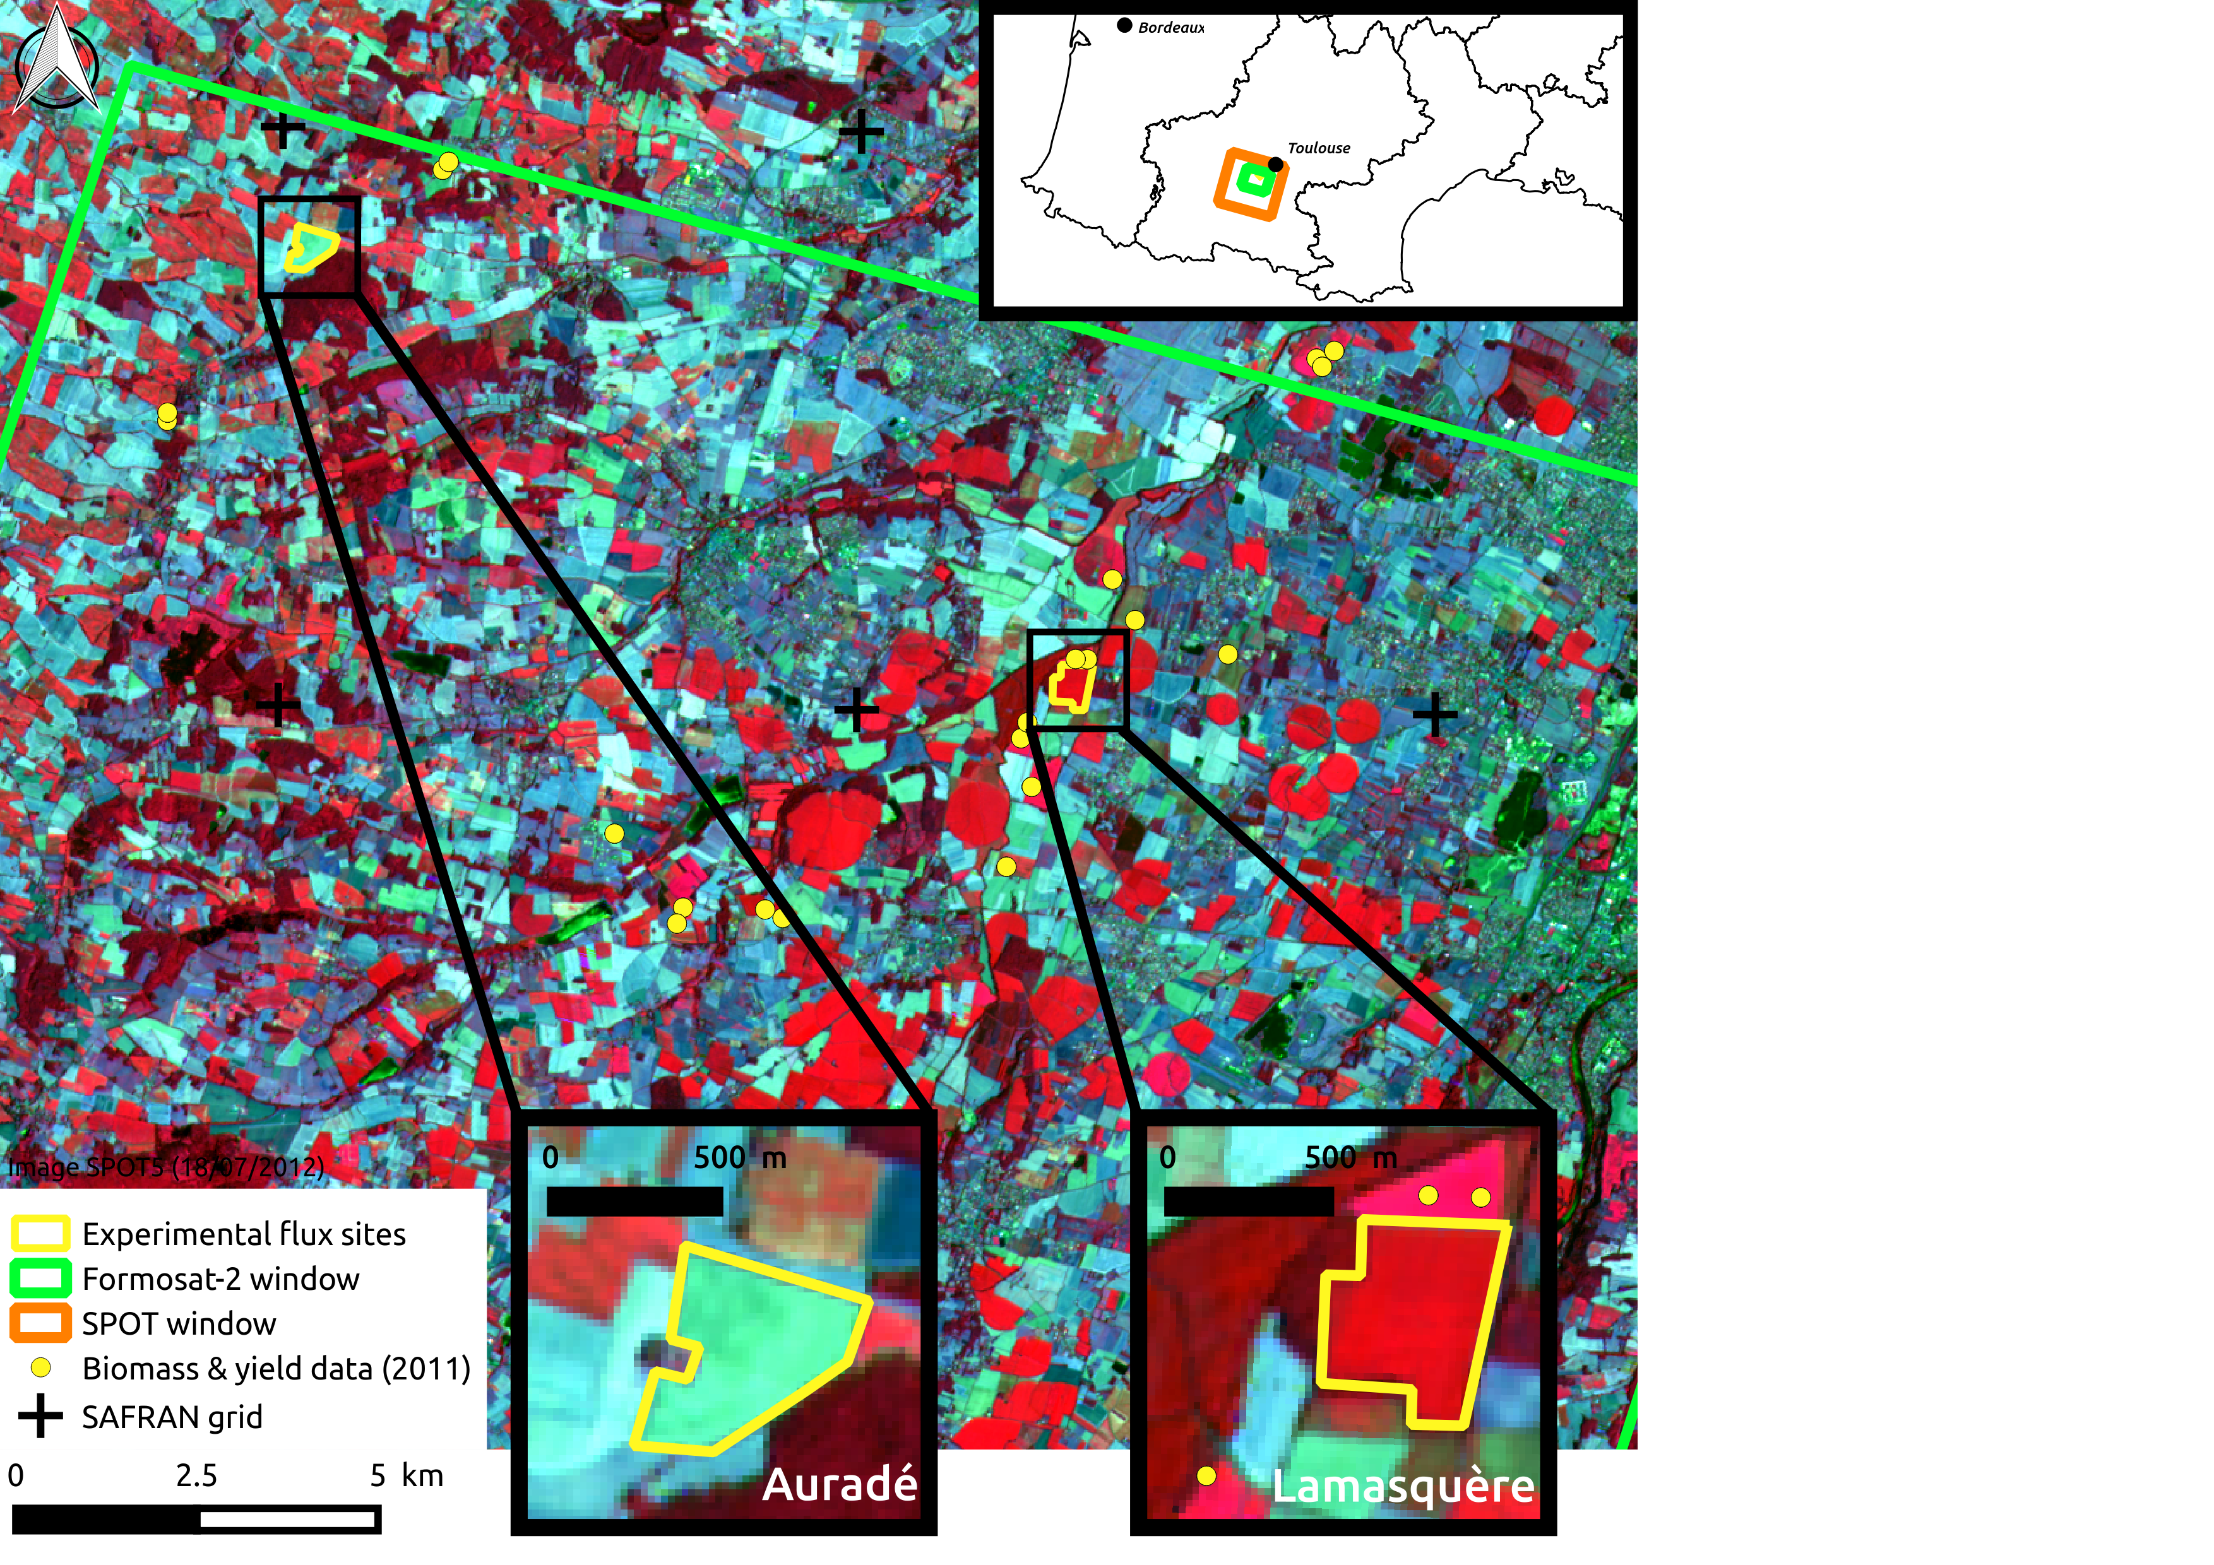
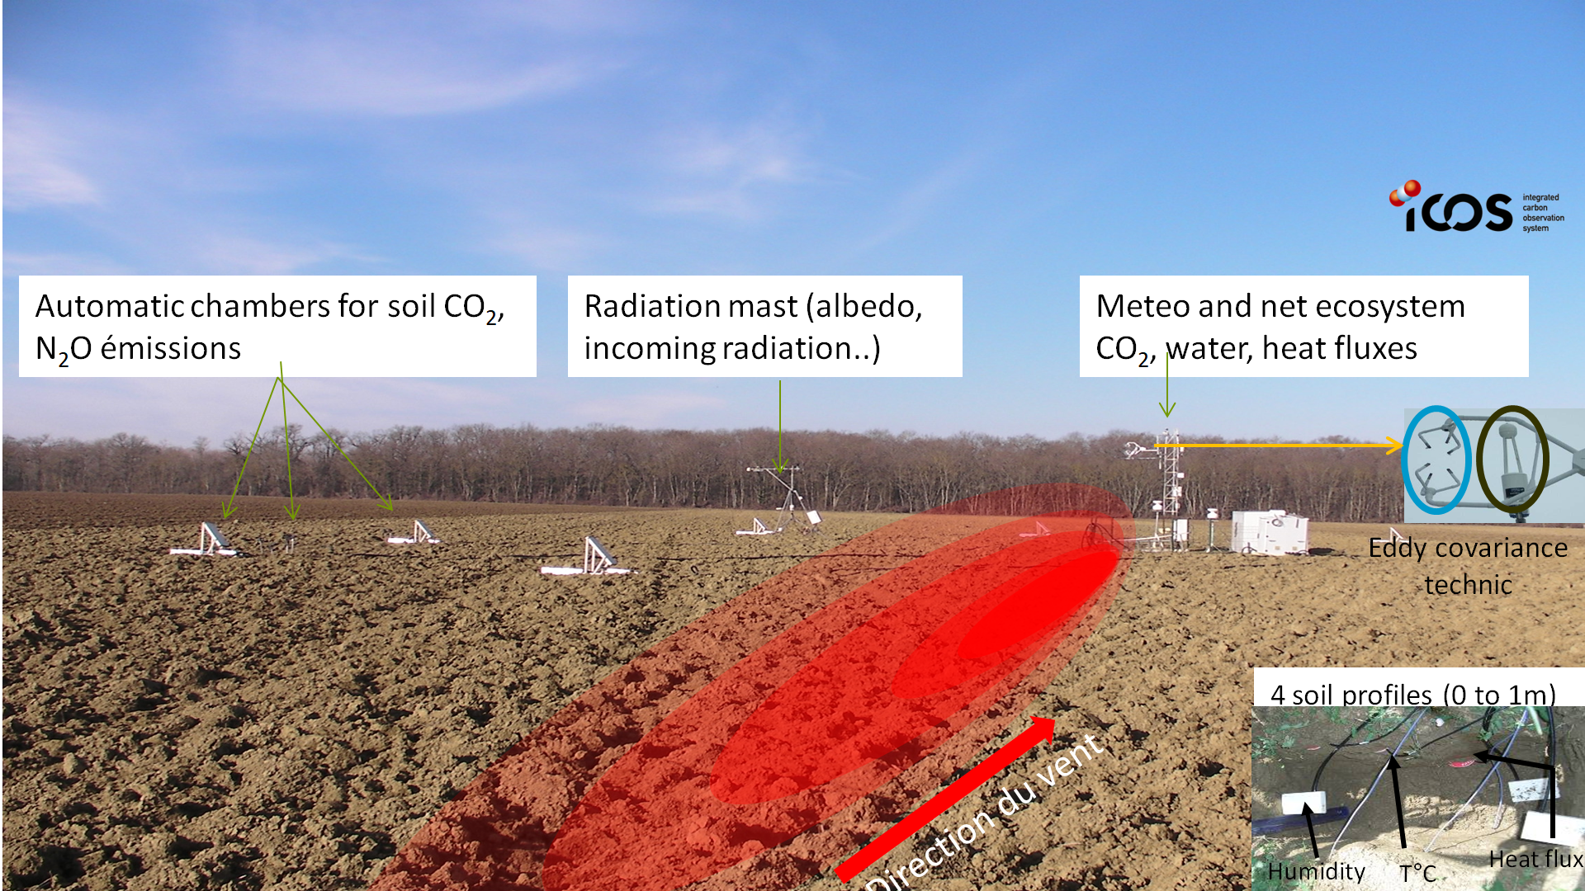
The Spatial Regional Observatory (SRO)
Sentinel 1&2
Monthly to weekly high resolution satellite observations since 2002 similar to current Sentinel images
Part of JECAM & ICOS international scientific networks
Yearly intensive field campaigns (Biomass, yield, vegetation index, soil properties)
Two plots with continuous CO₂ & H₂O flux measurements since 2005
ECO innovations from biomass congress 17th and 18th March 2022
4
Notes:
SUd-ouest / OSR: Étude de l’impact des pratiques agricoles sur les échanges et les bilans d’eau et de carbone

Slide 5

NIVA’s project methodology
Collab. IGN & ASP (task leader UC1b)
Discussion with key stakeholder (European Commission) based on a preliminary selection of 13 candidate indicators
Selection of 3 indicators
  Carbon budget => climatic change
  Nitrate Lixiviation => water quality
  Biodiversity
Indicators may be computed at various TIERs (i.e. levels of complexity),
  TIER 1 : easily feasible, less accurate, operationnal
  TIER 2 : better result but requires farmer’s data
  TIER 3 : best results, less operational
Empirical approaches
Modelling approach
ECO innovations from biomass congress 17th and 18th March 2022

Slide 6
Carbon budgets indicators
  A similar conceptual approach: Carbon balance
Indicators are calculated for each cropping year (at 10m/plot level), but can be summed over several years (crop rotation),
Methodology:
  Calculations of TIER 1 (CO₂ fluxes) and TIER 2 (C budget) are based on empirical approaches and can be applied to most crops species except rice,
  TIER 3 is based on the SAFYE-CO2 crop model calibrated by the vegetation indices (LAI) derived from satellite observations (Sentinel 2) ➔ allows other indicators to be calculated (biomass, yield, CO₂ fluxes, evap/transp…), but at this stage it is only parametrised for 4 crop types species (straw cereals, sunflower, maize and rapeseed) + cover crops.
TIERs
2 & 3
  C budget = Net CO₂ flux – C harvested + Org. manure
TIER 1
Farmer’s data (FMIS)

Slide 7
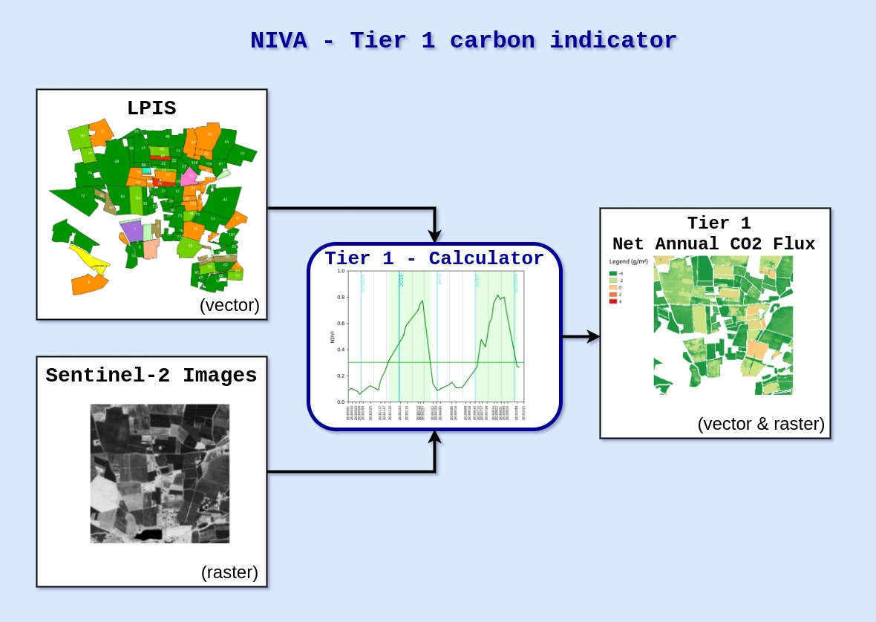
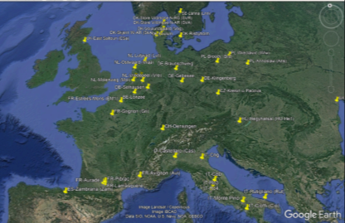
Carbon indicator Tier 1 : principle
IACS (LPIS + GSAA)
Empirical approach ➔ most crop species except rice
Open source code https://gitlab.com/nivaeu/uc1b_indicators_tool
Days with active vegetation
Based on Ceschia et al. (2010)
Net annual CO₂ flux
Vegetation soil coverage (days)
Cropland sites flux tower
Net annual CO₂ flux depends on the total number of days with active vegetation covering the soil

Slide 8



Carbon Tier 1 : National scale 10m resolution
NIVA’S algorithm + Iota2 software
With the support of
Associated uncertainty map coming soon

Slide 9
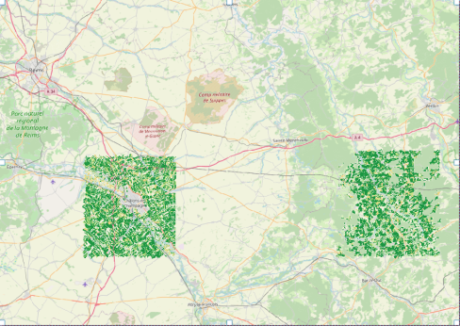
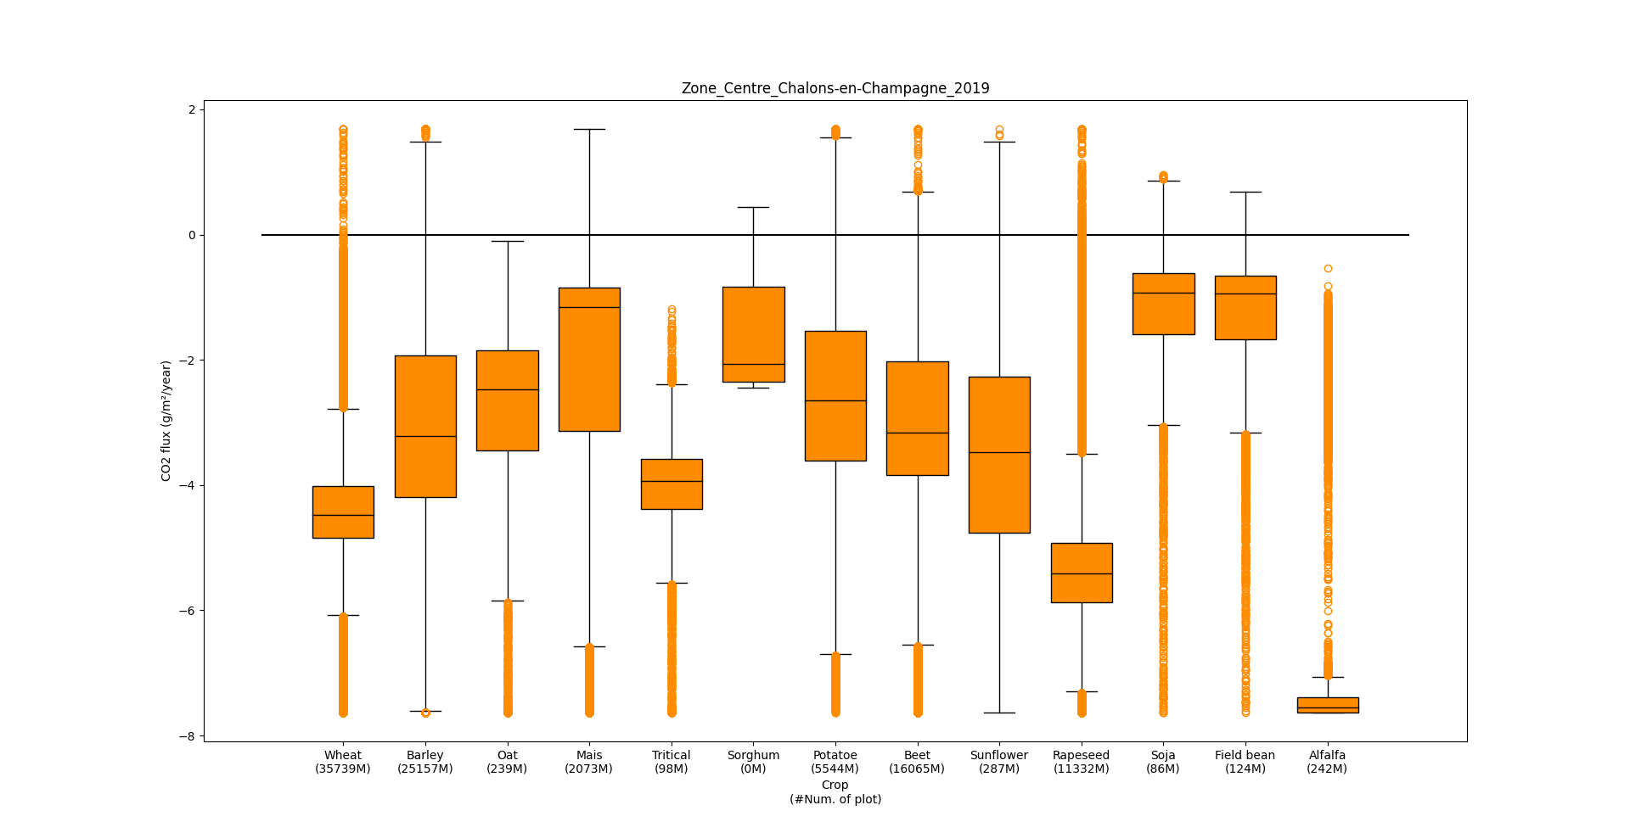
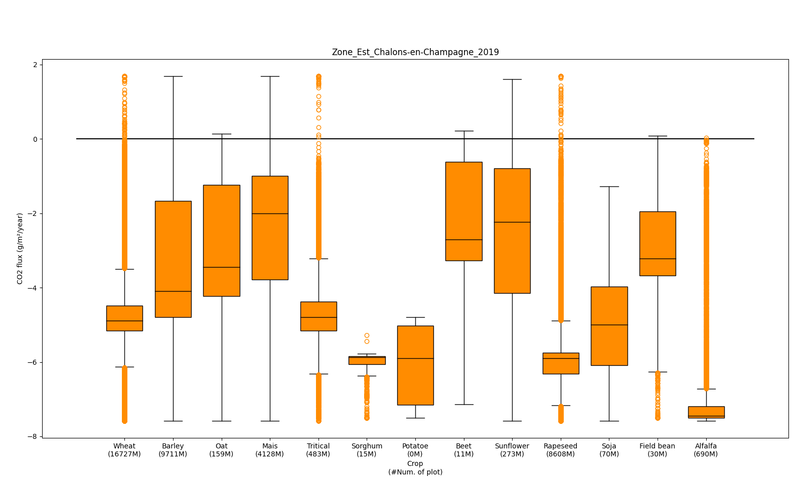
Carbon Tier 1 : statistics per crop
Spatial differences in results reflect differences in management (cover crops)
Around Chalôns en Champagne
East of Chalôns en Champagne
Net CO₂ annual fluxes (tC-CO₂.ha⁻¹)
Net CO₂ annual fluxes (tC-CO₂.ha⁻¹)
Winter crops : longer vegetation cycle ➔ absorb more CO₂, than summer crops & less variability
net CO₂ fixation of fields with summer crop depend on the presence or not of cover crops before
ECO innovations from biomass congress 17th and 18th March 2022

Slide 10
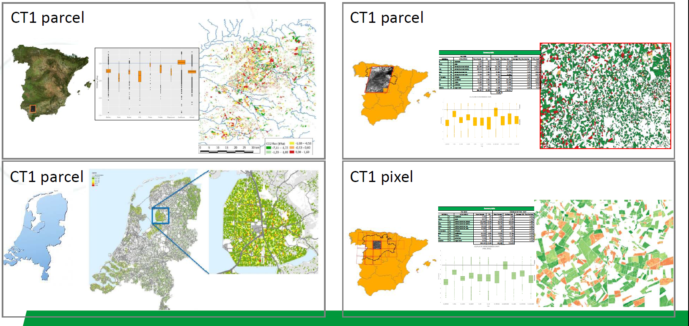


Carbon Tier 1 : Multi-MS testing
Open tools available at https://gitlab.com/nivaeu/uc1b_tier1_co2
2018
Annual CO₂ fixation
Annual CO₂ losses
ECO innovations from biomass congress 17th and 18th March 2022

Slide 11
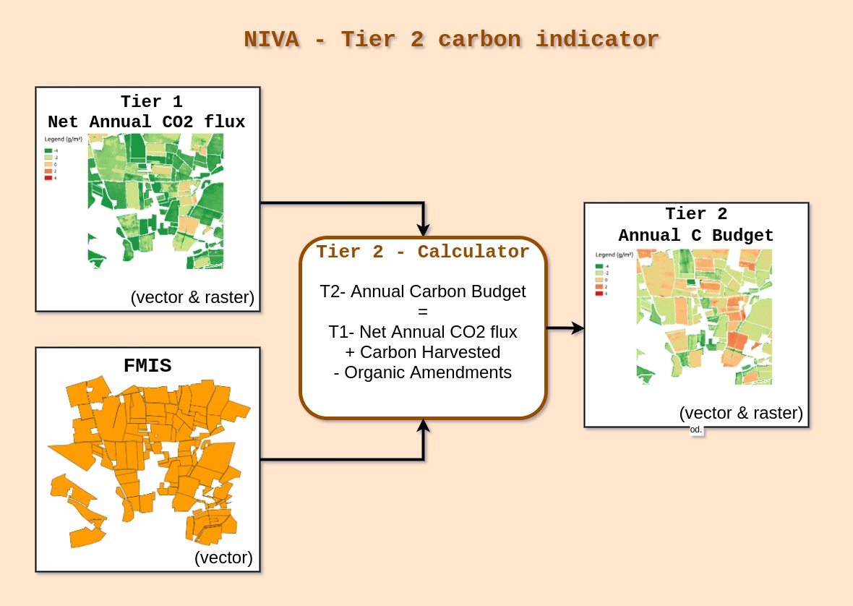



Carbon indicator Tier 2 : principle
Assesses Soil Organic Carbon stock changes
Empirical approach ➔ most crop species except rice
Currently tested in France in collab. with
Farmer’s data
Four our calculations main limitations is access to reliable farmer’s data
But once the TIER1 is producedwith our tools, farmers, cooperatives, agrifood companies…can produce TIER2 themselves
ECO innovations from biomass congress 17th and 18th March 2022

Slide 12
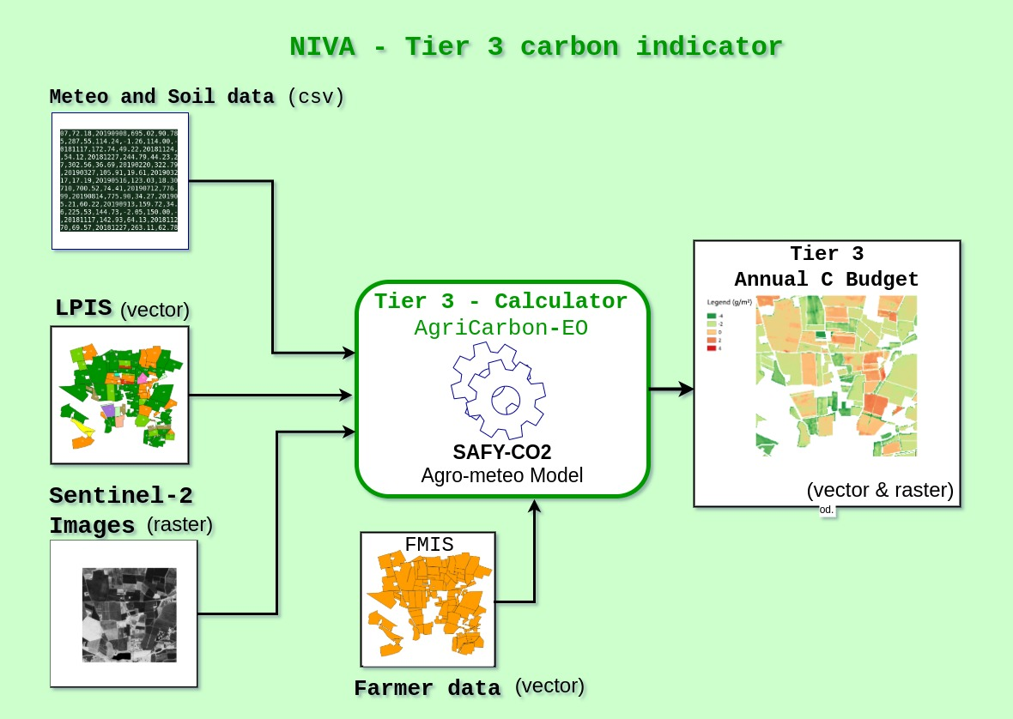
Carbon indicator Tier 3 : principle
Modelling approach ➔ wheat, maize, sunflower, cover crops
Pique et al. (2020 a & b)
IACS
LAI
+ yield, biomass, CO₂ fluxes
Large set of validation data: e.g. from ICOS flux tower network, Spatial Regional Observatory (➔ Terreno)
CO₂ flux are calculated by the model that is calibrated by Leaf Area Index derived from the Sentinel-2 data, farmer’s data are used to finalise the C budget calculation

Slide 13
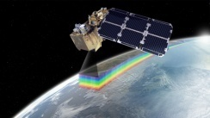
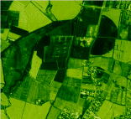
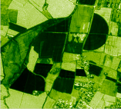
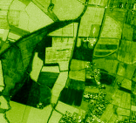
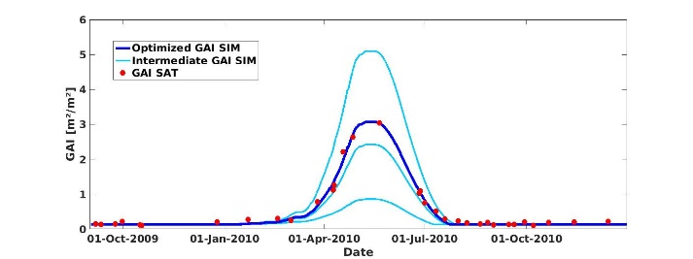

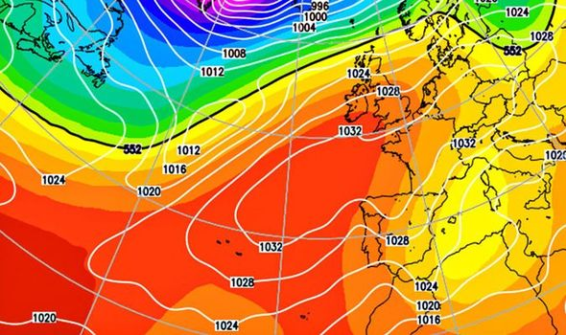

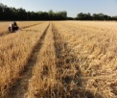


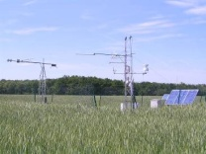
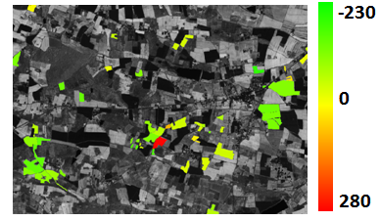


Modelling approach with SAFYE-CO2
29 Juin 2006
Radiative transfer model,
Spot, Landsat,
Sentinel 2
Calibration of phenological parameters & light-use efficiency parameter
Crop param
SAFY-CO₂
(Pique et al. 2020a et b)
Crop
Maps (LPIS)
Leaf Area Index
Rg,T°C
Climatic data (e.g. ERA-5)
Biomass & yield data
Biomass,
Yield
Yield
Flux tower network
CO₂ fluxes
C budget for wheat gC.m⁻²)
C budgets
Very few farmer’s data needed to calculate C budget
Farmer’s data (FMIS)

Slide 14
Modelling approach with SAFYE-CO2
Need very few field data ➔ suited for large scale applications at plot level,
The model is forced to reproduce the true development of vegetation ➔ objectivity of the approach,
Accounts for the « true effect » of cover crop/regrowth/weeds on the C budget (only approach that allows it),
Analysis of large scale transposability during NIVA (research ➔ operational MRV tool).
ECO innovations from biomass congress 17th and 18th March 2022

Slide 15
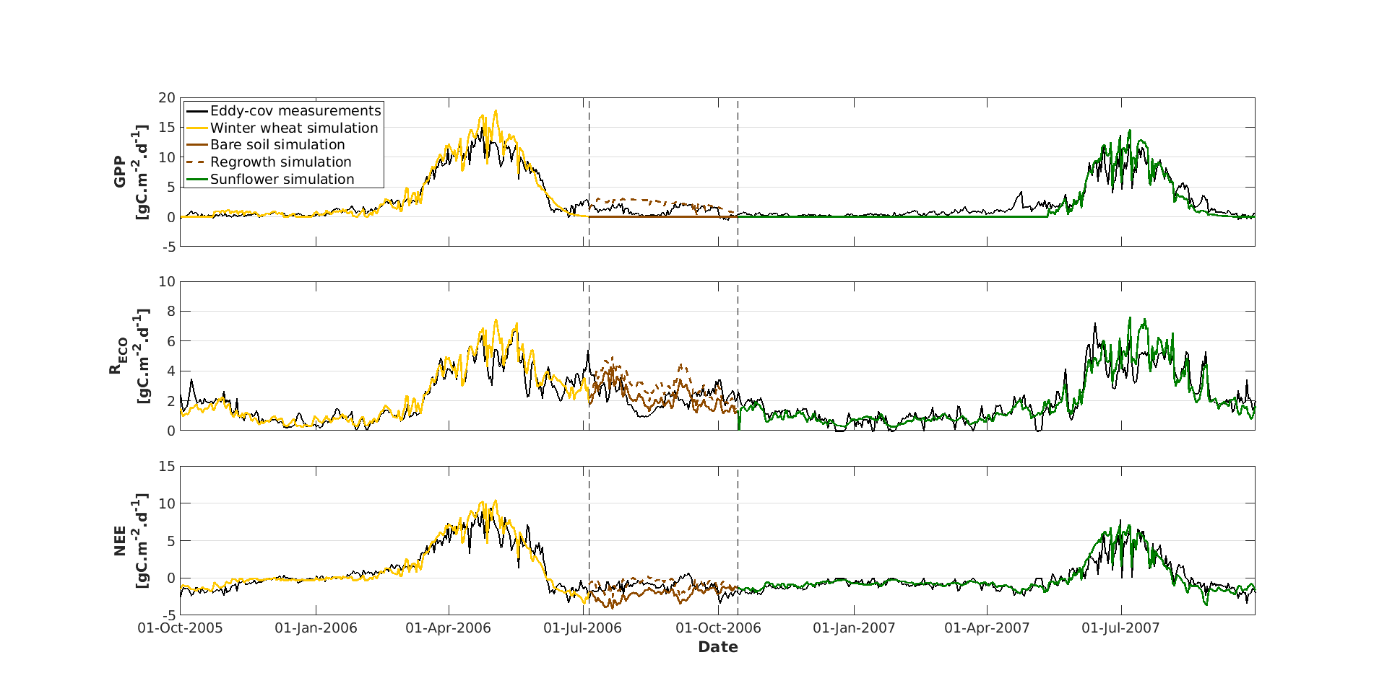
Performances of our approach
Possibility to chain 2 years of simulations and take into account the effect of cover crops/regrowths/weeds in an automated way on water/C fluxes and budgets
Pique et al (2020b) in Remote Sensing
Photosynthesis
Ecosystem
respiration
Net CO₂ flux
ECO innovations from biomass congress 17th and 18th March 2022

Slide 16
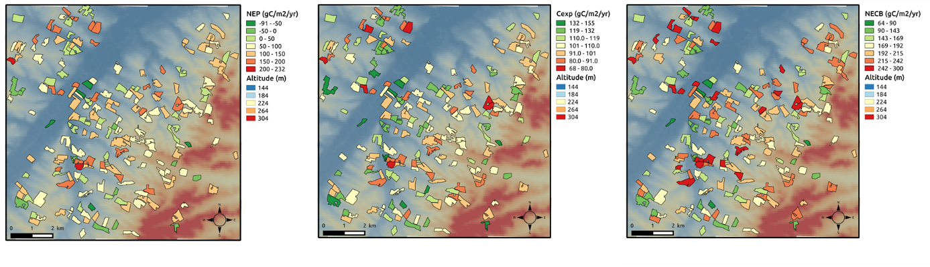
Plot scale regional estimates for Sunflower
Pique et al (2020b) in Remote Sensing
Net CO₂ flux C harvested C budget
Plot scale simulations :
  Analysis of spatio-temporal variability of the components of the carbon budget components
  Identify the effect of some practices on the C budget (green plots had cover crops)
ECO innovations from biomass congress 17th and 18th March 2022

Slide 17
Limits of the approach
Research tool that we are adapting for private companies involved in the agricultural C market (e.g. MyEasyFarm, NetCarbon),
Diagnostic approach but some scenarii can be tested (e.g. straw exported or not),
Calibration procedure based on a Simplex approach does not allow simulations over more than a couple of hundred plots for a given run,
Only a few crop species are parametrised (and therefore can be simulated at this stage) + cover crops,
Optical RS data : problem for calibrating when long cloud coverage and LAI saturates for high biomass); ongoing research ➔ use of radar satellites,
Only annual C budgets can be estimated ➔ coupling with an organic C soil model (e.g. AMG).
ECO innovations from biomass congress 17th and 18th March 2022

Slide 18
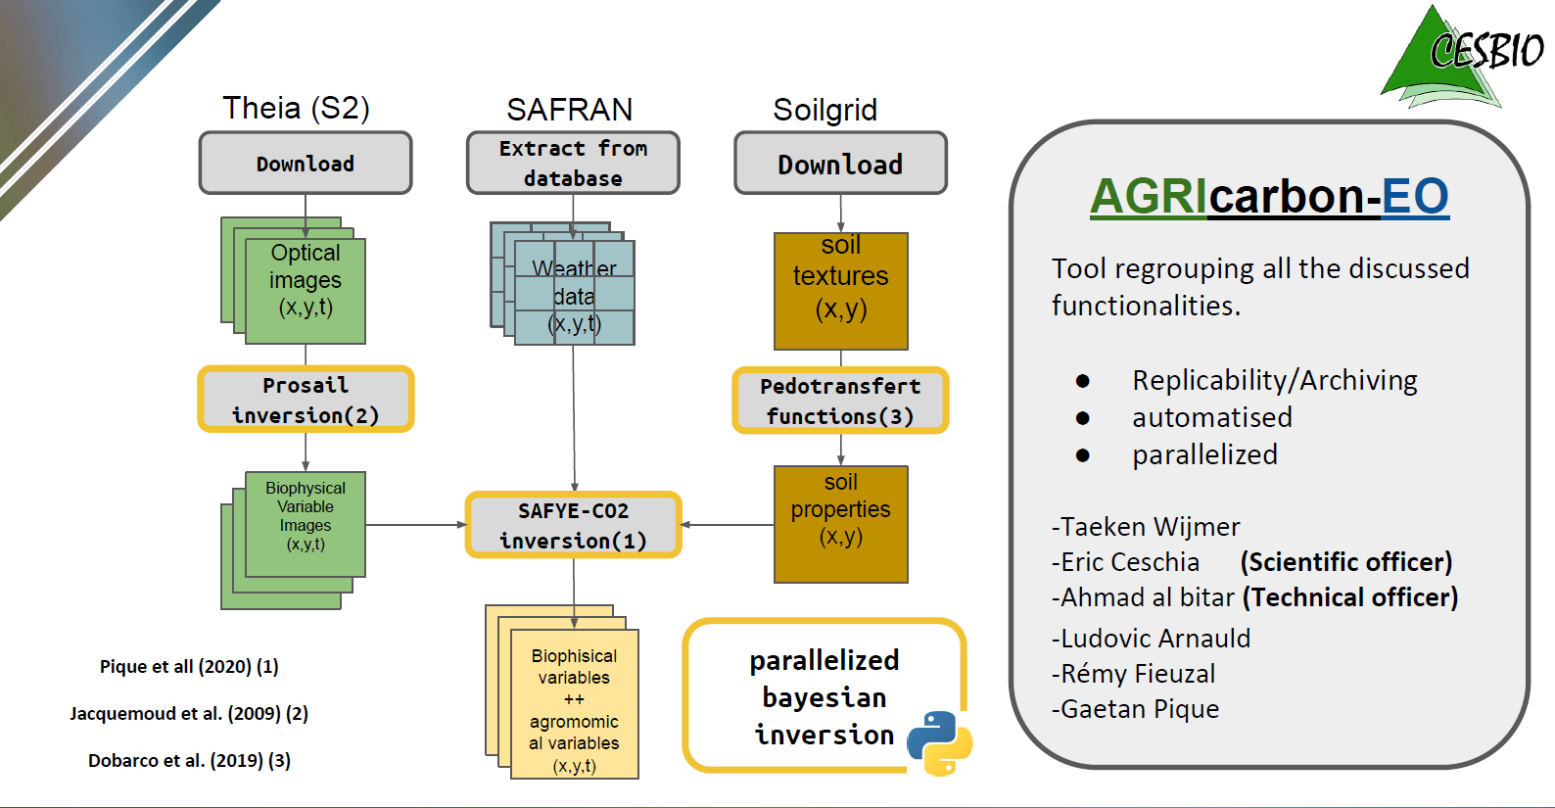
The AgriCarbon-EO processing chain
An end to end processing chain adapted to large scale/high resolution (10m) applications: parallelized bayesian inversion approach ➔ uncertainty analysis, super computers…(Wijmer et al. in prep)
PhD
PhD
Clivot et al. (2019) (4)
AMG soil model (4)
A scalable solution for large scale high resolution cropland carbon budget compliant with recommendations by the CIRCASA initiative (Coordination of International Research Cooperation on Soil Carbon Sequestration in Agriculture; Smith et al 2019) ➔ IRC on Soil Carbon (2023)

Slide 19
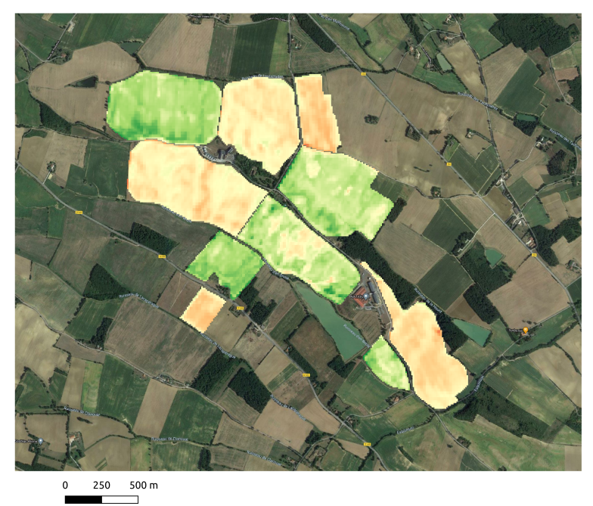

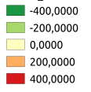
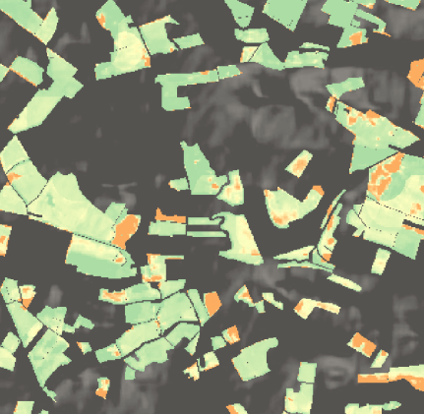
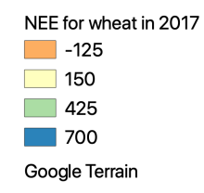
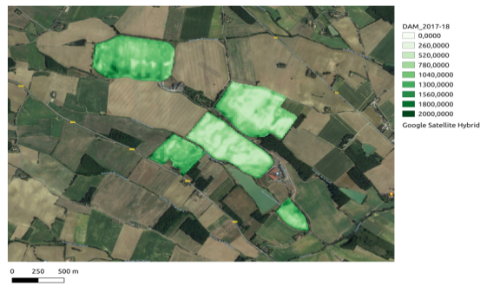
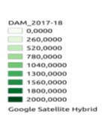
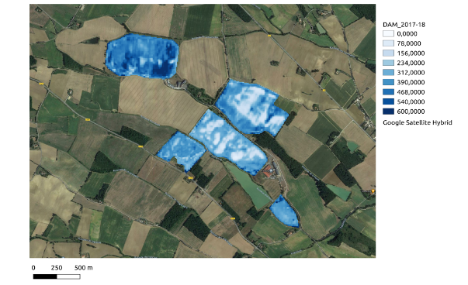


High resolution C budget components with AgriCarbon-EO
Net annual CO₂ fluxes for 2018 straw cereals in South West France (10 m resolution)
10m resolution C budget map for cover crop/maize/wheat crop rotations (Villeneuve farm, Bézéril, France )
gC/m²
Net annual CO₂ flux
(gC-CO₂/m²/yr)
Collab. with the Nataïs company, European leader of popcorn production (Naturellement popcorn) ➔ farmers get a bonus according to the C they store in the soil with cover crops
Whole Sentinel 2 Tile (31TCJ)
Cover crop biomass Uncertainty map
CO₂ fixation / soil C storage
CO₂ losses / soil C losses
g DM/m²

Slide 20
Conclusions
Based on (mainly) open data & tools, C indicators were produced with 3 levels of complexity at pixel/plot scale over large territories but with a similar conceptual approach (C balance),
TIER 1: easy to implement at large scale/high resolution but lack of accuracy as do not account for some farmer’s practices that may impact the results (e.g. organic amendments),
TIER 2: more accurate, technically easy to implement (e.g. API’s connecting to the FMIS) but for us the main limitation is the access to reliable farmers data,
TIER 3 (model) offer higher levels of accuracy, may provide additional indicators (yield, biomass), but needs farmer’s data and are less operational (need to parametrise new crops species and to validate the transposability ➔ Crop 2021 initiative…),
Access to large scale reliable data on farmer’s practices is a challenge for accurate CAP Agri-environmental monitoring and C market in agriculture ➔ initiatives such as AgDataHub, Just Connect, Join Data may solve this issue.
ECO innovations from biomass congress 17th and 18th March 2022

Slide 21


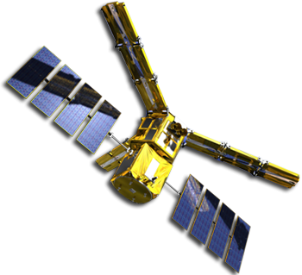







Thanks for your attention and thanks to our financers
If you want to have more details concerning our work please contact me at :
eric.ceschia@inrae.fr

