Slide 1

CNRS, CNES, INRAE, IRD, Univ. Toulouse III
Remote sensing & modelling to assess C budget components
FACCE-JPI – JPI Climate workshop on the use of emerging science to
improve agricultural GHG inventories for the UNFCCC reporting
PART 3: Improving GHG inventories using novel sources of information
Brussels, 20/10/2022
Eric Ceschia (INRAE)
A. Ihsusta, G. Pique, T. Wijmer, R. Fieuzal, A. Al Bitar, L. Arnaud (CESBIO), E. De Laroche (ASP), A. Tarko & D. Laurent (IGN)

Slide 2
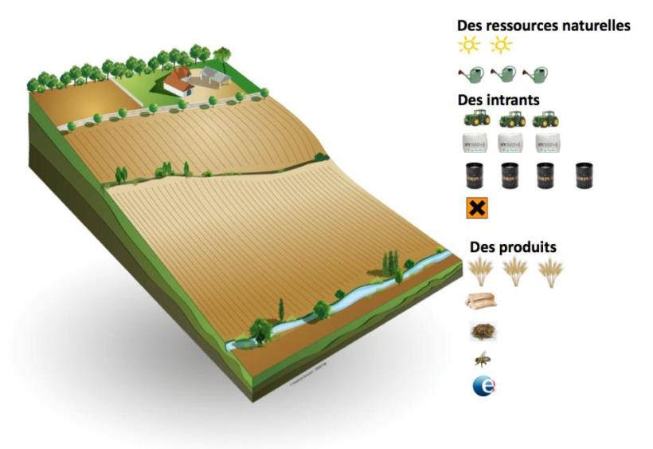
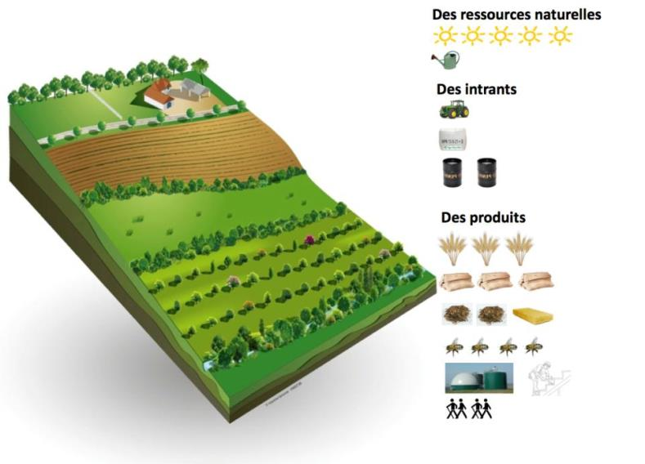
Context/Societal challenges
  Questioning of the durability of conventional agriculture ➔ food security, resilience, climatic & other environmental impacts)
Agro-ecological practices
No till
Cover crops
Agroforestery
Illustrations: Arbre et Paysage 32
C storage
➔ 4p1000 initiative
  Lack of large scale tools to quantify cropland C budgets and its components (e.g. biomass, CO₂ fluxes) at plot level and to analyse the effect of management practices on C budgets
Need for methods & tools adapted to different context (CAP, C market) combining crop modelling and high resolution remote sensing ➔ e.g. H2020 NIVA & ORCaSa & ClieNfarm, Soil Carbon Farming (Climate Kic) projects
FACCE-JPI – JPI Climate workshop , Brussels, 20th October 2022

Slide 3
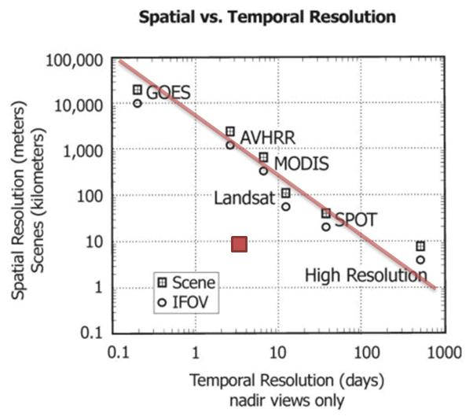
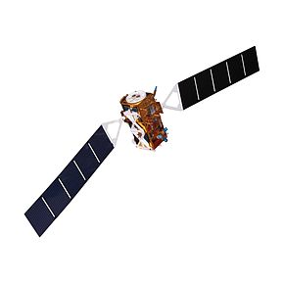
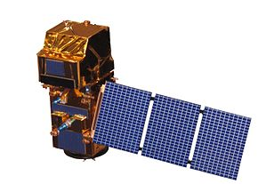

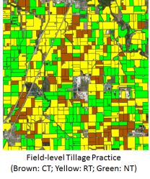
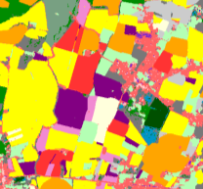
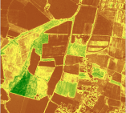
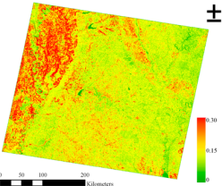
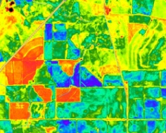
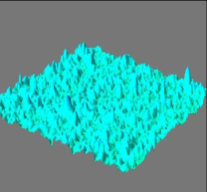
Why is it possible now ?
A
Revolution !!!
(free all over
the globe)
Sentinel 1
(10 m, 6j, Radar)
Sentinel 2
(10 m, 5j, Optical)
Sentinel
Clear or cloudy sky conditions
Rugosity & surface water content
Monitored
parameters
Clear sky conditions
Reflectances (13 bands)
40%
Dynamic mapping
Soil water content
2%
Biomass
Soil work
Land cover
LAI/
phenology
Albedo
!! Monitoring of superficial Soil Organic C content do not provide information on SOC stock changes !!
How to use those data to quantify C budget and its components ?
Notes:
A la différence des anciennes missions spatiales…les nouveaux satellites S1&2 lancés en 2015 n’obligent pas à faire un compromis entre résol spatiale et temporelle

Slide 4
Carbon budgets indicators
  A similar conceptual approach: Carbon budget (Smith et al 2010)
Indicators are calculated for each cropping year (at 10m/plot level), but can be summed over several years (crop rotation),
Methodology:
  Calculations of TIER 1 (CO₂ fluxes) and TIER 2 (C budget) are based on empirical approaches and can be applied to most crops species except rice,
  TIER 3 is based on the SAFYE-CO2 crop model calibrated with satellite observations (LAI from Sentinel 2) ➔ allows other indicators to be calculated (biomass, yield, CO₂ fluxes, evap/transp…), but only parametrised yet for few crop types species (straw cereals, sunflower, maize and rapeseed) + cover crops.
TIERs
2 & 3
  C budget = Net CO₂ flux – C harvested + Org. manure
TIER 1
Farmer’s data (FMIS)

Slide 5
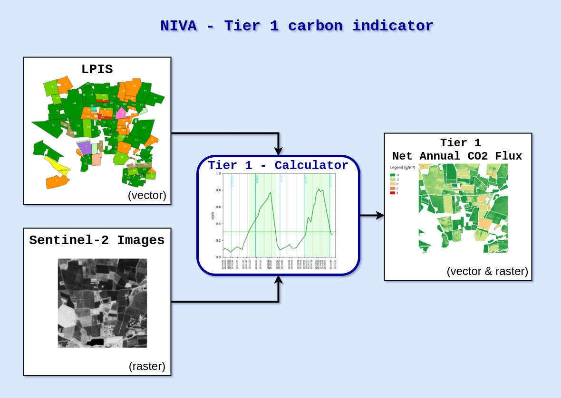
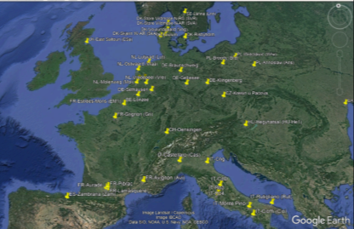
Carbon indicator Tier 1 : principle
IACS data (LPIS + GSAA)
Empirical approach ➔ most crop species except rice
Open source code https://gitlab.com/nivaeu/uc1b_indicators_tool
Days with active vegetation
- Days with low radiation
Vegetation index (NDVI)
Based on Ceschia et al. (2010)
Solar radiation (ERA5)
Net annual CO₂ flux
Vegetation soil coverage (days)
Cropland sites flux tower
Net annual CO₂ flux depends on the total number of days with active vegetation covering the soil ƒ(NDVI, solar radiation)

Slide 6

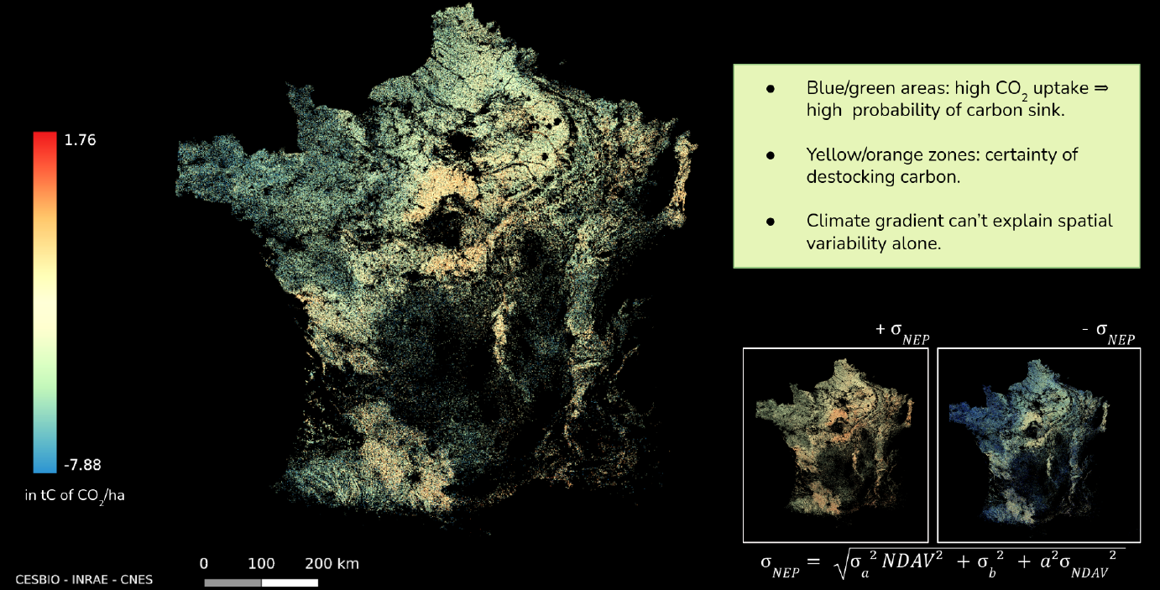


Carbon Tier 1 : National scale 10m resolution
NIVA’S algorithm + Iota2 software
With the support of
Associated uncertainty map coming soon

Slide 7
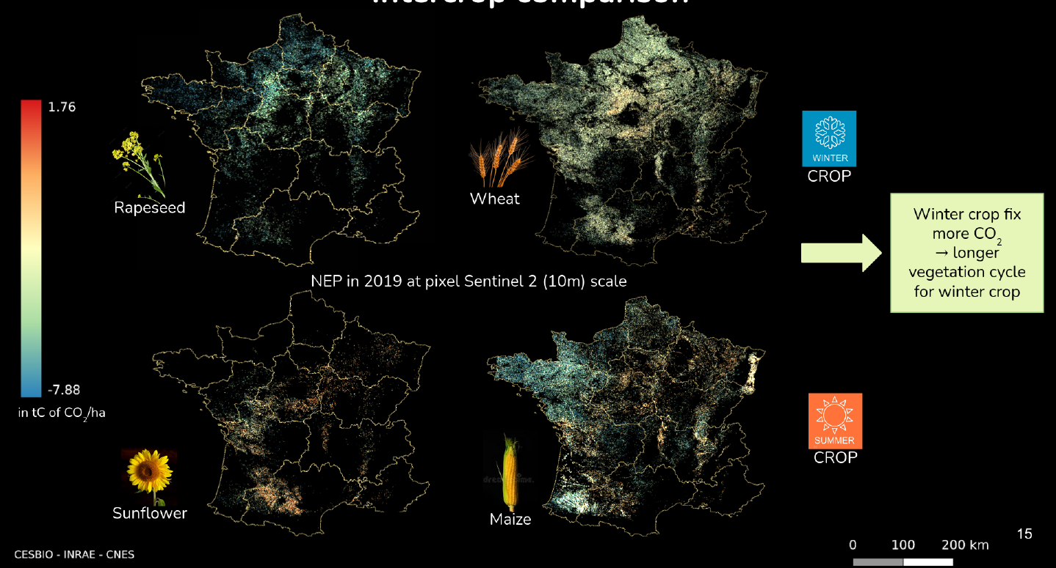
Carbon Tier 1 : National scale 10m resolution
Crop Comparison of the Net Annual CO₂ fluxes (NEP)
In general winter crops fix more CO₂ (longer vegetation cycle) but :
- Overestimated here for winter crops ➔ low radiation effect not accounted for here
- Maize fix a lot of CO₂ in Bertagne
FACCE-JPI – JPI Climate workshop , Brussels, 20th October 2022

Slide 8
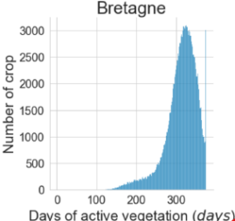
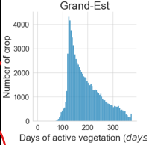
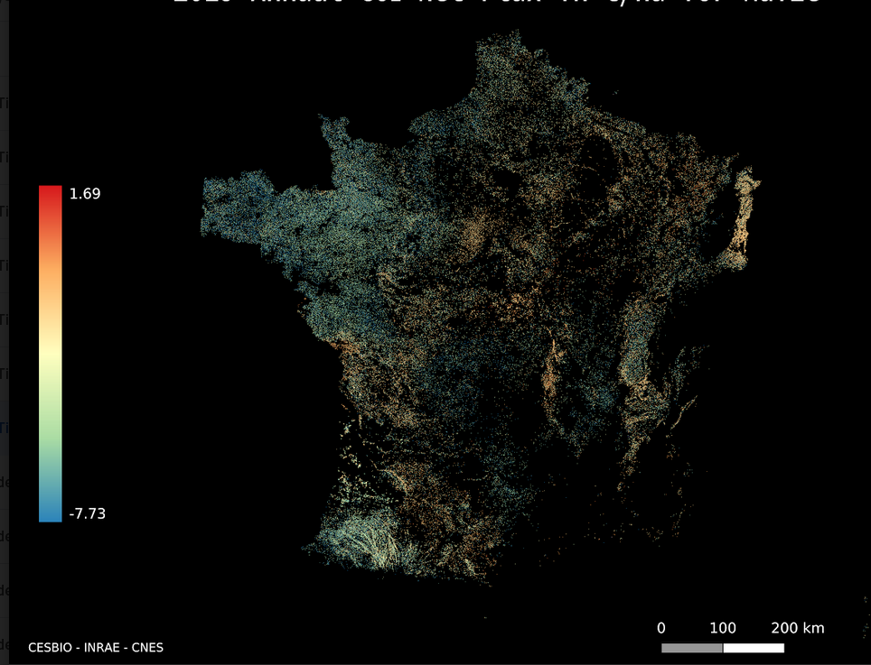
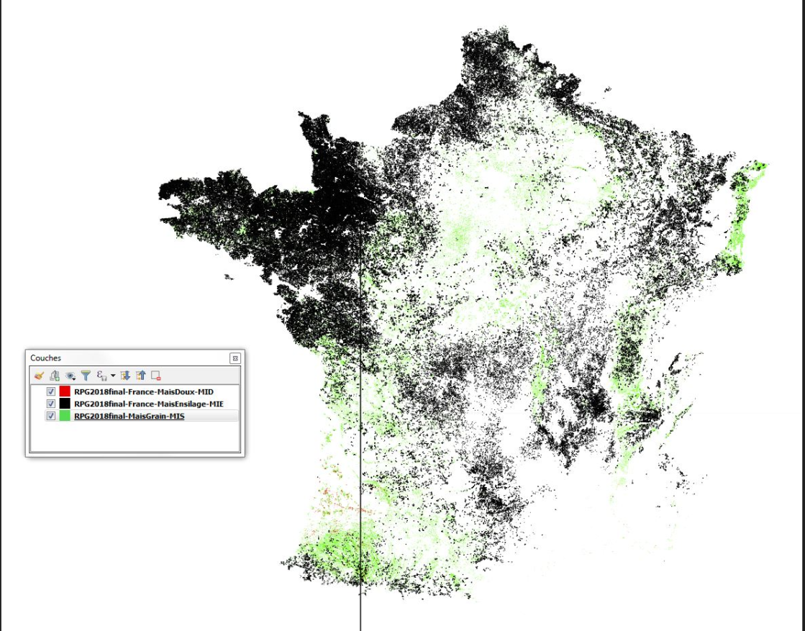
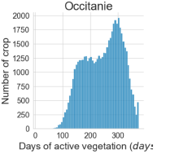
Carbon Tier 1 : National scale 10m resolution
Net Annual CO₂ fluxes (NEP) for maize on France in 2019
Pointe de l’Alsace
Maize types (LPIS data)
Cover crops before silage maize
No cover crop before grain maize
tC of CO₂/ha
Grain maize
Silage maize
Cover crops on 50% of the grain maize

Slide 9
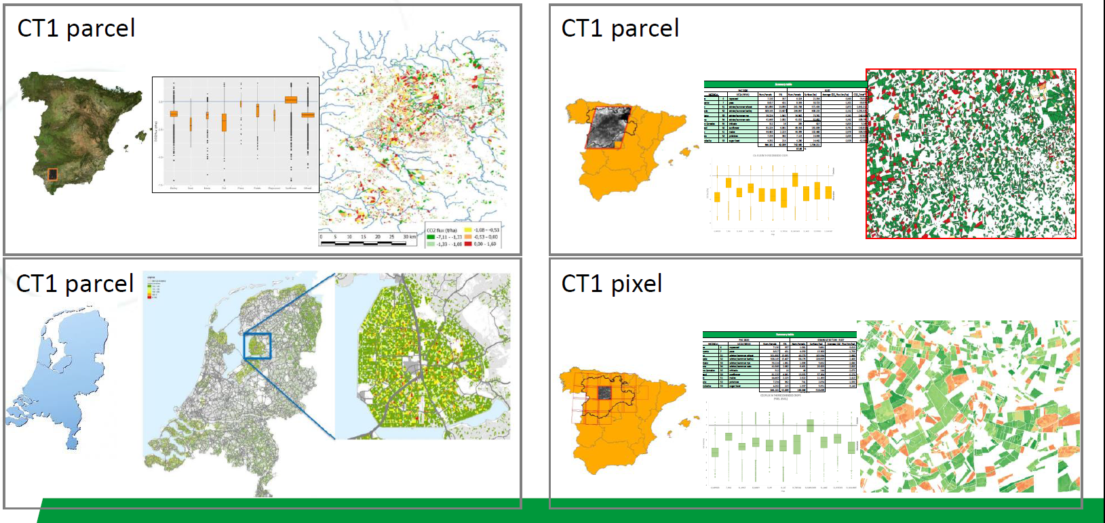


Carbon Tier 1 : Multi-MS testing
Open tools available at https://gitlab.com/nivaeu/uc1b_tier1_co2
2018
Annual CO₂ fixation
Annual CO₂ losses
Approach currently being validated against new & independent in-situ flux data in Europe
FACCE-JPI – JPI Climate workshop , Brussels, 20th October 2022

Slide 10
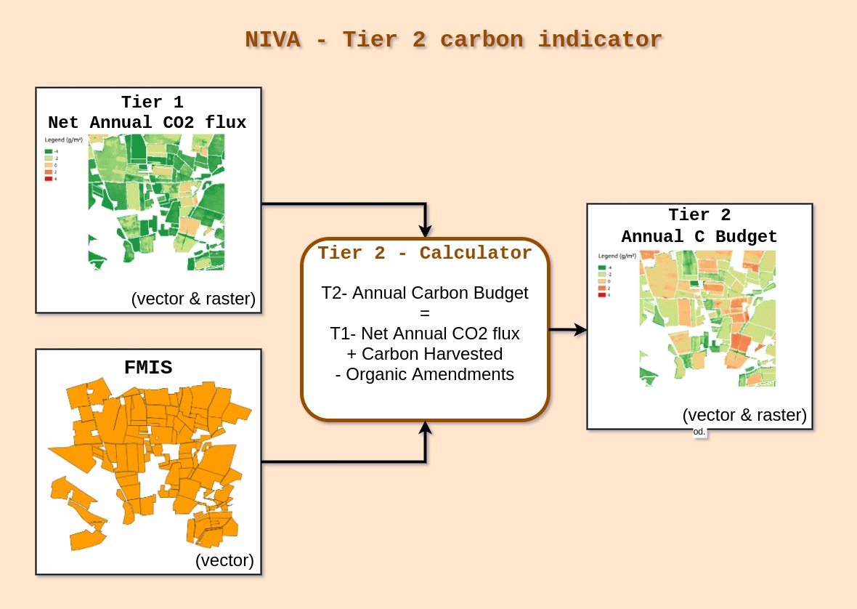
Carbon indicator Tier 2 : principle
Assesses Soil Organic Carbon stock changes
Empirical approach ➔ most crop species except rice
Farmer’s data
For our calculations main limitations is access to reliable farmer’s data
But once the TIER1 is produced with our tools, farmers, cooperatives, Paying agencies, agrifood companies…can produce TIER2 themselves
FACCE-JPI – JPI Climate workshop , Brussels, 20th October 2022

Slide 11
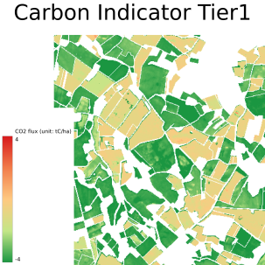
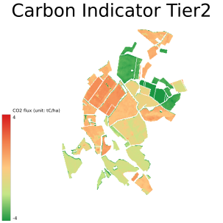

Carbon indicator Tier 2 : principle
Net annual CO₂ flux map
Annual C budget map
+ Farmer’s data
NEP (tC of CO₂/ha)
C budget (tC/ha)
Tested in South West France with the collaboration of
Tool availlable at: https://gitlab.com/nivaeu/uc1b_indicators_tool

Slide 12
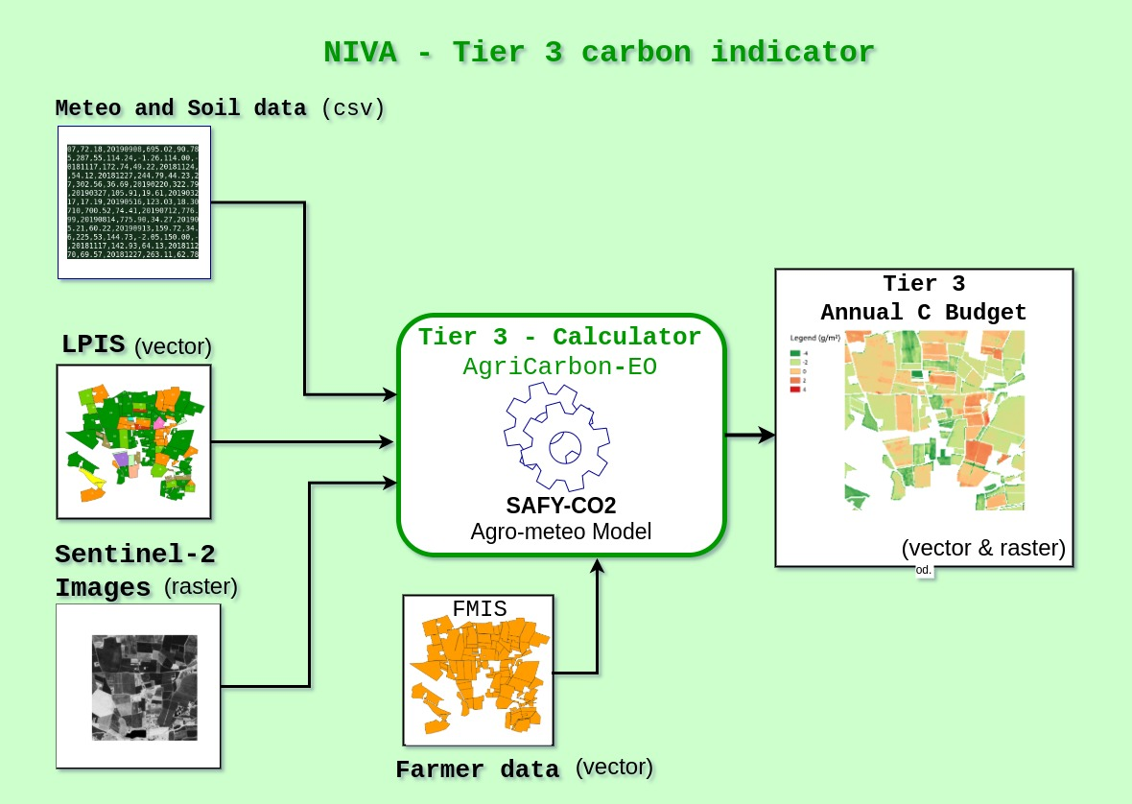
Carbon indicator Tier 3 : principle
Modelling approach ➔ wheat, maize, sunflower, cover crops
https://framagit.org/ahmad.albitar/safye_co2.git
Pique et al. (2020 a & b)
IACS
LAI
+ yield, biomass, CO₂ fluxes
Large set of validation data: e.g. from ICOS flux tower network, Spatial Regional Observatory…
CO₂ flux are calculated by the model that is calibrated by Leaf Area Index derived from the Sentinel-2 data, farmer’s data are used to finalise the C budget calculation

Slide 13

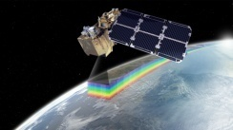
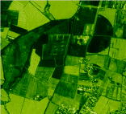
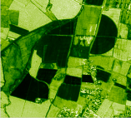
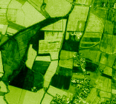
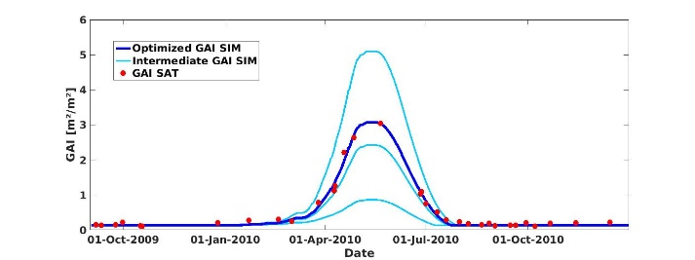

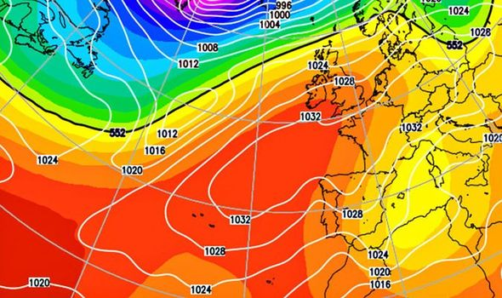

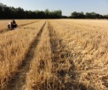


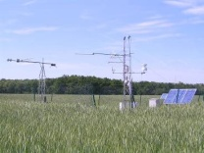
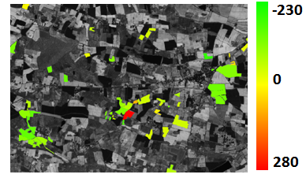


Modelling approach with SAFYE-CO2
29 Juin 2006
Copernicus HR LAI product
Spot, Landsat,
Sentinel 2
Calibration of phenological parameters & light-use efficiency parameter
Crop param
SAFY-CO₂
(Pique et al. 2020a et b)
Crop
Maps (LPIS)
Leaf Area Index
Rg,T°C
Climatic data (e.g. ERA-5)
Biomass & yield data
Biomass,
Yield
Yield
Flux tower network
CO₂ fluxes
C budget for wheat gC.m⁻²)
C budgets
Few farmer’s data needed to calculate C budget
Farmer’s data (FMIS)

Slide 14
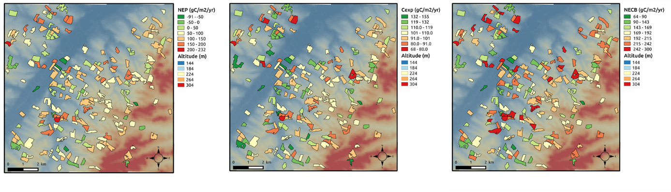
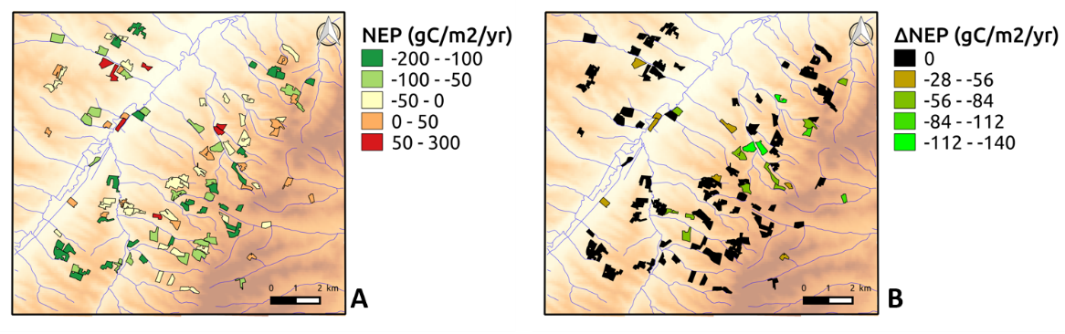
Plot scale regional estimates for Sunflower
Pique et al (2020b) in Remote Sensing
Net CO₂ flux C harvested C budget
Plot scale simulations ➔ Analysis of spatio -temporal variability of the components of the carbon budget
Effect of summer cover crops/weeds on the C budget components ➔ only satellite based approach allows to account for that
FACCE-JPI – JPI Climate workshop , Brussels, 20th October 2022

Slide 15
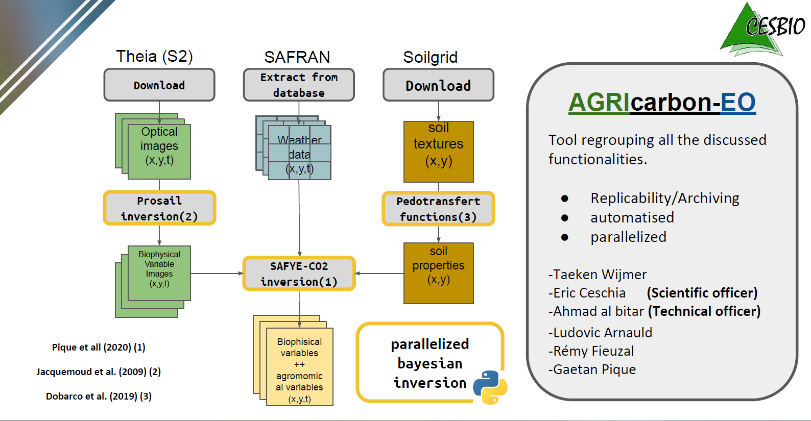
The AgriCarbon-EO processing chain
An end to end processing chain adapted to large scale/high resolution (10m) applications: parallelized bayesian inversion approach ➔ uncertainty analysis, super computers…(Wijmer et al. submitted)
Activity data
Sentinel 2
ERA5
Soilgrids
Straw management
Organic amendments
PhD
LAI
+ uncertainty
PhD
Clivot et al. (2019) (4)
Crop residues + uncertainty
Soil model (AMG) (4)
A scalable solution for large scale/high resolution cropland carbon budget monitoring compliant with recommendations by the CIRCASA initiative (Smith et al. 2020) and the voluntary C market standards

Slide 16
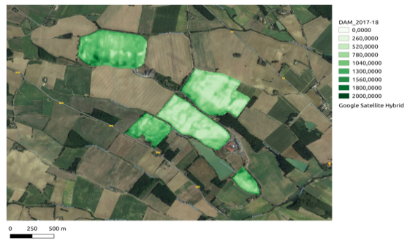
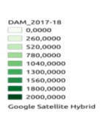
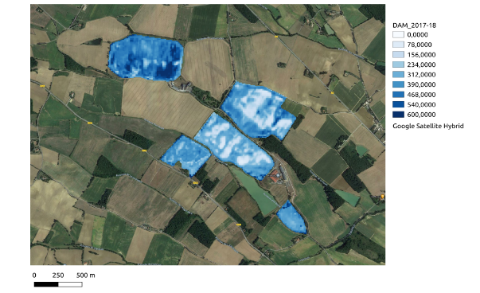

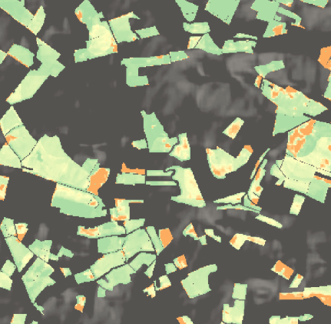
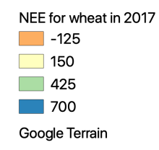
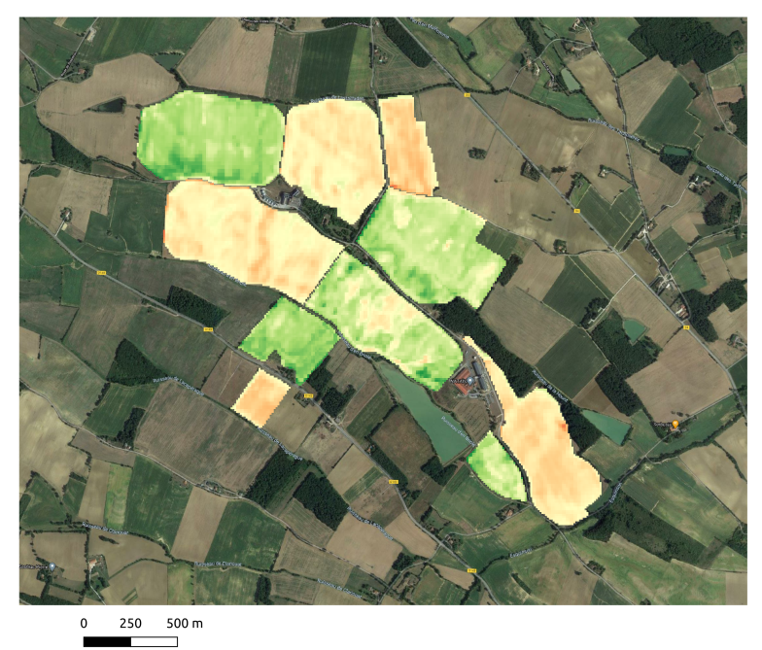
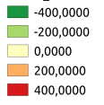


High resolution C budget components with AgriCarbon-EO
Net annual CO₂ fluxes for 2018 straw cereals in South West France (10 m resolution) ➔ 4h of computing
Cover crop biomass Uncertainty map
g DM/m²
Net annual CO₂ flux (gC-CO₂/m²/yr)
10m resolution C budget map for cover crop/maize/wheat crop rotations (Villeneuve farm, France )
gC/m²
+ farmer’s data
Whole Sentinel 2 Tile (31TCJ)
CO₂ fixation / soil C storage
CO₂ losses / soil C losses
Collab. with the Nataïs company (Naturellement popcorn project) ➔ farmers get a bonus according to the C they store in the soil with cover crops

Slide 17
Conclusions
Based on (mainly) open data & tools, C indicators were produced with 3 levels of complexity at pixel/plot scale over large territories but with a similar conceptual approach (i.e. C budget);
TIER 1: easy to implement at large scale/high resolution but does not account for some of the farmer’s practices which may impact the results (e.g. organic amendments),
CAP, NDCs
TIER 2: more accurate, technically easy to implement ➔ the main limitation is the access to reliable farmer’s data (next is to use API’s to connect to the FMIS),
TIER 3 (model) also require farmer’s data, offer higher levels of accuracy and provides additional useful indicators (yield, biomass, water requirements) but are less operational as for each new crop specie the model needs to be parametrised/validated ➔ transposability currently tested (NIVA, ClieNfarm projects),
CAP, NDCs,
C market
Solutions exist for large scale/high resolution monitoring of C budget components but access to reliable data on farmer’s practices is the main limiting factor ➔ initiatives such as AgDataHub, Just Connect, Join Data may solve this issue.
FACCE-JPI – JPI Climate workshop , Brussels, 20th October 2022

Slide 18


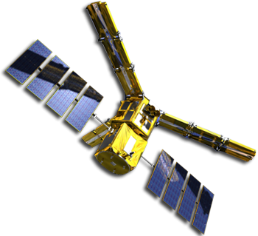









Thanks for your attention and thanks to our financers
Naturellement
popcorn
ORCaSa
If you want to have more details concerning our work:
- visit: https://www.cesbio.cnrs.fr/agricarboneo/
- contact me at : eric.ceschia@inrae.fr

Slide 19

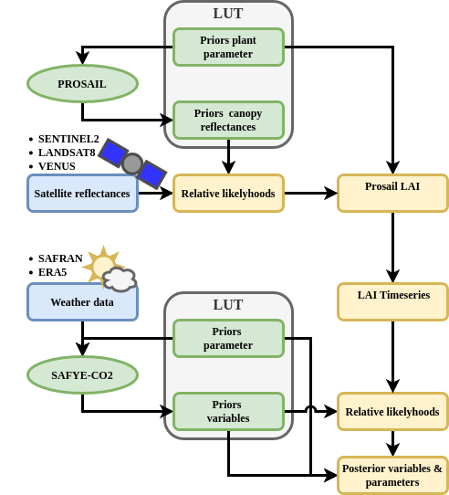

Overview of the Agricarbon-EO processing chain
Downloads, colocates and regrids data from optical satellites (Theia* ), weather reanalysis ERA5LAND (ECMWF**)/SAFRAN & validation data
Bayesian LUT based Inversion of Prosail for each image to obtain LAI +uncertainties
Bayesian LUT based assimilation of LAI time series into SAFYE-CO2 to obtain parameters and variables
Produces
Quality indicators & uncertainties
Maps of variable & parameter as well as their distributions.
SAFYE-CO2 simulation
over one Sentinel2 tile 4h
spatial
temporal
https://www.cesbio.cnrs.fr/agricarboneo/
Notes:
1 min

