Slide 1





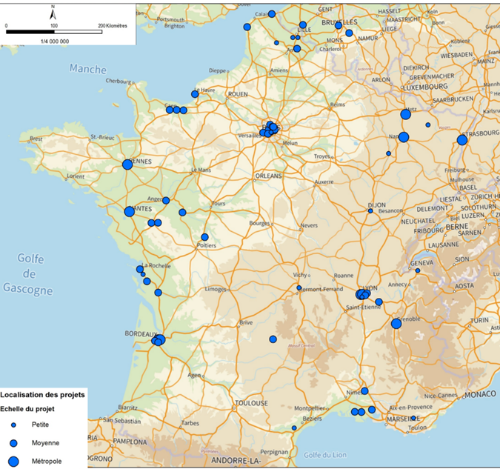
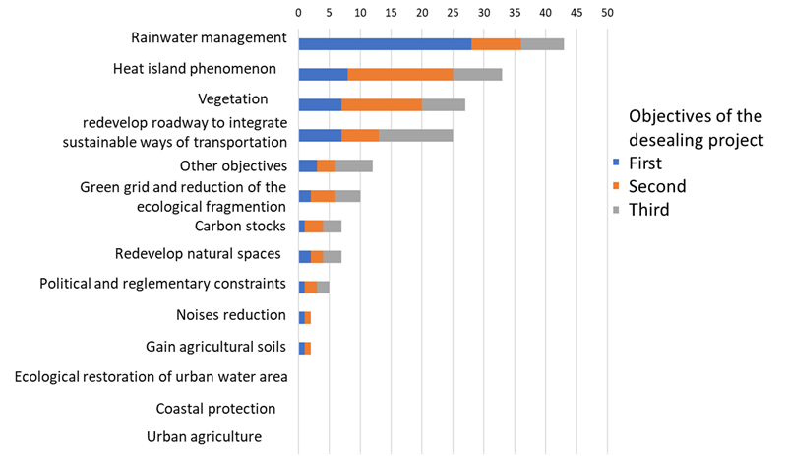
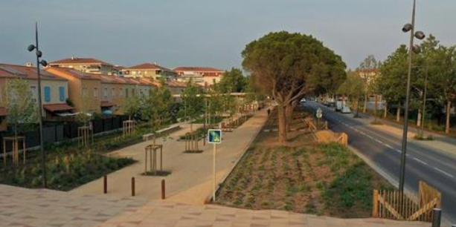
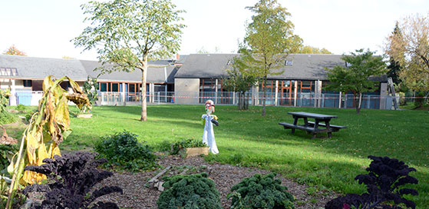
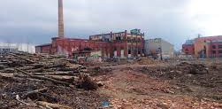
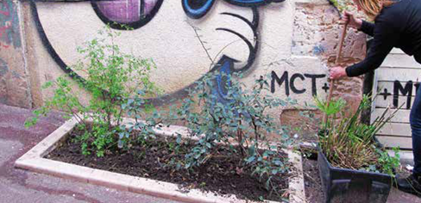




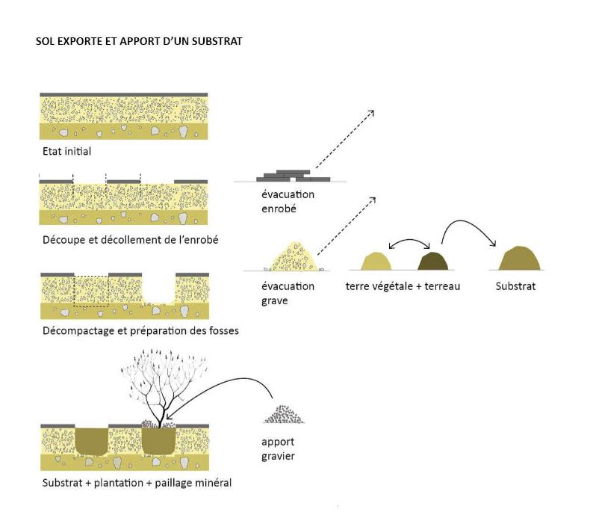
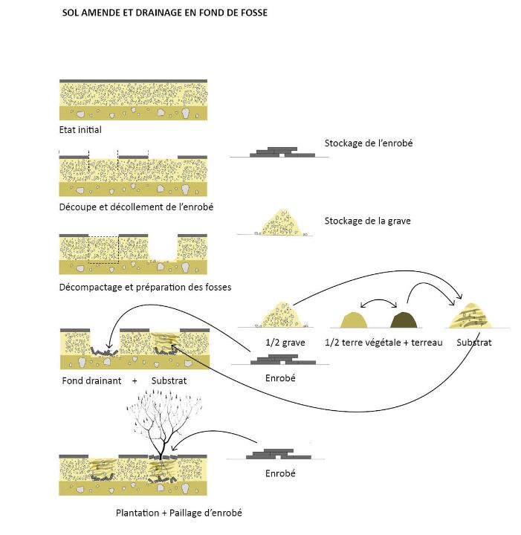






Desealing soils to promote ecosystem services:
synthetizing practices among stakeholders
R. Dagois¹, C. Vieillard^{1,2,3}, L. Beaudet², S. Ouvrard³
¹ Plante & Cité, 26 rue Jean Dixméras, Angers, ² L’institut Agro Rennes Angers, ³ Laboratoire Sols et Environnement, Université de Lorraine - INRAE
Methods
Acquiring technical data on existing urban projects and initiative including desealing practices.
A national survey towards landscape managers and designers, cities and consulting engineers (Approx. 40 questions with LimeSurvey – Summer 2021)
Documented information from the initiatives led by private partners
Contact: robin.dagois@plante-et-cite.fr
Data type on desealing initiatives
Location, stakeholders, dates
Surface, uses before and after set-up, costs
Type of materials, reuse or evacuation of materials
Techniques to create fertile soils and substrates
Difficulties and opportunities
Map of the case studies
Why desealing soils ?
Number of responses
More than 60 initiatives (40 from survey and 20 from documented initatives)
Collected data in France
and Belgium
(mostly in urban areas)
Desealing mostly
for rainwater management purposes
Heat management
and vegetation opportunities come
as second objectives
Location of desealing initiatives
Surface of desealed soils:
Small
Medium
Large
What are the objectives behind desealing initiatives ?
I. Typology of desealing initiatives:
(1) Various desealed surfaces, (2) potential for new plantations and (3) concertation with citizen
Roadway, parking lot and square requalification
Desealed and planted schoolyards
Brownfield requalification
Municipalities’ desealing initiatives for citizens
*
*
*
*
*
*
*
*
*
*
*
Main objectives : *water management, *landscape and vegetation, *heat mitigation, *public and children access
II. Different techniques of soil construction:
Overall removal of impervious materials (asphalt or concrete)
A
B
C
Conventional technique of soil construction after desealing
Innovative technique of soil
construction with recycled technical layer
Soil construction with two
recycled layers of re-used materials
De-desealing and opening
First steps (see B)
Asphalt removal
½ gravel
½ topsoil + compost
Asphalt
Substrate + planting + gravel mulsching
Input of gravel
Gravel removal
Topsoil and compost
Substrate
Drainage layer (rushed asphalt) + substrate
Asphalt
Substrate
Planting + mulsching with asphalt
Use of exogenous material (non-renewable soil)
High environmental impact and economical cost (destruction of arable lands and transportation of materials)
Mix of exogenous materials and recycled materials from desealing operation
(gravels, asphalt, etc)
Re-use of crushed materials as a deep technical layer for drainage
Similar to B but with re-use of crushed impervious materials as mulching
for soil coverage and conservation of soil moisture
Conclusion : more than 60 case studies of desealing initiatives were documented. This helped build a typology of desealing projects. The results will help guiding the conception of future projects as long as experiments on desealed soils.
Ready for Desert ? The Dessert (« Desert ») research program aims at better understanding the practices of desealing and characterize the functionning of desealed soils for green spaces.
This program will further investigate the practices of soil desealing in urban areas with fields and lab’ experiments to designing tools for stakeholders.
Acknowledgement : the authors wish to thank the partners of the dessert program : Aix-Marseille Université, Durand TP, SCE, Wagon Landscaping
This work was made possible by the financial contributions of :

