Slide 1





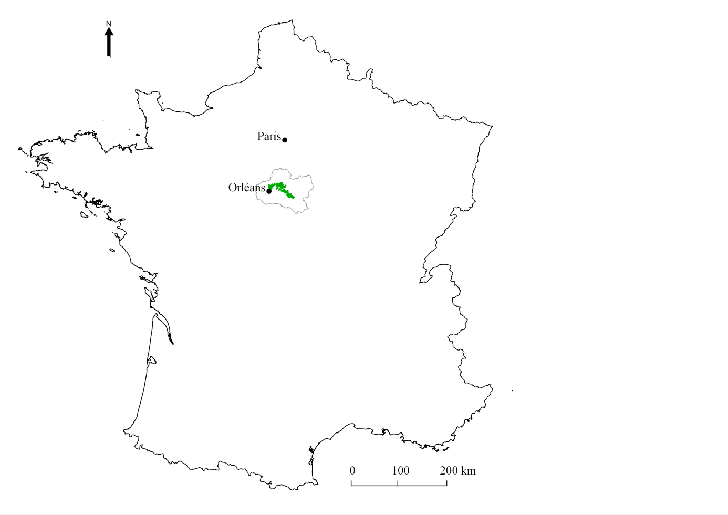
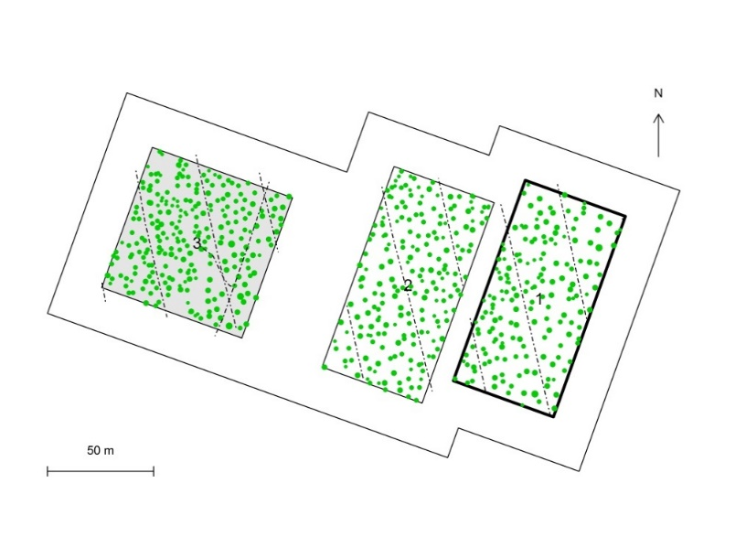
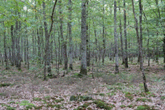
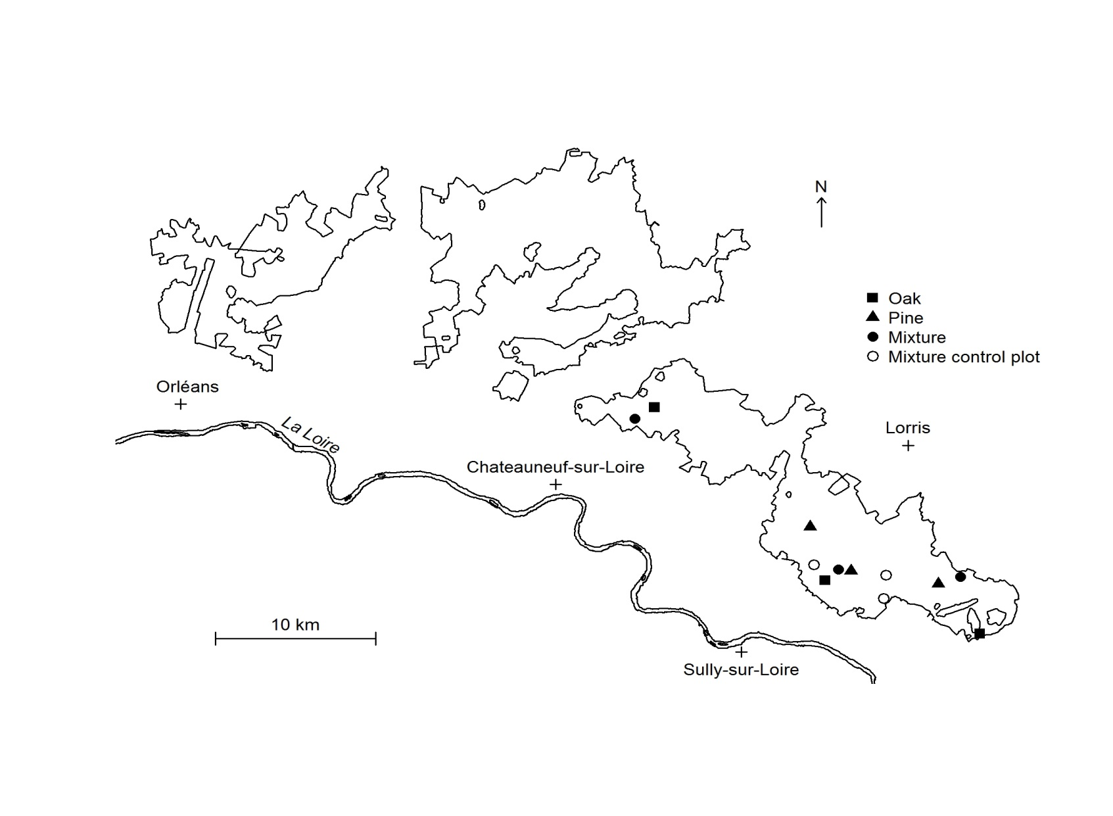
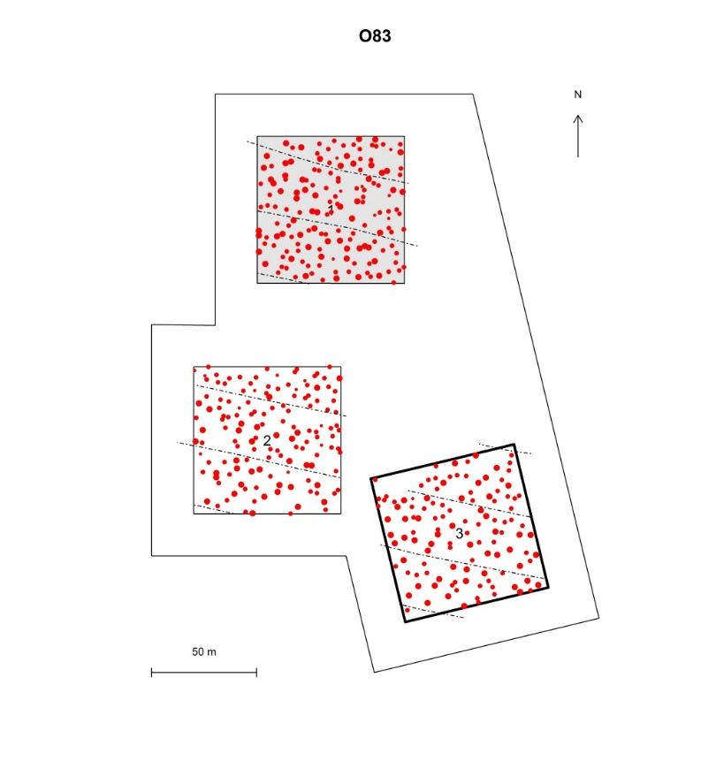
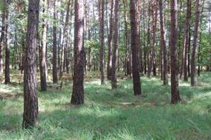
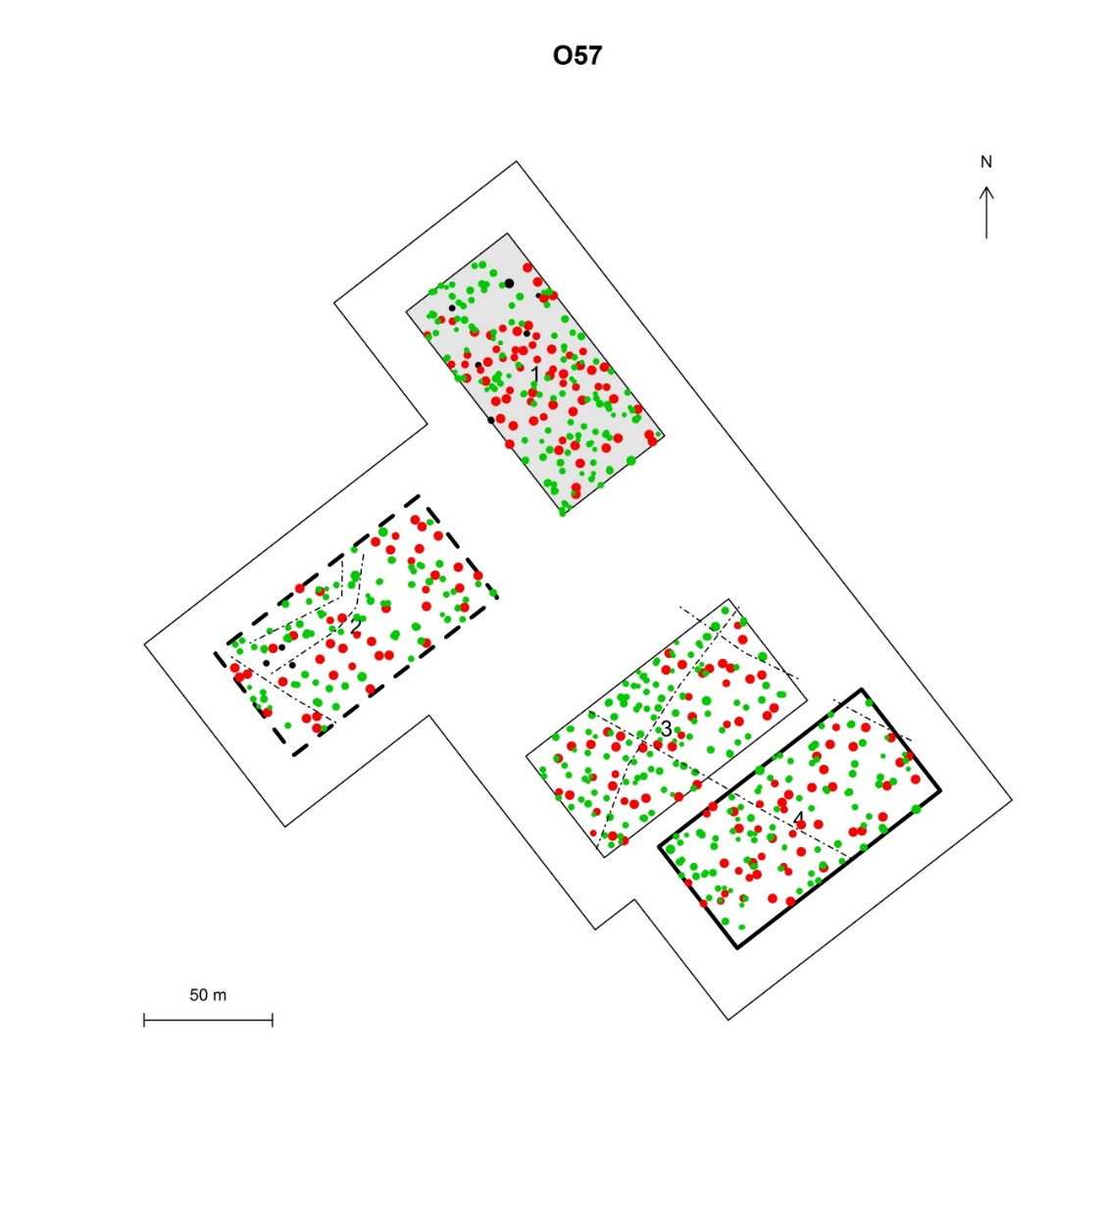
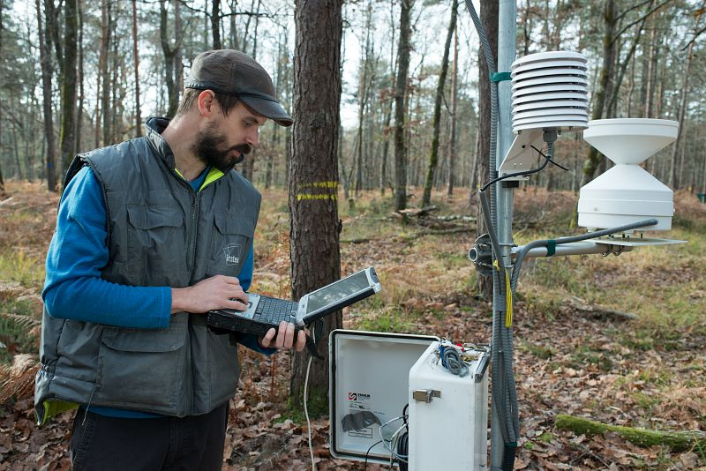
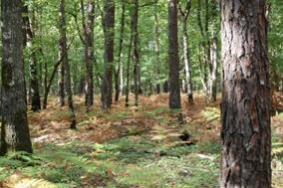
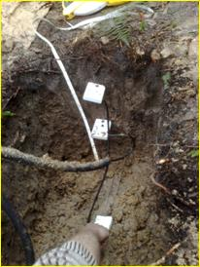
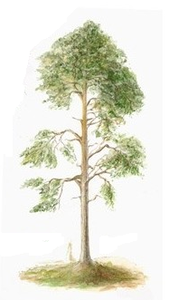
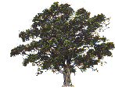


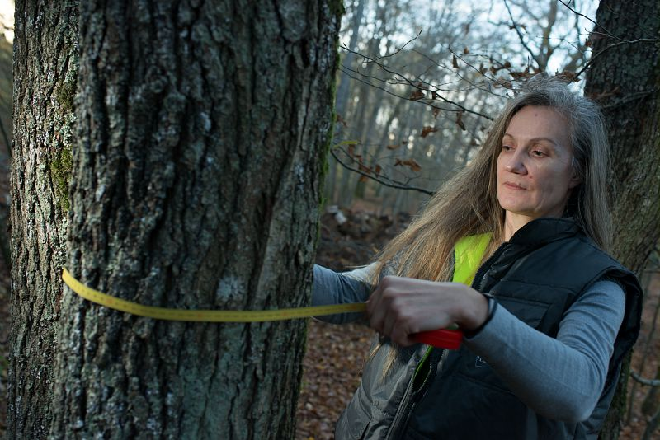
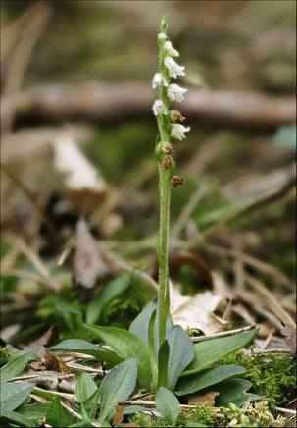
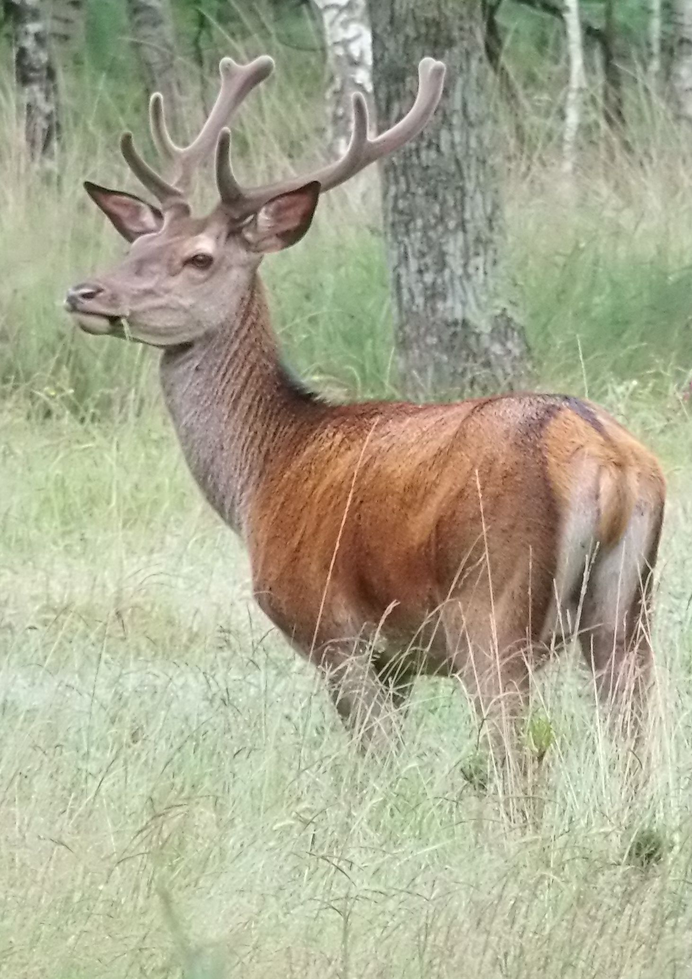
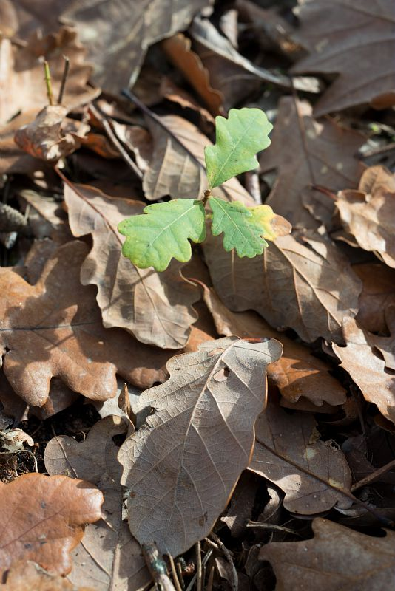
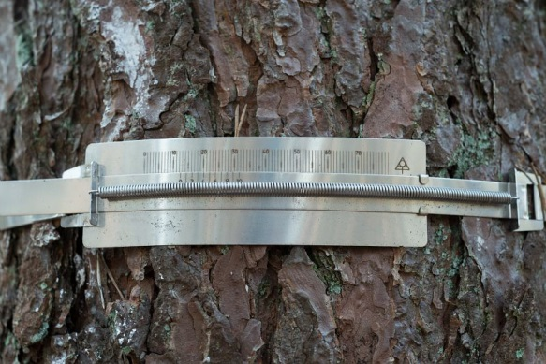

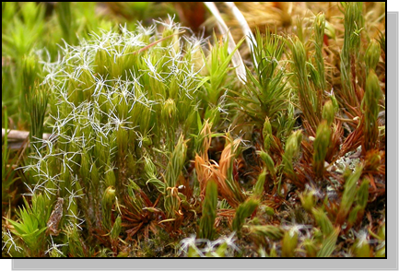








Long-term experimental site in temperate oak-pine forest
https:\\optmix.inrae.fr
Korboulewsky N., Balandier P., Boscardin Y., Chaintreuil, O., Chevalier A., Couteau C., Dumas Y., Gosselin M., Hamard J.P., Kara, A., Mårell A., Pérot T., Perret S.
INRAE, Forest Ecosystems Research Unit, F-45290 Nogent-sur-Vernisson, France
In the CONTEXT of
climate change,
the increase of wood demand, the development of populations of wild ungulates, and the need to preserve soil and the biodivsersity, management practices have to evolve.
The OBJECTIVE is to study the effects of
stand composition (pure oak, pure pine, mixed pine-oak) and
stand density (number of trees/ha) combined with
presence of wild ungulates (roe deer, wild boar, red deer),
on the ecosystem functioning such as tree productivity, resource use and allocation (including water and nutrients), biodiversity and understory vegetation dynamics including regeneration.
OPTMix is an experimental site
33 plots of 0.5 ha,
40 ha (including buffer zone)
even-aged,
lowland temperate forest stands
60-80 years old
The experiment consists of a partially crossed factorial experiment:
stand composition and tree density (low and medium) have a completely crossed factorial design;
the third factor, herbivory, is completely crossed with stand composition only for the low tree density.
We added mixed control stands without any harvest (with the aim to study self-thinning process).
The site is equipped with sensors (temperature, light, relative humidity, rainfall, soil water content, soil water table depth) connected to a datalogger.
Some figures:
10 000 trees measures;
180 trees equipped with
automatic dendrometers;
670 sensors for 15 000 data measured/day;
480 plots to study forest regeneration & plant diversity;
250 oak & 250 pine trees equipped for foliar sampling;
100 plant and animal species identified
Paris
Pure sessile Oak, Quercus petraea
Orléans
Orléans
Oak
Pine
Mixed
INRAE
Pure Scots pine, Pinus sylvestris
Study site in Orleans state forest in Central France (47°49‘ N, 2°29’ E), and example of the experimental design for one of the three replicates.
Buffer zone (>20 m-wide)
INRAE
Mixture oak-pine
Stand density:
medium (RDI=0.7, gray background)
low (RDI=0.4, white background)
INRAE, G. Maisonneuve
INRAE
Total exclusion or partially open for large ungulates
Partially fenced
INRAE, G. Maisonneuve
Unfenced
Fenced
INRAE, G. Maisonneuve
INRAE
INRAE
INRAE, G. Maisonneuve
INRAE
We study various parameters on soil (physico-chemical parameters, water, nutrient cycle), vascular plants, bryophytes and lichens (diversity, cover, litter quantity and chemistry) and animals (diversity, predation) in order to understand:
(i) the functioning of mixed stands vs monospecific stands, (ii) the role of biotic and abiotic factors on forest dynamics including biodiversity and tree regeneration, (iii) benefits and limits of management practices to face climate change and (iv) the vulnerability of forests towards global change.
The experiment will benefit to forest managers and stakeholders to meet the socio-eco-environmental challenges.
Centre
Val de Loire – Nogent-sur-Vernisson
FRANCE
Domaine des Barres
45290 Nogent-sur-Vernisson
Tél. : + 33 (0)2 38 95 65 42
Contact:
Nathalie.korboulewsky@inrae.fr

