Slide 1
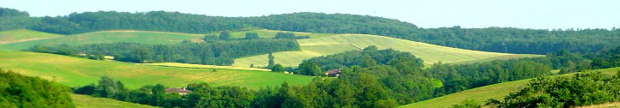

Forest edges: places of many transitions
Marc Deconchat (DR INRAE)
UMR Dynafor
Biosefair
Marc.deconchat@inrae.fr

Slide 2

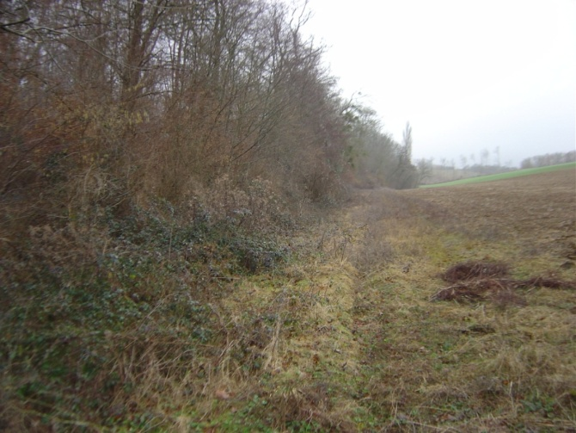
Forest (de)fragmentation: a matter of edges
matrice
matrice
(Herlin 2001; Fagan et al. 2003)
Fragments
Fragments

Slide 3
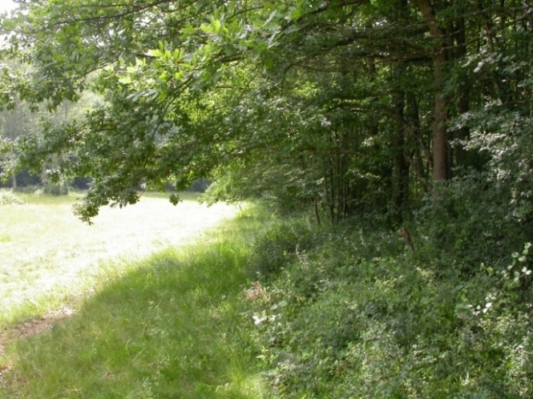
Diversity of forest edges
Interfaces between forest and open habitats
(mostly farmland)
  A transition area by definition
Linear feature of relatively low area
Vast diversity of situations (Meeussen et al. 2020)
  Aspect
  Slope
  Age
  Structure
  Tree species
  Adjacent habitats
  Ownership
  Management
  Etc.
Notes:
Définir; diversité des formes

Slide 4
Under-estimated roles of forest edges
Forest area under edge influence in the world (Pfeifer et al., 2017)
  20% at less than100m
  70% at less than 1 km
805 000 km of edges in France = 50 m/ha (750 000 km of hedgerows) (IGN)
  Very few and inaccurate statistical data about forest edges
Less consideration than for hedgerows,
despite their socio-ecological functions
« Grey area » between forest and agriculture policies:
who cares for forest edges?

Slide 5
What are some of the key roles of forest edges in the on going transitions?
Forest edges are not taken into account in current prospective scenarios about global changes and in current forest and agriculture policies
  Ex: ADEME; Afterres2050; IGN/FCBA
Objective: To show, with some examples from scientific litterature, that forest edge characteristics need to be more studied and included in transitions thinkings
Transitions: expansion of forests and/or radical shift in management practices

Slide 6
Bibliographic approach, with a pinch of AI
+/- 2000 scientific papers related to forest edge topic
ResearchRabbit (https://researchrabbitapp.com/home) as a way to enrich the corpus and to identify links between papers
  Very useful, a must see free service
Elicit (https://elicit.com) as a way to analyse and synthetise the content of papers
  Promising but not well suited for emerging topics
Many papers about the « edge effects » but fewer deal with temporal dynamics and consequences and roles in transitions

Slide 7
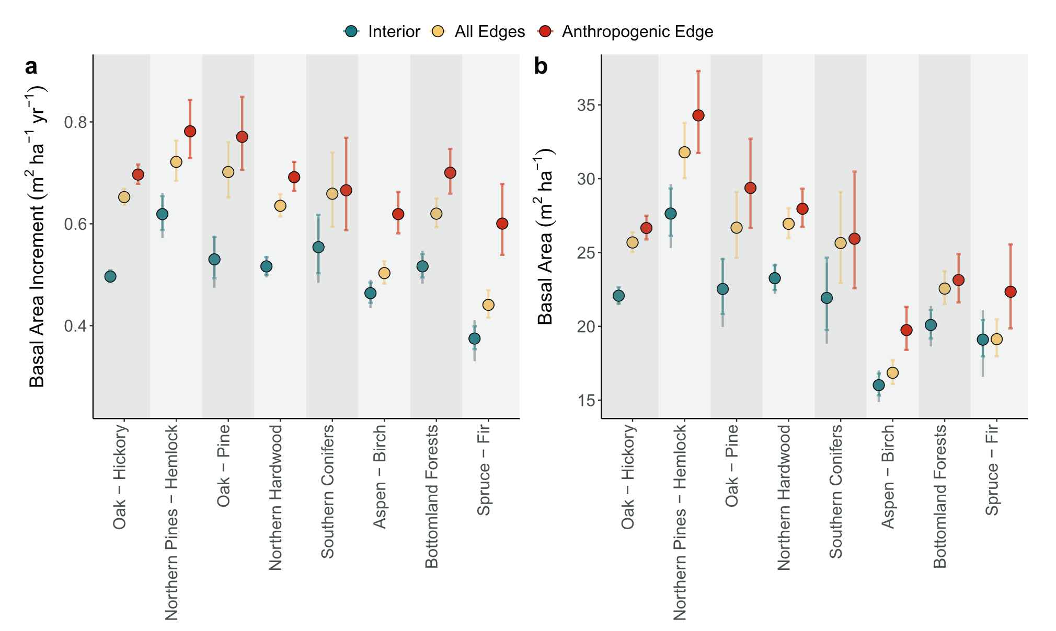
Forest edges more productive for wood: store CO2 faster
(Baker et al., 2019)

Slide 8
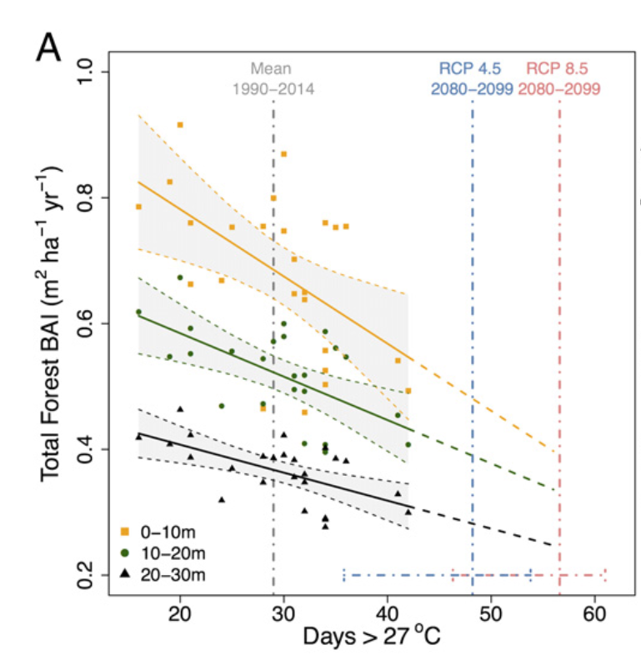
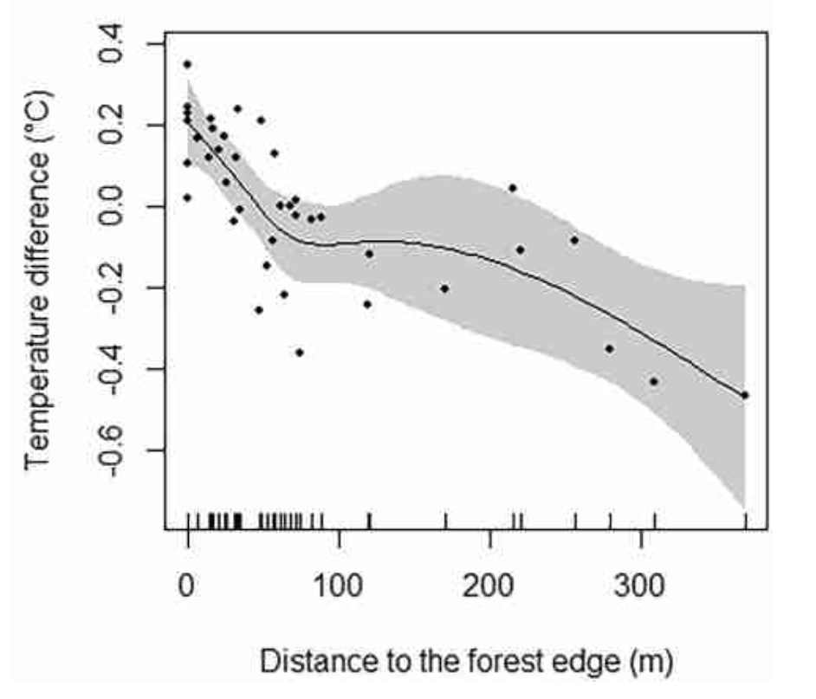
Forest edges more impacted by climate changes
(Hofmeister et al., 2019)
Meeussen, C., 2022. Functioning of forest edges in the face of climate change. Ghent, Belgium.
(Reinmann and Hutyra, 2017)

Slide 9
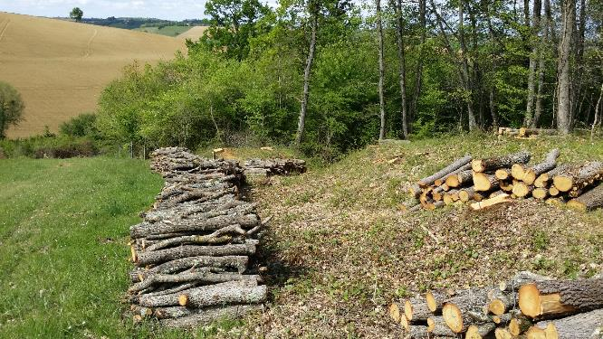
Wood harvesting in forest edges by farmers who say that there is a higher productivity and that it is easier

Slide 10
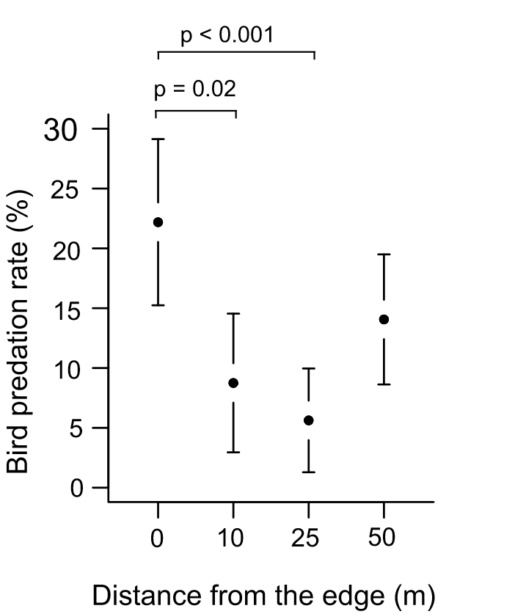
Forest edges and forest threats
More pests but a better regulation in forest edges (Guyot et al., 2019)
  May change if pest pressure changes
Damages by windstorms depend on forest edge shape (Wuyts et al., 2008; Gromke et al., 2018)
  Based on models
Forest edges have an influence on the occurrence and intensity of wildfires (Armenteras et al., 2013) (in the Amazon)
  (Bereczki et al., 2015)

Slide 11
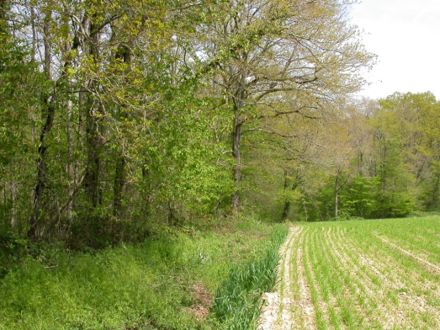
Forest edges can have an influence on transitions of agriculture towards more agroecolocical practices
Agroecology based on a better use of all the non-cultivated areas in the landscape
Strong emphasis on agroforestry as a key agroecological practice
Hedgerows are in first place, but small woodlots and their edges may play also their part

Slide 12
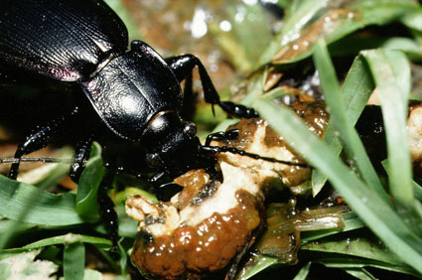
Forest edges provide ecosystems services for agriculture
Pest control (Roume et al. 2011; Vialatte et al. , 2024)
Pollination (Olynyk et al., 2021; Duflot et al., 2022)
Less papers than about hedgerow
Distance to/amount of forest edges among other factors
Number of individuals/trap/week
Distance (m) from the border
Ph Cugnot

Slide 13
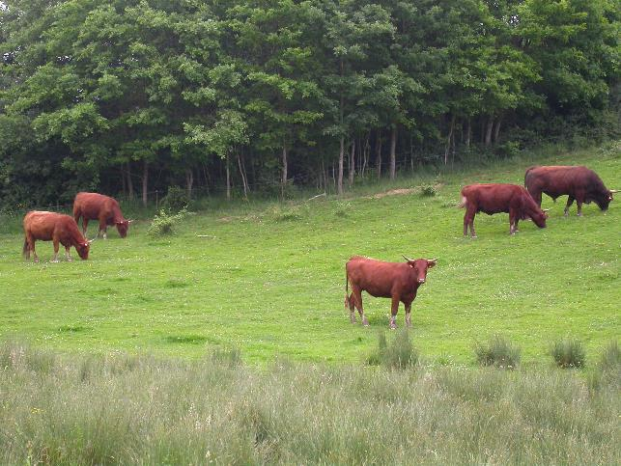
Obvious but understudied relationships between forest edges and animal breeding
No scientific paper dealing explicitly with forest edges and their roles for animal breeding activities
  Fodder
  Shelter
  Disease dissemination
Forest edges are more frequent in pasture land than in crop land
Papers about hedgerows and cattle, and about sylvopastoralism
More papers on tropics

Slide 14
Conclusion and perspectives
Forest edges are key ecological components in rural landscape that desserve a better attention and more research
Edge effects should be studied in their temporal dynamics, related to global changes
Forest and agriculture should be considered equaly regarding forest edge impacts
Links with cattle and animal breeeding need much more consideration and are a gap of knowledge, despite their potential roles
Bibliographic database will be available for all by the end of 2024

